Slide 1
CMPT 120
Lecture 3 - Introduction to Computing Science – Programming language, Variables, Strings, Lists and Modules

Slide 2
Weekly Exercise 1 - Show Case
# Weekly Exercise 1: A Joke
# Date: May 8th 2019
# ...
# ... print("What do you call 8 Hobbits? A Hobbyte!")
# Weekly Exercise 1 Joke
# Date: May 8, 2019
# ...
# ... print("You remind me of a software update; whenever I see you, I think 'Not now.'")
#print a computer-related joke on the screen
#May 8, 2019
#...
# ...
print("What's a computer's favourite snack?")
print("Microchips!")

Slide 3
Weekly Exercise 1 - Feedback
Marking criteria: Completeness
Possible problems:
Program does not load in Repl.it when click on link
What was submitted was not a proper Repl.it link
No header
Incomplete header – missing name/description/author/date
No algorithm/comments
Syntax errors
Joke not computer related <- semantic error

Slide 4
Unit 0 What is Computing Science?
In the first week, we'll talk about what computing science is, where it comes from, why it's awesome, and start to learn about how it works.
You'll get set up with the tools that we'll be using in this class to help you become proficient computer scientists by the end of this course.
By the way, in computing, we count from 0 :)

Slide 5
Questions from Last Lecture
Why do we need algorithms?
How can I express an algorithm?
How would I display 4 + 7 = 12 on the screen?

Slide 6
Questions from Last Lecture
What do we put in a header and why?
What would print("Above\nBelow") produce on the screen?
What are the steps we performed when we solve a problem?

Slide 7
Review - Steps we perform when we program
Design solution
(algorithm)
Problem
statement
Implement
program
Test

Slide 8
Homework - Activity - Human meets alien!
Find a partner
Decide which of you will play the part human and which will play the part of alien
The alien has to be a really good alien. I mean, you need to imagine you’ve never been to Earth. You don’t know anything about what we do here. Food and drinks don’t exist on your planet.
But what's cool is that you can communicate through a common language. It happens to be English. But you can only communicate with that language. No gesture.
The human needs to explain how to drink a cup of coffee

Slide 9
Homework - Activity - Human meets alien!
Observations

Slide 10
Unit 1 – Automation - Chatbots
In this unit, we’ll learn about the computing science field of natural language processing, and its applications such as chat bots.
We’ll learn about the basics of programming, through exercises (i.e., creating Python programs) loosely based on chatbots.
Python: We’ll learn about comments, outputting to the screen, creating lists, working with text, and changing output depending on conditions.

Slide 11
What is a chatbot?
Wiki: A chatbot is a computer program which conducts a conversation by processing text expressed in natural language.
Some chatbots use sophisticated natural language processing systems.
Simpler ones scan for keywords within the input, then pull a reply with the most matching keywords, or the most similar wording pattern, from a database.

Slide 12
Programming language
This semester, we’ll be learning a new language
What is a programming language?
Definition: is a language that allows us to communicate with the computer, specifying detailed instructions that a computer can understand and execute
A programming language, like a natural language, is made of
Vocabulary (“building blocks”)
Syntax rules (grammar)
Python, C++, Javascript, etc, are programming languages

Slide 13
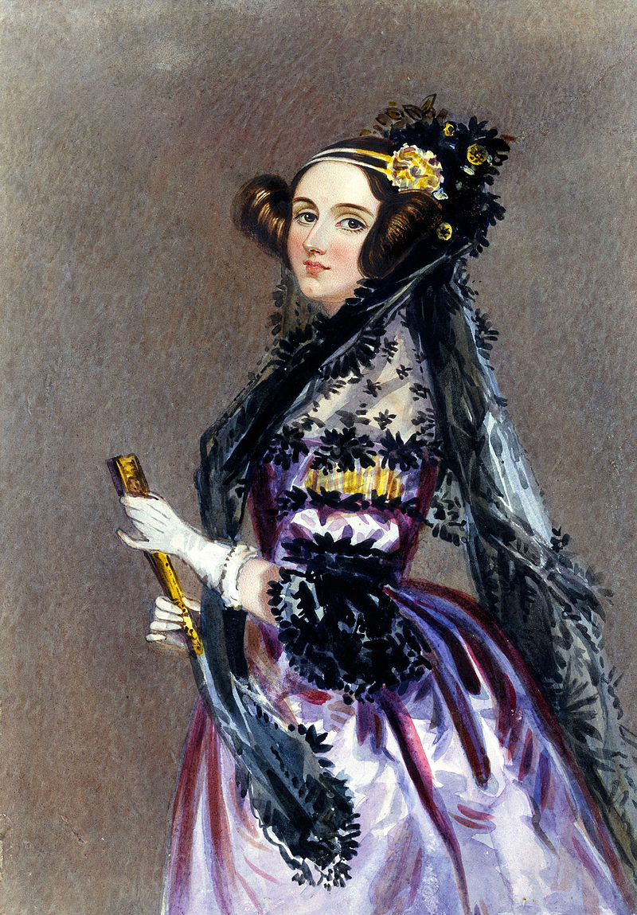
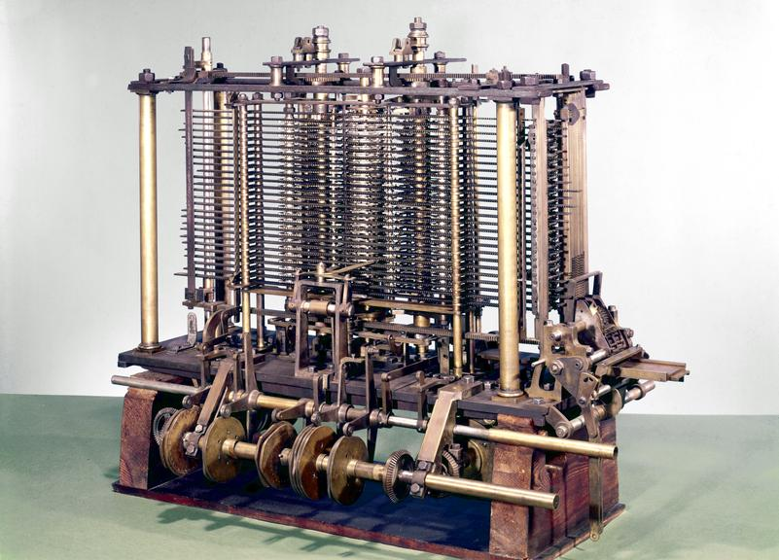
The first programmer
In 1842, Lady Ada Lovelace wrote the first computer program for Charles Babbage's Analytical Engine (1837)
Source:
https://en.wikipedia.org/wiki/Ada_Lovelace#/media/File:Ada_Lovelace_portrait.jpg
http://collection.sciencemuseum.org.uk/objects/co62245/babbages-analytical-engine-1834-1871-trial-model-analytical-engines
Notes:
Lovelace's notes made it clear that she understood the Analytical Engine as well as Babbage himself, and furthermore, she understood how to make it do the things computers do. She suggested the data input that would program the machine to calculate Bernoulli numbers, which is now considered the first computer program. But more than that, Lovelace was a visionary: she understood that numbers could be used to represent more than just quantities, and a machine that could manipulate numbers could be made to manipulate any data represented by numbers. She predicted that machines like the Analytical Engine could be used to compose music, produce graphics, and be useful to science. Of course, all that came true—in another 100 years.

Slide 14
Let’s review some concepts
What is an advantage of compilers over interpreters?
Python is an ____________________ language.
What is an advantage of the high level languages over the low level languages?
Which one (compiler or interpreter) produces object code?
What would be a synonym of “source code”?

Slide 15
Let’s try our first chatbot!
Problem Statement:
Write a chatbot that can say Hi! and learn your name

Slide 16
About variables
There are some constraints to how you can name your variables, e.g.
Can contain letters, numbers, and underscores
Should start with a letter (lowercase, by convention)
They can't contain spaces or symbols
They can't be one of the reserved keywords (see below for list)
http://interactivepython.org/runestone/static/thinkcspy/SimplePythonData/VariableNamesandKeywords.html

Slide 17
Your turn!
Problem Statement:
Write a chatbot that can say hi and learn your name
and …
After the greetings, make the chatbot ask what your favourite music band is, and let you respond
Then, the chatbot makes a comment about your response (but it cannot simply repeat what you have just said!)

Slide 18
Don’t forget to …
Update your algorithm -> comments
Translate them into Python
Test your program

Slide 19
Let’s review some concepts
How do you print in Python?
What is the command or function to get input from the user?
How do you concatenate two words in Python?
How do you store an input from the user?
What symbol do we use to assign a value to a variable?
What is an example of a chatbot?

Slide 20
Let’s create another chatbot!
Problem Statement:
Write a chatbot that prints random cookie fortune statements

Slide 21
Let’s review some more concepts
How do we make a list in Python?
What module do we need to import to randomly choose something from a list?
How can we test smaller pieces of our Python code?
What is concatenation?
What does a dot after a module name do?
What is the only kind of symbol we can have in a variable name?

Slide 22
Next Lecture
We shall practice using randomness in our programs
We shall introduce branching
A way to control the execution flow
What’s that?

