Slide 1
SFU Research Administration Enhanced Project Costing Refresher May 31, 2023

Slide 2
Agenda
Background
Session Objectives
What is Enhanced Project Costing?
FAST Award Views
Enhanced Payroll Encumbrances
Questions?
Appendices
2

Slide 3
Background
Enhanced Project Costing is a project under the Research Enterprise Systems (RES) program
Enhanced Project Costing encompasses a set of tools that the research community can use to manage the financial position of research projects
A common financial repository – everyone has access to the same project data
Multi-year reporting based on the project budget period – not SFU fiscal year
“Award List” set of FAST views that provide basic project information that is not available in the “Operating” view
Multi-year payroll encumbrances
The core functionality went live in early 2022, but issues were identified that impacted functionality
The Project Team has done extensive analysis to identify the root cause of the issues and has developed and tested the required fixes

Slide 4
Current Status
The core functionality has been in place for more than a year and it is the system that Research Accounting uses to complete its deliverables
The Project Costing project is scheduled to close out at the end of June and RA will be the business owner of the project costing functionality
RA will provide FAST Award List training for the research community periodically for new faculty and staff and as a refresher for others

Slide 5
Session Objectives
To provide training on the FAST Award List views and enhanced payroll encumbrances
Summarize the differences between the Operating view and Award List views
Provide an overview of enhanced payroll encumbrances in Award List views
5

Slide 6
What is Enhanced Project Costing?
A tool to help researchers record expenditures and forecast the financial position of their Fund 30s projects
Budget periods are based on a project budget period, not SFU fiscal year
Multi-year budget periods are enabled
Multi-year encumbrances for payroll and non-payroll commitments
It includes project details not available in the Operating view
Award Start & End Dates, Total Awarded, PI name, etc
Project supporting documents are accessible and saved as attachments
Notice of Award, amendments, etc.
6

Slide 7
How Does it Work?
Users can access the information through a set of FAST views collectively referred to as the Award List views
Operating view is still available for Fund 30’s
Through the expanded use of the PeopleSoft project costing module, Award List views capture multi-year project financial data including future periods
Operating view is based on the general ledger and includes current and prior fiscal year transactions and encumbrances, it does not include data for future periods
A customized payroll encumbrance process allows encumbrances to be extended to the end of an appointment which goes beyond the current fiscal year
Operating View encumbrances cannot exceed last pay period of current fiscal year (e.g. March 23, 2024)
7

Slide 8
FAST Award List Views
8

Slide 9
Award List Views Basics
The Award List views are delivered in “Levels” where drilling down to the next level provides additional details
Level 1 – overview of research projects with basic information
Level 2 – financial information based on past, current and future project budget periods
Further levels can be reached through clicking on values to drill down
Hover notes are provided in most headers
Award List views reflect
Invoice and expense claim transactions processed by Payment Services, not when initiated by submitter/claimant
Payroll actuals and encumbrances processed during the most recent biweekly pay cycle. This data is not updated between pay cycles
Purchase requisitions processed by Procurement, not when initiated by Requesters
9

Slide 10
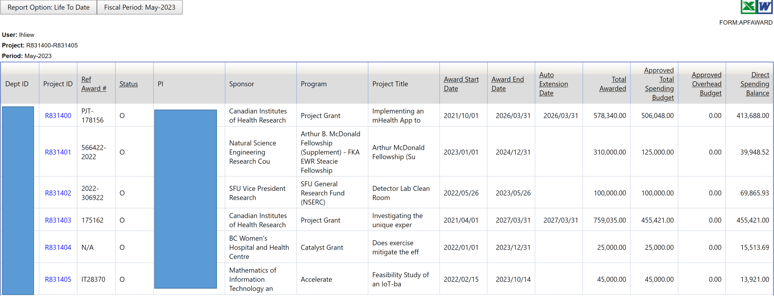
Award List Views – Level 1 “Overview”
10

Slide 11
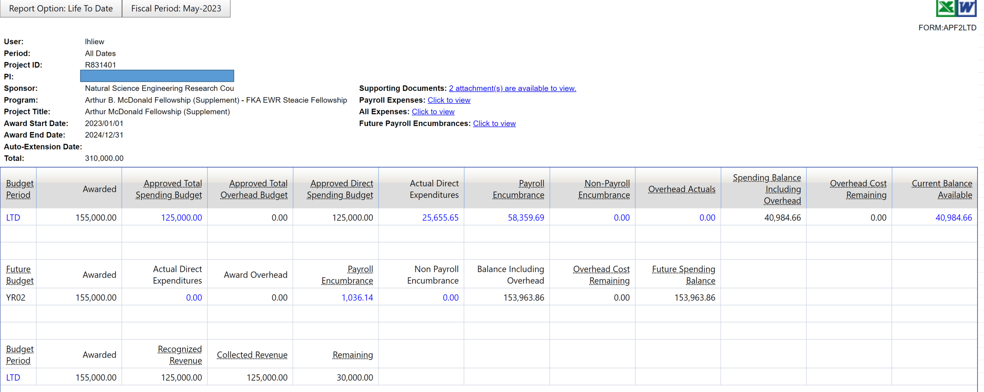
Award List Views– Level 2 “Project View”
11

Slide 12
Award List Views Recap
What can I find in the Award List report?
Fund 30s Research Projects (based on your existing FAST access)
Entire project’s financial information (past, current, and future)
Multi-year budget periods, unique to each project (e.g. Sept 1 - Aug 31)
Project’s non-financial information (PI name, Sponsor/Program, Start/End Date, Project Title)
Key project supporting documents (Notice of Award, Contract, Amendments)
Payroll Encumbrances including future payroll encumbrances
Non-Payroll Encumbrances
12

Slide 13
Award List Views Tips
Before you fill out a PAF: Ensure project is in status O or E
Export Award List views to Excel to sort/refine further information
Awarded amounts and end dates will change as sponsors provide amendments
Use Award List views report to determine the financial position of the project
The Direct Spending Balance (DSB) is intended to provide users with a “snapshot” of what is available to spend
It is a conservative metric as it is the Approved Direct Spending Budget less all actual direct expenditures, payroll encumbrances including future years, and non-payroll encumbrances
13

Slide 14
Enhanced Payroll Encumbrances
14

Slide 15
Payroll Encumbrance Basics
Payroll Encumbrances - a forecasting tool to allocate planned expenditures for spend on payroll resources
Payroll Actuals - the amounts charged in each pay period
Encumbrances and actuals are recalculated every biweekly pay cycle. These updated numbers will appear in FAST Award List views the following Tuesday morning
Each time payroll is run, three things happen:
The actual salary and benefits are posted
The previous calculated encumbrance is reversed
New encumbrance is set up reflecting the forecasted amount remaining to be charged
15

Slide 16
Payroll Encumbrance Basics
Appointment period – term of the appointment, which is based on the individual’s employment agreement
Encumbrance period is the term over which the encumbrance is calculated. It is the time between:
Start of Encumbrance – later of the:
the project start date
the pay period begin date (to capture amounts due to be paid on next pay date and beyond)
appointment start date
End of Encumbrance – end of the appointment
What is the implication of the encumbrance period?
When an appointment’s end date exceeds the project end date, the encumbrance may create a negative Direct Spending Balance (DSB). For example, if appointment is for 2 years and project runs for Year 1 of appointment, the Year 2 portion of the encumbrance may create an encumbrance resulting in a negative DSB.
Options: This negative DSB should prompt the supervisor to find a funding source for the second year
16

Slide 17
Encumbrances Tips
Encumbrances are recalculated every biweekly pay cycle, and will decrease over time to zero
Encumbrances affect Direct Spending Balance (DSB) even if appointments are future-dated
Hourly appointments: If biweekly hourly estimate is not provided on a PAF in Funding Details, the encumbrance will be calculated based on the default of 70 hours.
17
Notes:
-

Slide 18
Questions?
18

Slide 19
Appendix 1
Key Terms
19

Slide 20
Key Terms
“Awarded” vs “Approved” Budgets
The awarded budget is the total budget over the life of a project. The approved budget is the amount of the award that has been released to spend
Project Year vs Fiscal Year
The Project Budget Period is the annual reporting cycle for the project, determined by the sponsor
Typically, the Project Budget Period will be determined by the project end date
SFU’s Fiscal Year is April 1 to March 31
20

Slide 21
Key Terms
Direct Spending Balance (DSB)
It is the amount available to spend on a project
It is Approved Direct Spending Budget minus direct expenditures and encumbrances where:
Approved Direct Spending Budget is the total approved budget for direct costs
Direct expenditures are direct costs incurred (e.g. salary, supplies, travel, etc.)
Encumbrances are payroll and non-payroll commitments
Payroll encumbrances are salary commitments not yet expensed
Non-payroll encumbrances are non-salary commitments not yet expensed such as purchase requisitions
The purpose of the DSB is to provide a “snapshot” of what is available to spend when considering an approval of an expense submission. It is intended to be a conservative measure.
21

Slide 22
Key Terms
Payroll Appointment Form (PAF)
A paper-based process to appoint an individual to a project resource for a fixed-term
Not to be used for continuing appointments
Specifies key information of the individual’s appointment in Appointment Details section
Appointment start/end date, pay rate, eligibility for health benefits
Provides information on how the appointment is funded in Funding Details section
The project(s) account to be encumbered for the individual’s salary and benefits
It is possible for an appointment to be split among multiple projects.
E.g. If a person is hired for 2 years, the person is assigned on the first project at the start of Year 1, and then second project at start of Year 2.
22

Slide 23
Appendix 2
Project Status Summary
23

Slide 24
Project Status Summary
Status | Meaning | When would it happen? | Can PI spend? | Can PI encumber?
A | Proposal Awarded | RS processes Notice of Award info in system | No | No
E | Partially Released Budget | RS releases part of year 1 budget | Yes, partial budget for protocol dev. | Yes
O | Project Open | RS releases full year 1 budget | Yes | Yes
H | On Hold | RS asks RA to put on hold due to an issue* with the project | No, except for committed payroll | No, except for committed payroll
S | Closeout Started | Project has reached end date | Only expenses incurred prior to end date | No
F | Closeout Final | Sponsor financial reporting has been completed | No | No
C | Closed – No Further Activity | Final reporting has been received and accepted by sponsor | No | No
24

Slide 25
Appendix 3
Award List views Field Summary
25

Slide 26
Award List Views – Level 1 “Overview”
Column Header | Definition (hover over column header)
Project | Project number assigned by SFU
Status | Used to communicate where the project is at in its lifecycle
PI | Principal Investigator
Sponsor | Sponsor as indicated on Award Letter or Fully Executed Contract
Program | Sponsor Program, if applicable, as indicated on Award Letter or Fully Executed Contract
Project Title | Title PI submitted with Project’s proposal
26

Slide 27
Award List Views – Level 1 “Overview”
Column Header | Definition (hover over column header)
Award Start Date | Project start date indicated on Notice of Award or fully executed contract
Award End Date | Project end date indicated on Notice of Award or fully executed contract, or as determined by an approved amendment (i.e., an extension)
Auto Extension Date | 1-year auto-extension date as defined by the Tri-Agency Guide on Financial Administration. If there is an Auto-Extension as part of the award, then the Auto-Extension field in FAST will mirror the award end date.
27

Slide 28
Award List Views– Level 1 “Overview”
Column Header | Definition
Total Awarded | Total amount awarded to PI indicated on Notice of Award or fully executed contract
Approved Total Spending Budget | Total direct and indirect (overhead) budget approved for spending
Approved Total Overhead Budget | Total overhead budget approved for allocation
Direct Spending Balance | Balance available for spending (approved direct spending budget less actual direct expenditures, payroll encumbrances (current and future) and non-payroll encumbrances (current and future)
28

Slide 29
Award List Views– Level 2 “Project View”
Column Header | Definition
Budget Period | Segregation of total awarded amount by period(s) as defined by Sponsor
LTD (Life to Date) | All transactions related to the current and prior budget periods
Approved Direct Spending Budget | Approved total spending budget less approved total overhead budget
Payroll Encumbrance | Salary encumbrance commitments not yet expensed
Non-Payroll Encumbrance | Non-salary encumbrance commitments not yet expensed (e.g., purchase orders and requisitions)
29

Slide 30
Award List – Level 2 “Project View”
Column Header | Definition
Overhead Actuals | Overhead amount incurred to date
Spending Balance Including Overhead | Spending Balance including overhead costs remaining (approved total spending budget less actual direct expenditures, payroll and non-payroll encumbrances, and overhead actuals)
Overhead Cost Remaining | Amount of overhead costs remaining related to the current budget period
Current Balance Available | Balance available for spending (approved direct spending budget less actual direct expenditures, payroll encumbrances (current), and non-payroll encumbrances (current))
Future Budget | Sponsor commitment for providing funding beyond the current budget period
30

Slide 31
Award List – Level 2 “Project View”
Column Header | Definition
Recognized Revenue | Revenue that has been recorded in the system (when the project earns the revenue not necessarily when it is received, and that is based on costs that are incurred, which is the accounting practice SFU follows)
Collected Revenue | Revenue that has been received and posted in the system (i.e., the actual cash the sponsor has paid)
Remaining | Awarded Amount less collected revenue
31

Slide 32
Award List – Level 3 “Project Details”
Column Header | Definition
Source Type | Only used for CFI, represents the CFI line item number.
Activity | New fund 30s chart field value that is required. Default value for all transactions will be SPN001. Where additional activities (Sub Out, CFI funding source) have been defined they would be SPN002, etc.
32

Slide 33
Appendix 4
How Payroll Encumbrance Displays in Operating Statement Vs. Award List View
33

Slide 34
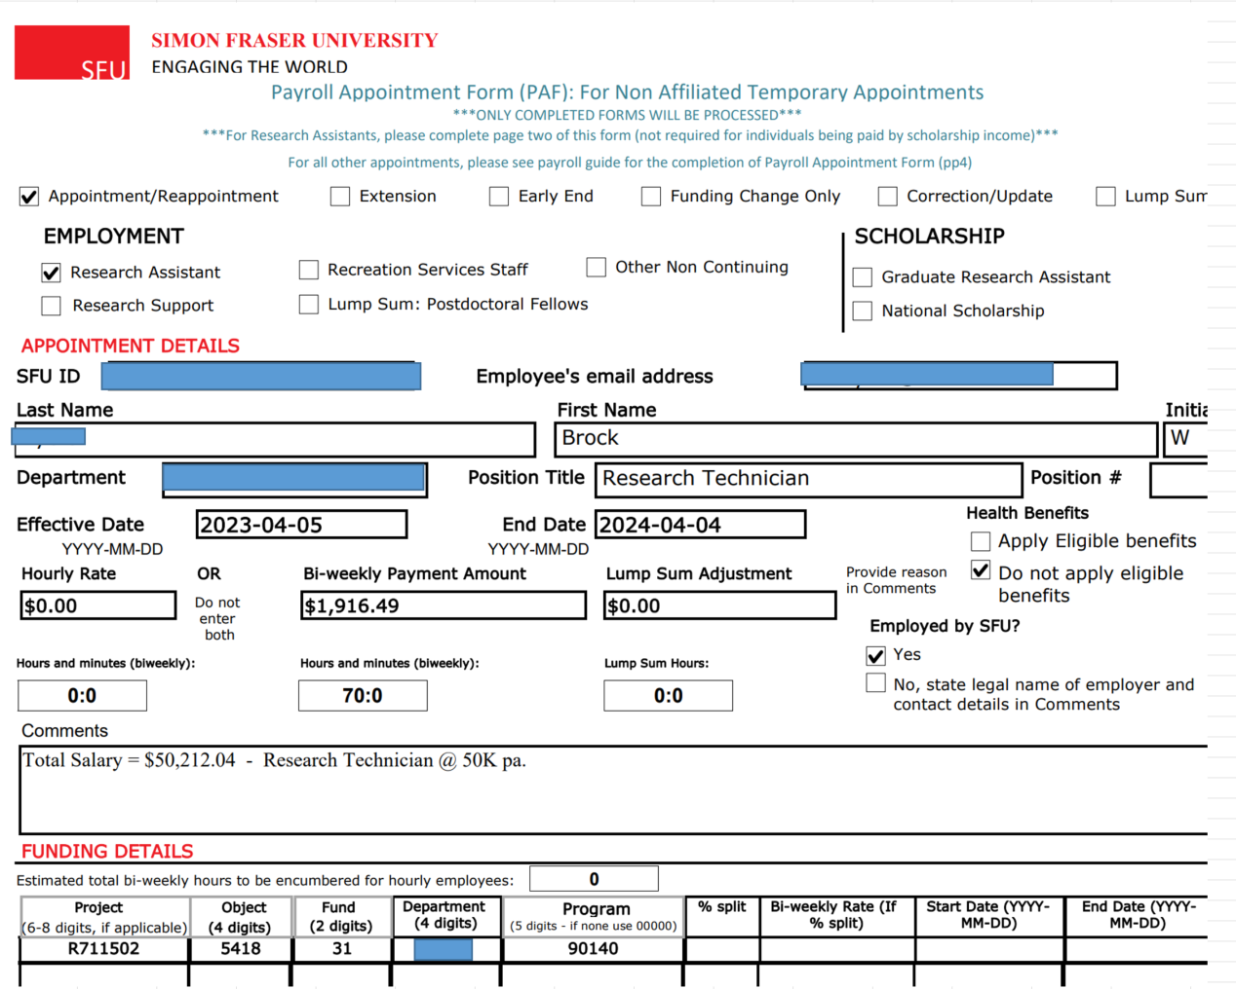
About Payroll Encumbrances
Payroll will be encumbered after every biweekly pay period until the appointment has ended.
34
Notes:
In this case, Brock’s appointment will be encumbered until his appointment ends April 4, 2024.

Slide 35
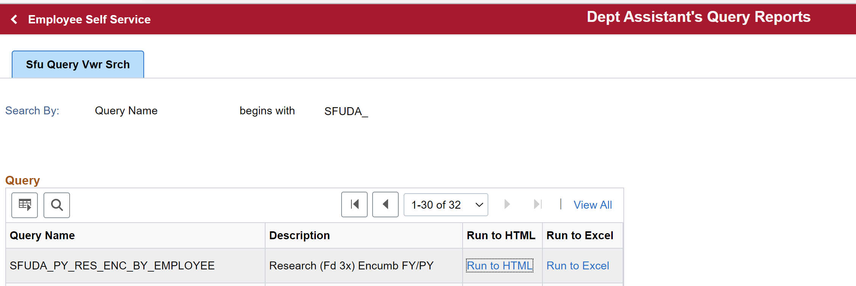
Enhanced Payrol Encumbrance Report in Myinfo
For RES, an enhanced payroll encumbrance report was created called SFUDA_PY_RES_ENC_BY_EMPLOYEE.
It is available to Department Managers in myinfo and found in the Dept Assistant’s Query Reports section.
35

Slide 36
Enhanced Payroll Encumbrance Report (cont’d)
The payroll encumbrance report displays the breakdown of the encumbrances by a combination of :
SFU payroll calendar year (202X, FY Begin Date, FY End Date) and
project annual year (YR0X, PY Begin Date, PY End Date)
36
Notes:
Please note two observations about the payroll encumbrance report for this example and impact on FAST views:
-Note that Brock’s appointment ending April 4, 2024 will be encumbered over the Payroll Calendar Year 2024 and 2025 which have periods ending March 23, 2024 and March 22, 2025 respectively, which are their last pay periods for such years.
- Only the 2024 - and not both 2024 and 2025 - will display in Operating Statement view since such view displays by SFU current fiscal year basis.
-Brock’s appointment will be encumbered for over two project annual periods YR04 and YR05 which ends March 31, 2024 and March 31, 2025 respectively.

Slide 37
Payroll Encumbrance in Operating Statement View
The encumbrance by Year 2024 is $50,331.84:
It displays in the O/S encumbrance column of the Operating Statement view:
37

Slide 38
Payroll Encumbrance in Award List View
The encumbrance by Project Year YR04 is $51,430.01:
It displays in the LTD Budget Period’s Payroll Encumbrance column of the Award List view:
38

Slide 39
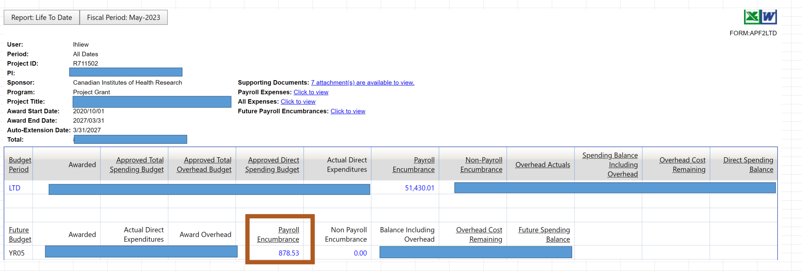
Payroll Encumbrance in Award List View (cont’d)
The encumbrance by Project Year YR05 is $878.53:
It displays in Future Budget YR05’s Payroll Encumbrance of the Award List view:
39

