Slide 1
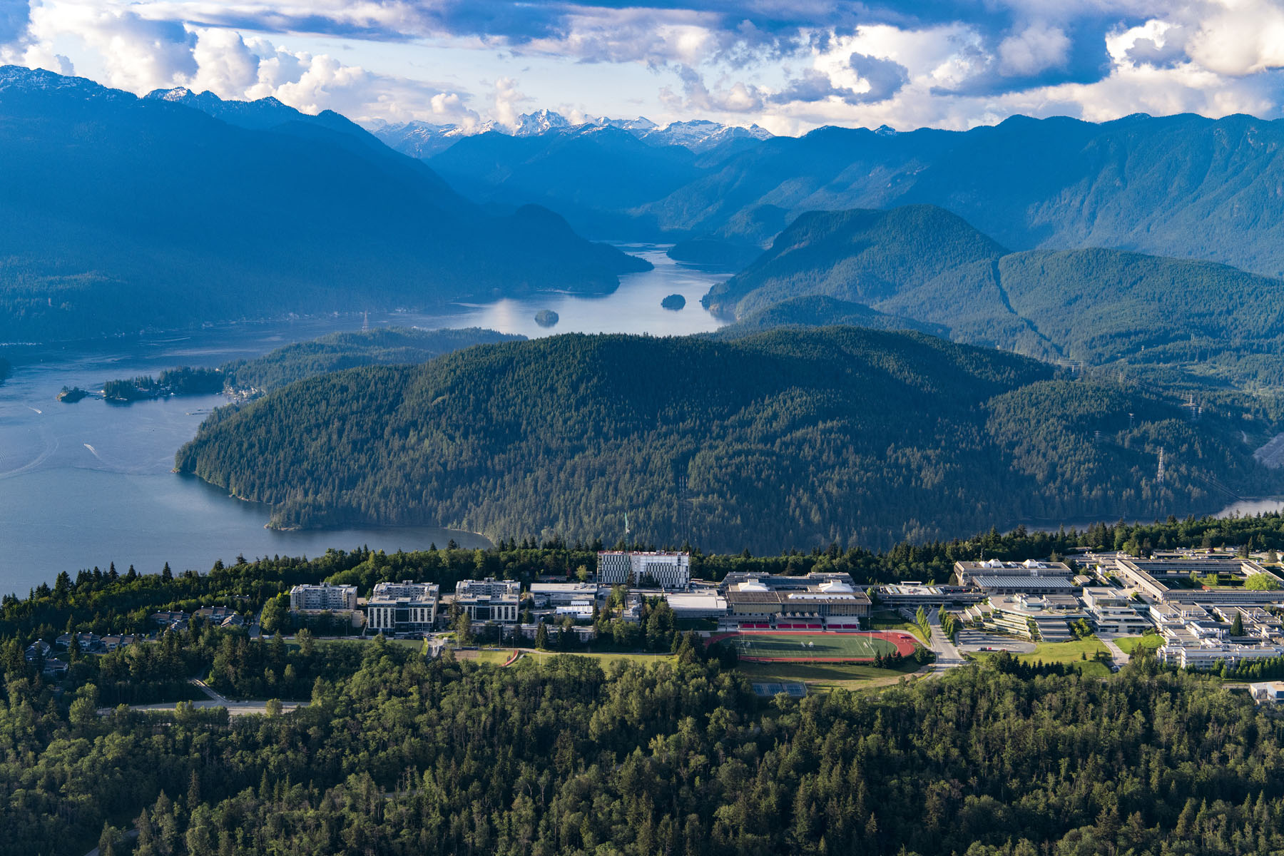
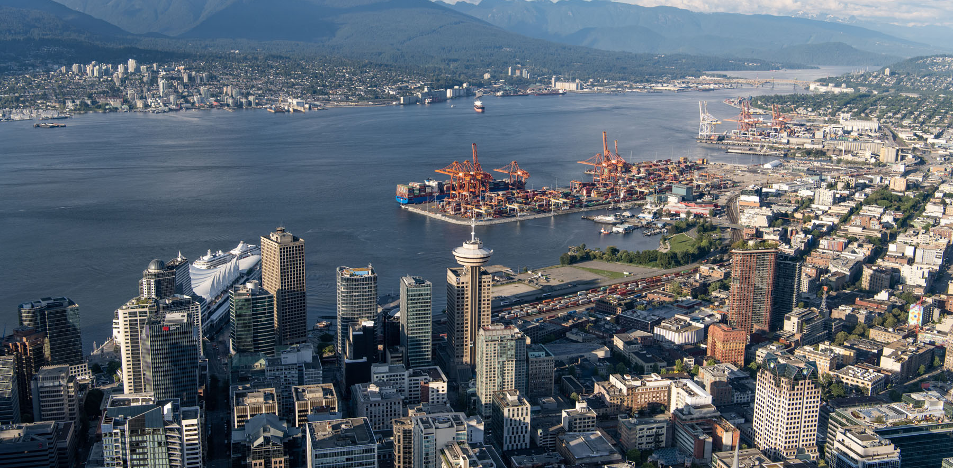
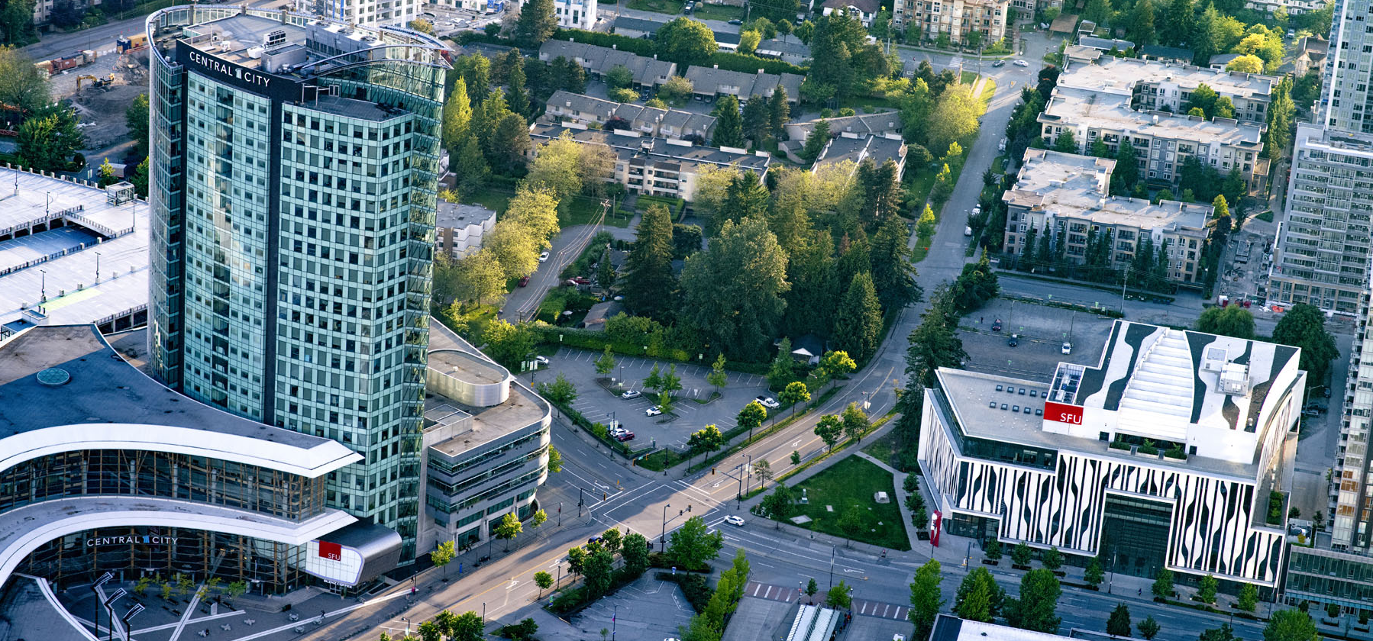
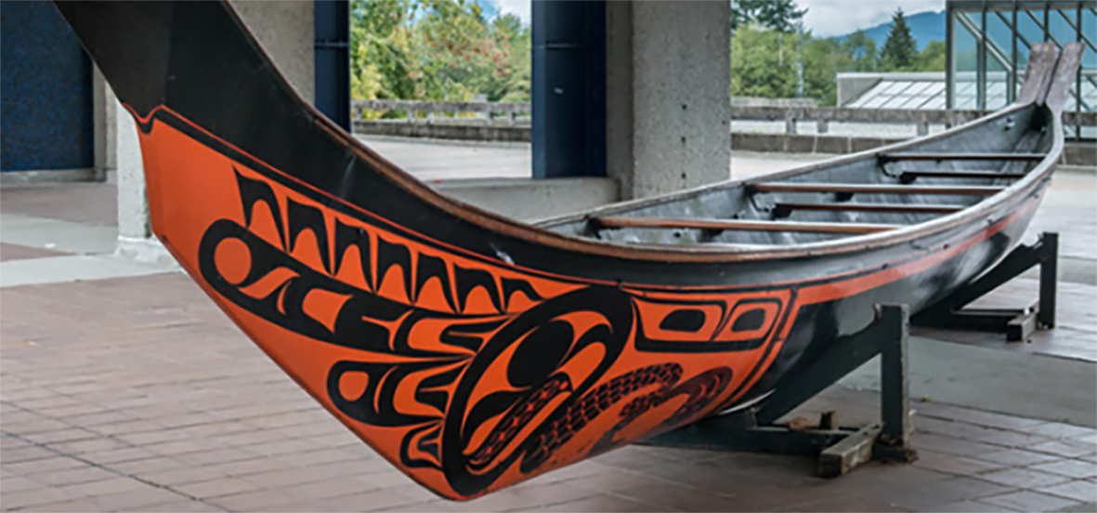
GRADUATE AWARDS + SCHOLARSHIPS Vanier CGS + Trudeau Foundation Scholarship (July 17, 2024)

Slide 2
Land Acknowledgment
We encourage you to download the Bill Reid mobile app to learn more about the Indigenous Art at SFU
ímesh, meaning "to walk" in Skwxwú7mesh snichim (Squamish Language), is a mobile app being developed by the Bill Reid Centre for Northwest Coast Studies at Simon Fraser University. The app is a response to the university’s Community Engagement Strategy, and its Aboriginal Strategic Plan, and is intended to be a step, however small, toward decolonizing the university and the surrounding landscape
We respectfully acknowledge the unceded Traditional Coast Salish Lands including the Tsleil-Waututh (səl̓ilw̓ətaʔɬ), Kwikwetlem (kʷikʷəƛ̓əm), Squamish (Sḵwx̱wú7mesh Úxwumixw) and Musqueam (xʷməθkʷəy̓əm) Nations on which Burnaby Campus is located.

Slide 3
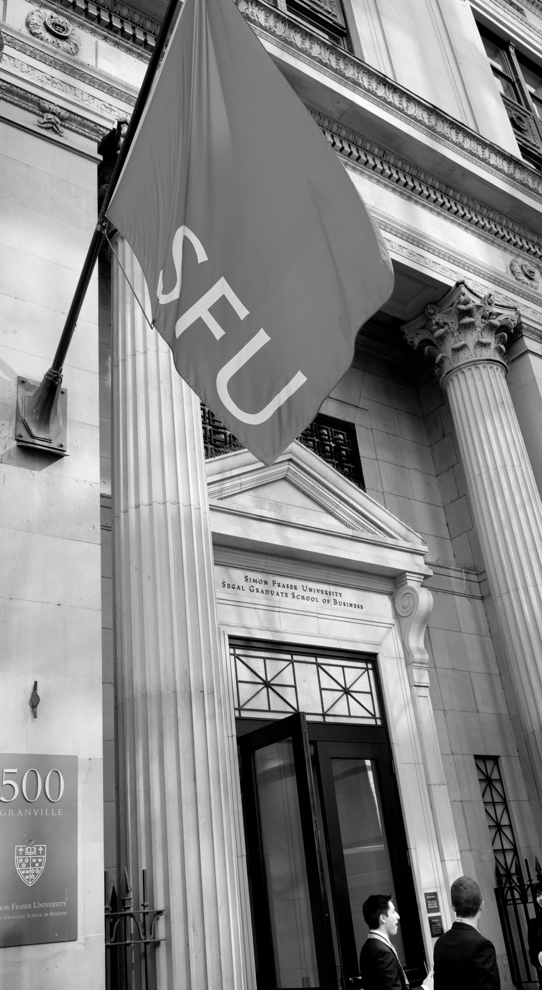
AGENDA
Award Funding Sources
Tri-agencies
Selecting the right agency & opportunities
Vanier Canada Graduate Scholarship
Eligibility points & process
Trudeau Foundation Scholarship Program
Eligibility points & process
Graduate Studies Website & Sample Document Library
Q & A

Slide 4
Award Funding Sources
INTERNAL + DONOR FUNDED AWARDS
Listed on our website by academic unit
Awards vary in value and decision process
Applied for in GA3, our awards system
In GA3, search under Dean of Graduate Studies too!
EXTERNAL + ADDITIONAL AWARDS
Listed on our website by external funding agencies
Awards vary in value and process
Applied for on external award systems
Graduate Studies usually handles award payments
TRI-AGENCY (CIHR, NSERC, SSHRC)
CGSM Canada Graduate Scholarships – Masters
Vanier Canada Graduate Scholarships – Doctoral
Agency Doctoral Scholarships - Doctoral
Various supplements and partner awards
OTHERS (not through Graduate Studies)
SFU’s Financial Aid and Awards handles bursaries, work-study, loans and emergency loans
Visit SFU’s Co-op page for paid employment experience
Register for the SFU Food Pantry prior to your visit
Notes:
The green boxes match the webpages on our website. For the External & Additional Awards, we’ve organized by research area and outlined details regarding the organization –we recommend students subscribe to the organizations that are a match so you don’t miss funding or event opportunities.

Slide 5
What are the Tri-Agencies?
Tri-agencies refers to these federal research funding agencies:
CIHR: Canadian Institutes of Health Research
NSERC: National Sciences and Engineering Research Council
SSHRC: Social Sciences and Humanities Research Council
Which agency do I choose?
The following webpage has general guidelines for the eligibility of subject matter + for health related research topics:
https://science.gc.ca/site/science/en/interagency-research-funding/policies-and-guidelines/selecting-appropriate-federal-granting-agency
Notes:
Pro Tip: if you have to justify why your research fits within a specific agency, use some of the wording from the science.gc.ca website

Slide 6
Which opportunity do I choose?
Here is an overview of the funding opportunities and deadlines for Fall 2024:
 | Name | Deadline | Funds research in: | What if I win?
 | Trudeau Foundation | Nov 20-25 | PhD – Social Sciences | Accept! Your scholarship is paid outside of SFU.
Tri-agency funding | Vanier CGS | Sept 5, 2024 | PhD – CIHR, NSERC and SSHRC | You can apply for Trudeau, Vanier + 1 other opportunity. If you win both a Vanier and another Tri-agency award, you can only accept 1. If you accept a Vanier or other doctoral level tri-gency award, you cannot apply
 | CIHR Doctoral Awards | Oct 1, 2024 | PhD - health research
 | NSERC Doctoral Scholarship | Oct 1, 2024 | PhD - natural sciences and engineering
 | SSHRC Doctoral Awards | Oct 1, 2024 | PhD - social sciences and humanities
 | CGS Masters | Dec 1, 2024 | Master’s/first year PhD – research in CIHR, NSERC and SSHRC
Notes:
Pro Tip: if you have to justify why your research fits within a specific agency, use some of the wording from the science.gc.ca website

Slide 7
Vanier Canada Graduate Scholarship: $50,000 for 3 years
Open! | Deadline: September 5
Funds: Doctoral researchers in social sciences & humanities, natural sciences/engineering and health.
Harmonized program: Eligibility, application process & deadline are the same for CIHR, NSERC or SSHRC
Application: apply on ResearchNet + users need to create a Canadian Common CV
Initiative + Supplements: Applicants who identify as Indigenous can choose to bypass committee review and have 1:1 assistance from Indigenous faculty member instead.
Winners of Vanier CGS can apply for additional supplements (MSFSS).
Information + Instructions
Visit the Vanier CGS website for full eligibility and Application Instructions for how to complete the application, attachments, CCV and referee assessment form.
Visit Graduate Studies Vanier CGS page, for SFU’s process. Step 3 includes a downloadable checklist!
Notes:
Vanier is open to international students. Leadership is an important criterion! So is Academic Excellence and Research Potential.

Slide 8
Vanier CGS: notes on main eligibility points
Eligibility basics
Must be Canadian citizen, permanent resident of Canada or foreign citizens
be pursuing your first doctoral degree
have completed no more than 20 months of full-time study in your doctoral program as of May 1, 2025
have completed no more than 32 months of full-time study in your doctoral program (i.e., joint graduate research program, directly from bachelor's, previously enrolled without obtaining master's degree, transferring), by May 1, 2025.
have achieved a first-class average, as determined by the host institution, in each of the last two completed years of study (full-time equivalent)
By Sept 5, 2024
Check the scenarios and count carefully!
If you are masters/PhD transfer, the count starts at your master’s start date.
CGPA 3.67 = pass
If not, we calculate your last 24 -30 credits
Notes:
If you completed a master’s, then started a PhD without a transfer or any leaves throughout your PhD, you may not be eligible if your PhD start BEFORE September 2023.
If you are a master’s – PhD transfer, without any leaves throughout either, you may not be eligible if your master’s started BEFORE September 2022.

Slide 9
VANIER CGS Timeline
MAY
2025
APRIL
2025
OCTOBER
30
GS pays award
OCTOBER
17 - 30
Agency decisions
are announced.
Top ranked applicants offered CGSD
SEPTEMBER 9 –
OCTOBER 16
SEPTEMBER 5
4:30 PM
(SFU Internal Deadline)
University submits applications to agency
Selected students update applications
Two levels of University review: Dept rankings + USSC
Student applies on
ResearchNet
Referees must also submit by their deadline; usually 2 days before the applicant deadline.
Notes:
Change the dates for 2024

Slide 10
TRUDEAU FOUNDATION: $30,000 – $60,000
Competition opens: September 9, 2024
Deadline: November 20 (references) + November 25, 2024 (application)
Interviews: between January – March, 2025
Funds: Doctoral research related to the humanities or human sciences of direct relevance to the future of Canada; doctoral work must relate to at least one of the Foundation’s Four Themes: Human Rights and Dignity, Responsible Citizenship, Canada and the World, People and their Natural Environment.
Program: more than a scholarship; the foundation provides a 3 years Leadership Development Program, based on Scientific Cycles – a scientific theme that has interdisciplinary dimensions and reflects a timely and significant set of issues for the future of Canada and the world.
Eligibility and Application:
Visit the Foundation’s general website: https://www.trudeaufoundation.ca/
Visit the doctoral scholarship page: https://www.trudeaufoundation.ca/scholarship
Application is on the Trudeau’s application portal: smartsimple
Notes:
For Trudeau, you apply directly to the Foundation, BUT our office is here to support you! We can read through your application and documents. If you are invited to an interview, we can provide practice interviews and contribute the costs you may incur.

Slide 11
TRUDEAU FOUNDATION: ELIGIBILITY
Eligibility basics
1) You must be registered or already accepted into or in year one or two (beginning year three in September 2024 or later) of a full-time doctoral program and expected to complete your doctoral studies in 2027 or later. 2) Your field of study is broadly related to the humanities or human sciences of direct relevance to the future of Canada; (please refer to the FAQ for more details and read up on past scholarship recipients) 3) Your doctoral work must relate to at least one of the Foundation’s Four Themes: Human Rights and Dignity, Responsible Citizenship, Canada and the World, People and their Natural Environment. 4) Be a Canadian citizen studying at a Canadian or foreign institution, or a non-Canadian (permanent resident of Canada or foreign national) enrolled in a doctoral program at a Canadian institution.

Slide 12
El Chenier, Associate Dean Scholarships

Slide 13
A complete Vanier CGS application package includes:
ResearchNet application form (includes two letters of reference, each with three sections)
CCV (limited entries; please see Completing the Common CV (CCV) for complete information)
research contributions (maximum one page)
personal leadership statement (maximum 2 pages for English applications; maximum of 2.5 pages for French applications)
special circumstances (maximum 1.0 page, optional)
two leadership letters of reference (maximum 2 pages)
research proposal (maximum 2 pages for English applications; maximum of 2.5 pages for French applications)
project references (maximum 5 pages)
transcripts
Visit the Grad Studies Vanier webpage for a downloadable worklist!

Slide 14
Selection Criteria
Academic Excellence (CGPA)
Research Potential (Your Proposal)
Leadership (Potential and Demonstrated Ability) within and beyond academia:
Given the prestige of the Vanier CGS program, this is an important criterion that has to be assessed in an indirect manner, since there is no opportunity for the selection committee to interview candidates.
When assessing the leadership criterion, consider how the nominee has gone above and beyond the expected norms to overcome obstacles, foster others, spearhead change, or otherwise demonstrate Leadership.
Weigh achievements according to the opportunities presented (lack of opportunities due to socio-economic status, culturally different academic settings for students with foreign academic backgrounds, etc.).
Note: consider that for foreign candidates, these opportunities may not always present themselves due to culturally different academic settings.
The Vanier Review Process outlines what the reviewers are looking for

Slide 15
Purpose of a Research Proposal
to show you have a worthwhile research project to undertake
to demonstrate that you have the competence to complete it
to present all relevant aspects of the research process
to enable the granting agency to evaluate whether the project is feasible, important/relevant, and that you have the capacity to carry it out
Vanier-specific: review the Equity, Diversity and Inclusion page

Slide 16
What do you wish to accomplish?
The proposal should be driven by a clearly articulated, S.M.A.R.T. [Specific, Measurable, Achievable, Relevant, and Time-Bound] research question.
The research question you seek to answer should appear in the first paragraph of your proposal.
Is it a feasible question? (scope, time, budget) Beware of scope creep!
How will you accomplish it? (Methodology) See also this
Who, what, when, where, why, and how?
Methods must be well thought out and comprehensive; it should justify the design choices by showing that the chosen methods and techniques are the best fit for the research question, aim, and objectives.
Describe your research design:
Qualitative, quantitative or mixed methods?
Cross-sectional or longitudinal studies?
Primary or secondary data analysis?
Research Ethics?
What are the steps in your research process? Are they logical and sequential? Are they achievable in the given time frame, with the given sources and the applicant’s expertise/skill set? Is there sufficient support, if needed?

Slide 17
Why it Matters
What are the anticipated results?
How will this project contribute to knowledge? What is the potential impact of this study? This is equally important in convincing adjudicators to fund your research; it might be obvious to you but will not necessarily be obvious to them.
How will this new knowledge contribute to/benefit the broader society? Be specific.
Anticipated outcomes
“Knowledge Mobilization” (SSHRC definition) Part I
“The reciprocal and complementary flow and uptake of research knowledge between researchers, knowledge brokers and knowledge users—both within and beyond academia—in such a way that may benefit users and create positive impacts within Canada and/or internationally, and, ultimately, has the potential to enhance the profile, reach and impact of social sciences and humanities research.”

Slide 18
Part II
Knowledge mobilization initiatives must address at least one of the following, as appropriate, depending on research area and project objectives, context, and target audience:
Within academia:
informs, advances and/or improves:
research agendas;
theory; and/or
methods.
Beyond academia:
informs:
public debate;
policies; and/or
practice;
enhances/improves services; and/or
informs the decisions and/or processes of people in business, government, the media, practitioner communities and civil society.
[Could be on a new slide if necessary] See also https://www.sshrc-crsh.gc.ca/funding-financement/policies-politiques/knowledge_mobilisation-mobilisation_des_connaissances-eng.aspx, but be aware that this is geared toward scholars who have earned a PhD. The expectation for KM at your career stage is lower. It also varies by discipline; ask your supervisor what they think are appropriate goals for you (conference presentations and published articles are typical – how many? Which conferences and In what journals?).

Slide 19
General Comments
Treat the application like an argument and present it with confidence.
Use the appropriate disciplinary concepts and methods.
3 C’s of Research Writing: Clear, Coherent, Compelling
Write and cite (and cite and cite)
Make sure your final proposal addresses the following:
The topic or research question (what is the gap in knowledge?)
The context (literature review, importance of the work)
Why you (passion versus skill), and why at SFU (your supervisor? Specific institutional support such as a research centre? Nationally recognized leader?)
Read examples of successful applications in the document library
Expect to write 3-6 drafts; have your supervisor(s) and peers read and offer feedback. Consider using the library’s Read Ahead service.

Slide 20
Further reading:
Alley, Michael, The Craft of Scientific Writing (3rd ed.: 1996), New York: Springer; and The Craft of Scientific Presentations: Critical Steps to Succeed and Critical Errors to Avoid (2nd ed.: 2013), New York: Springer.
Younging, Gregory. Elements of Indigenous Style: A Guide for Writing By and About Indigenous Peoples (2018), Edmonton, AB: Brush Education.
Zinsser, William, On Writing Well: The Classic Guide to Writing Nonfiction (7th ed.: 2006), New York, NY: HarperCollins.
Duke University, Thompson Writing Program Writing Resources

Slide 21
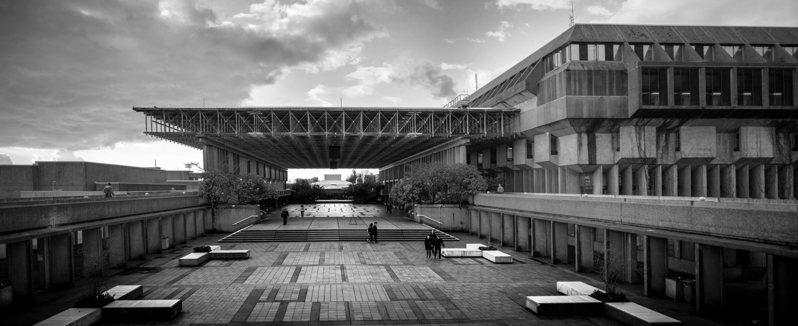
Q & A
Graduate Studies | Rachel Dawson
gradawards@sfu.ca
Information + Drop in Sessions
listed here on our website

