Slide 1
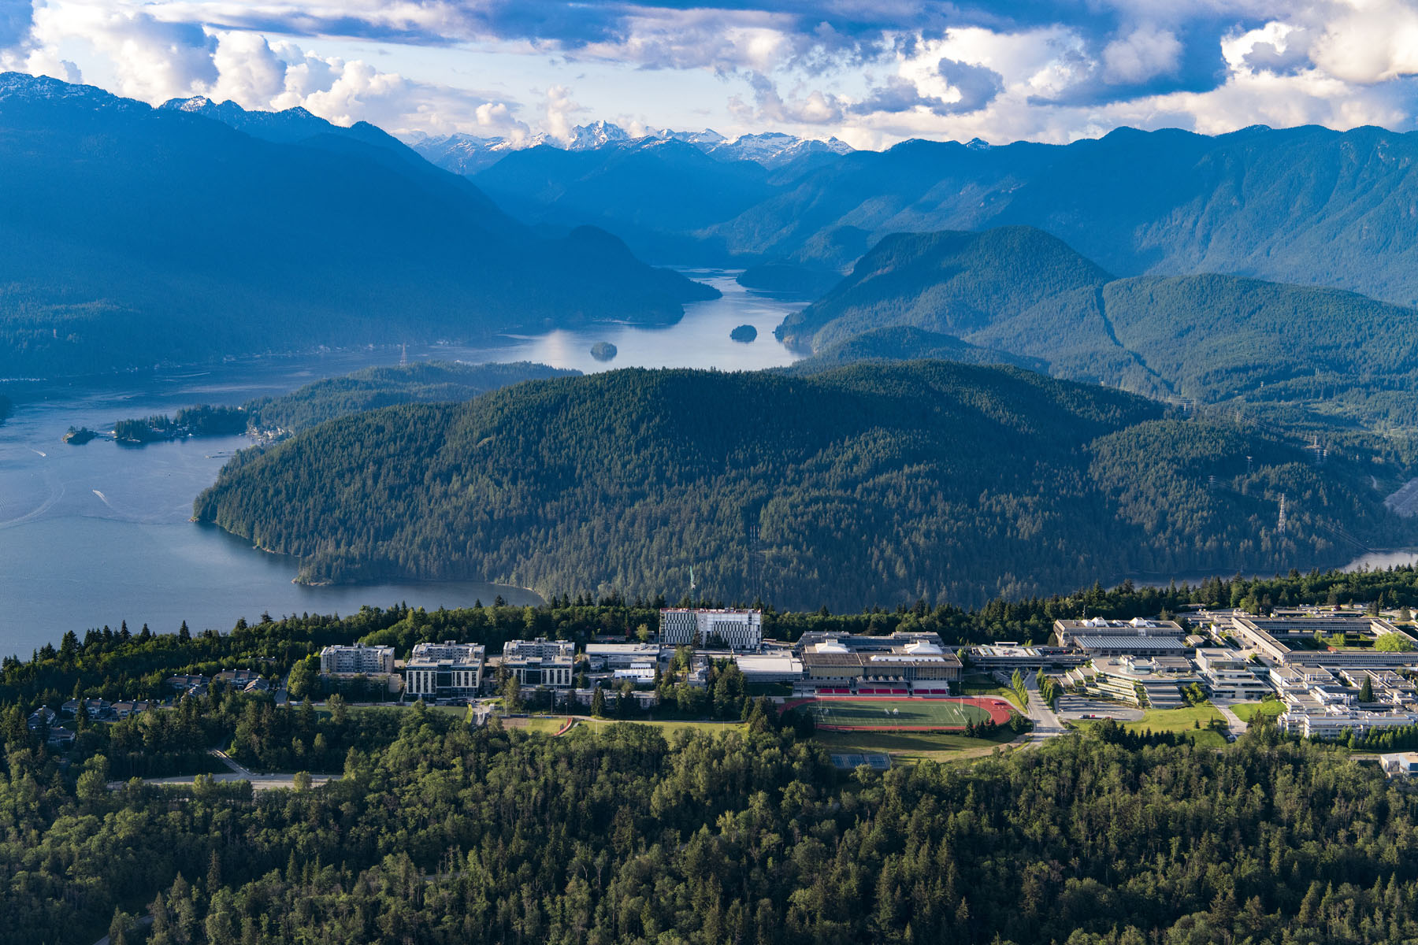
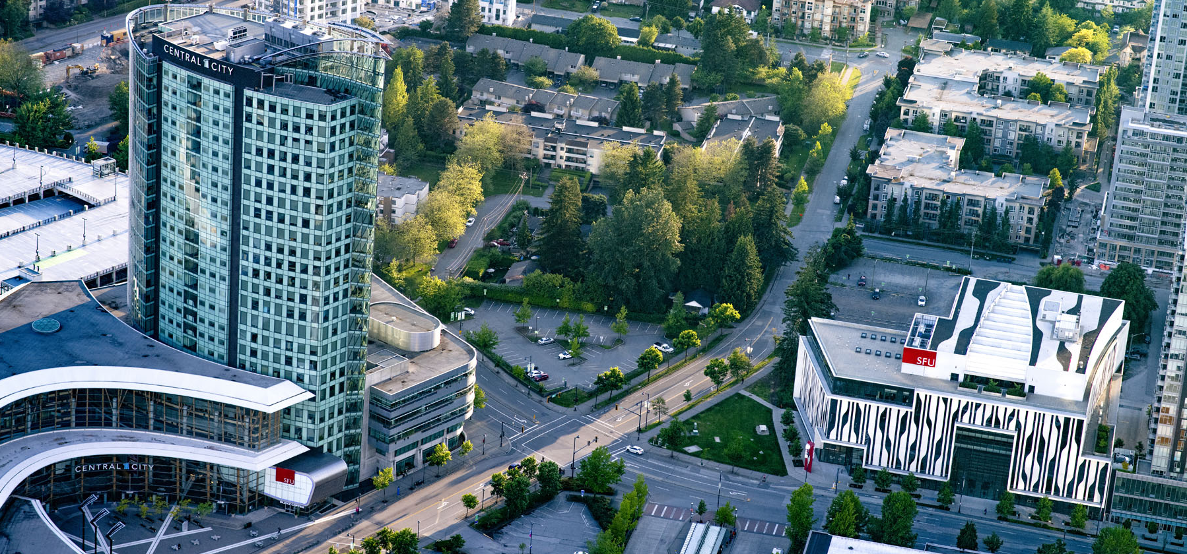
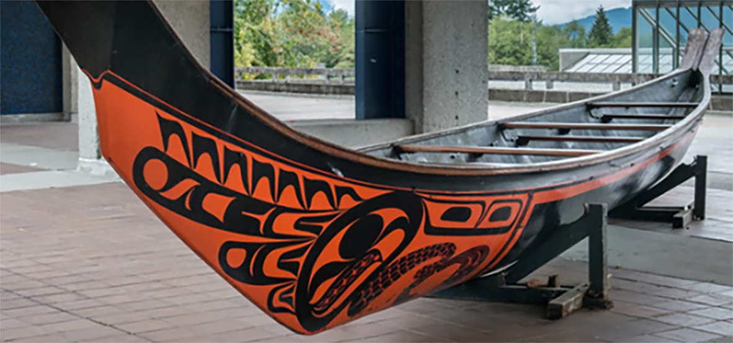
Writing a Tri-Agency Research Proposal
September 5, 2023 - Dr. El Chenier

Slide 2
Research Proposals: Some General Pointers
You are not starting from scratch; you are developing/building on the research proposal you submitted when you applied to GS
The process of writing a proposal should help you sharpen, develop, and clarify your ideas, thinking, methodology, etc. It is not a form you just fill out; it is something you craft.
Good proposals take time – plan for 3 - 4 drafts
Ask your supervisor and peers to read and comment on your draft(s); factor in the time it will take for them to get back to you
Follow the application instructions carefully

Slide 3
For example, note the very specific rules for presenting your text (taken directly from the CGS-M instructions):
You are expected to write your outline of proposed research independently. Ideas and text belonging to others must be properly referenced.
Include all relevant information in the outline. Do not refer reviewers to URLs or other publications for supplemental information.
In the outline of proposed research, provide the requested information according to the guidelines and format standards outlined in the presentation standards.
Bibliography and citations (one page maximum)
Provide a bibliography that includes citations for all works referenced in the research proposal. These citations should be in a format used by the primary discipline of the proposed research. You must ensure that all citations are clear and complete to allow reviewers to easily locate the sources.

Slide 4
Last thing before we get to the proposals:
The Graduate Studies website has a checklist for each grant which you can use to ensure that you have completed and included all required information and documents
-Click on Awards and Funding on our main page banner
-Choose "Tri-Agency and Government Awards" from the drop-down menu
-Click on the award you are interested in
-One more step: click on the text on the far right that says "View X Scholarship"
-Scroll down to the "How to Apply" section and find the subsection "Prepare Your Application." There you will find the link to the worksheet.

Slide 5
Notes:
Write your topic in the chat.

Slide 6
Masters and Doctoral, SSHRC,
NSERC and CIHR
On the following slides I share screenshots of the above scholarships’ instructions for the research proposal.
There are two significant differences between masters and doctoral research proposals:
1. the length of the proposal
2. the weight of the proposed research (see next slide)

Slide 7
CGS Master’s Evaluation Criteria
Criteria | Value
Academic Excellence | 50%
Research Potential | 30%
Personal/Interpersonal Skills and Characteristics | 20%

Slide 8
CGS-M Indicators: Research Potential (30%)
As demonstrated by your research history, your interest in discovery, the proposed research, its potential contribution to the advancement of knowledge in the field and any anticipated outcomes Indicators of research potential:
quality and originality of contributions to research and development
relevance of work experience and academic training to field of proposed research
significance, feasibility and merit of proposed research
judgment and ability to think critically
ability to apply skills and knowledge
initiative and autonomy
research experience and achievements relative to expectations of someone with your academic experience

Slide 9
CGS-Doctoral Evaluation Criteria
Criteria | Value
Research Ability or Potential | 50%
Relevant experiences and achievements obtained within and beyond academia | 50%

Slide 10
CGS-M (Tri-Agency Masters Scholarship)
Instructions for completing an application
Notes:
The next slides are screen shots from this page.

Slide 11
4. Outline of proposed research (attachment)
The single attachment consists of two separate sections: Outline of proposed research and Bibliography and citations. Each of these sections must be only one page. Pages in excess of the number permitted may be removed before the selection process, and your application may be at a disadvantage as a result.
Outline of proposed research (one page maximum)
Provide a detailed description of your proposed research project for the period during which you will hold the award. Be as specific as possible. Provide background information to position your proposed research within the context of current knowledge in the field. State the objectives and hypothesis, and outline the experimental or theoretical approach to be taken (citing literature pertinent to the proposal) and the methods and procedures to be used. State the significance of the proposed research to a field or fields in the health sciences, natural sciences and/or engineering or social sciences and/or humanities, as appropriate.
If the output of your degree program is an artistic creation rather than a thesis, clearly indicate the research component of your proposed work. Outline the objectives of your research, the context, methodology and contribution to the advancement of knowledge.
If your degree program does not involve a thesis, a major research paper/essay or a major research project, clearly outline the research component of the degree.
If you have not yet decided on a specific project, you must still provide a detailed description of a proposed research project. You may change your research direction or activities during the course of the award. Certain restrictions may apply. Refer to the Tri-agency research training award holder’s guide.
Notes:
This information is directly from the Tri-Council website https://www.nserc-crsng.gc.ca/ResearchPortal-PortailDeRecherche/Instructions-Instructions/CGS_M-BESC_M_eng.asp#presentation_standards

Slide 12
Tri-Agency CGS-M Criteria Up Close:
Provide a detailed description of your proposed research project for the period during which you will hold the award. Be as specific as possible.
Provide background information to position your proposed research within the context of current knowledge in the field.
State the objectives and hypothesis, and outline the experimental or theoretical approach to be taken (citing literature pertinent to the proposal) and
the methods and procedures to be used.
State the significance of the proposed research to a field or fields in the health sciences, natural sciences and/or engineering or social sciences and/or humanities, as appropriate.
Notes:
This criteria is directly copied from the Tri-Agency webpage.

Slide 13
NSERC Doctoral

Slide 14
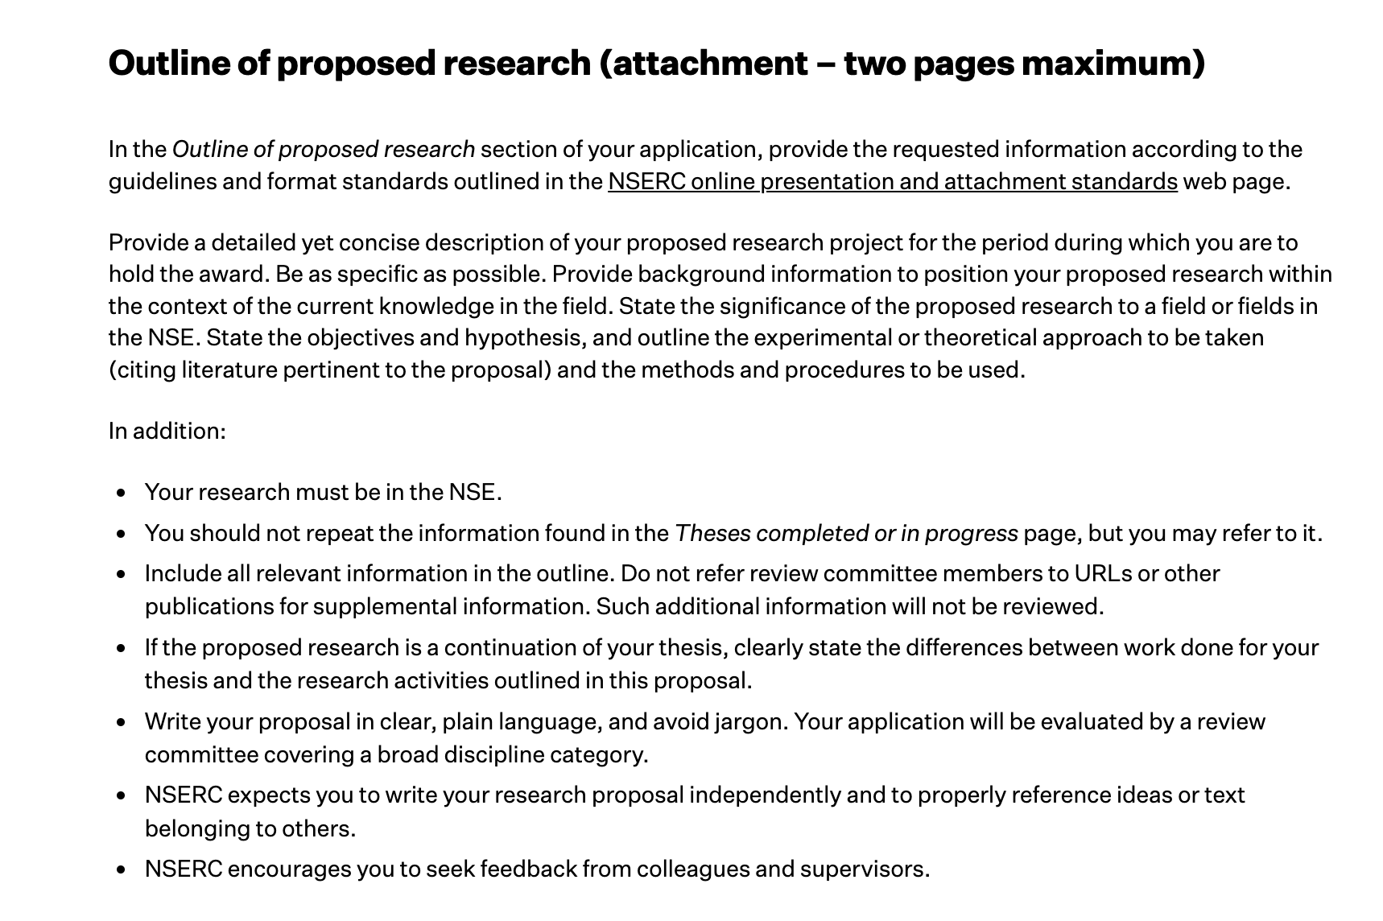
Notes:
NSERC Doctoral

Slide 15
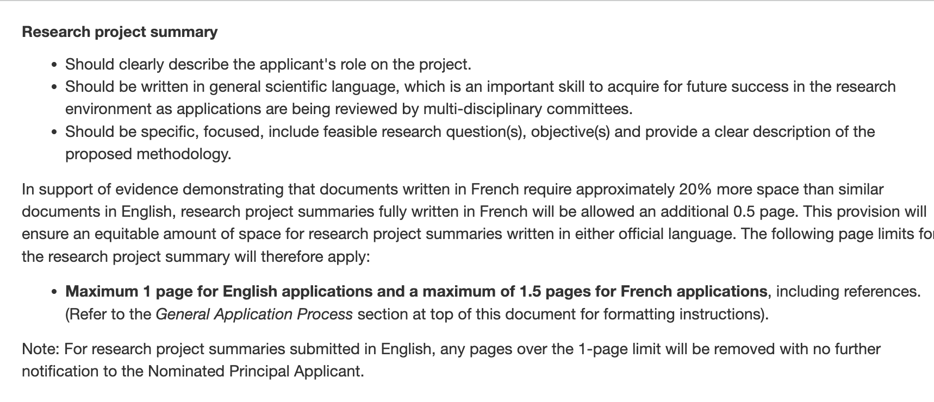
CIHR Doctoral

Slide 16
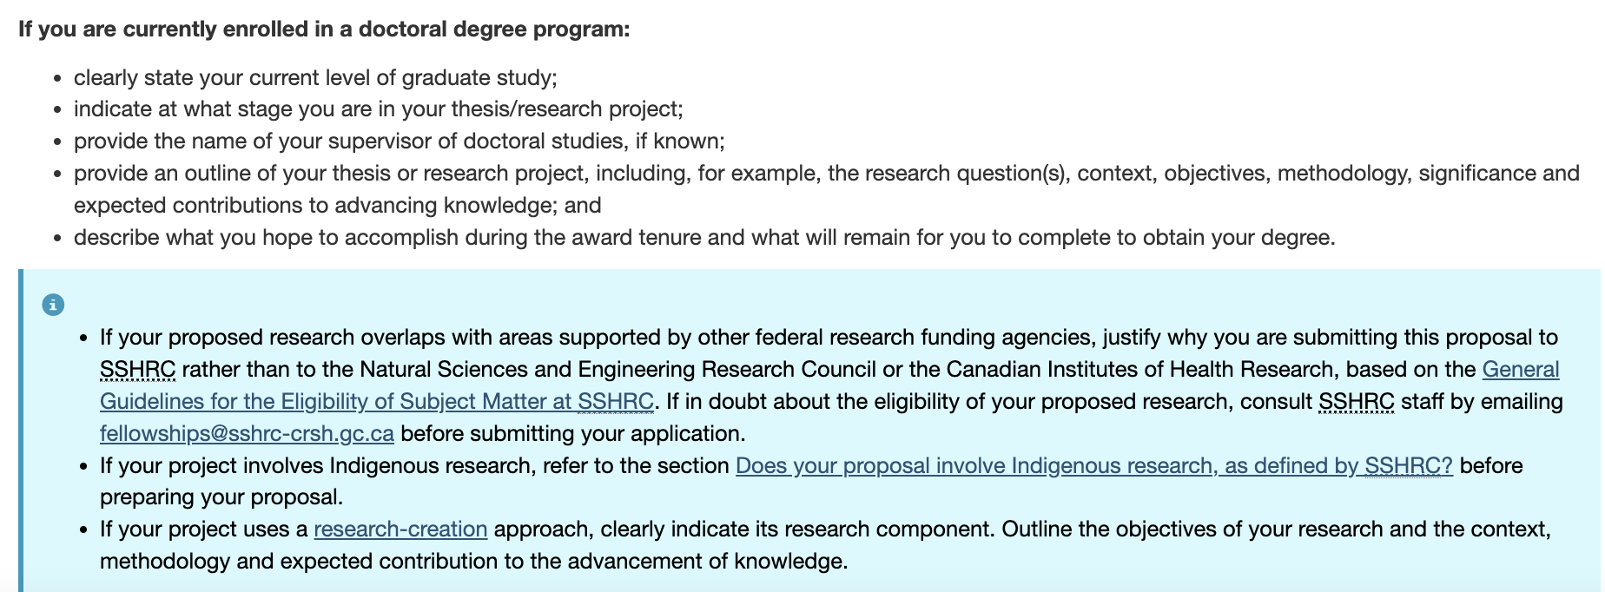
SSHRC Doctoral

Slide 17
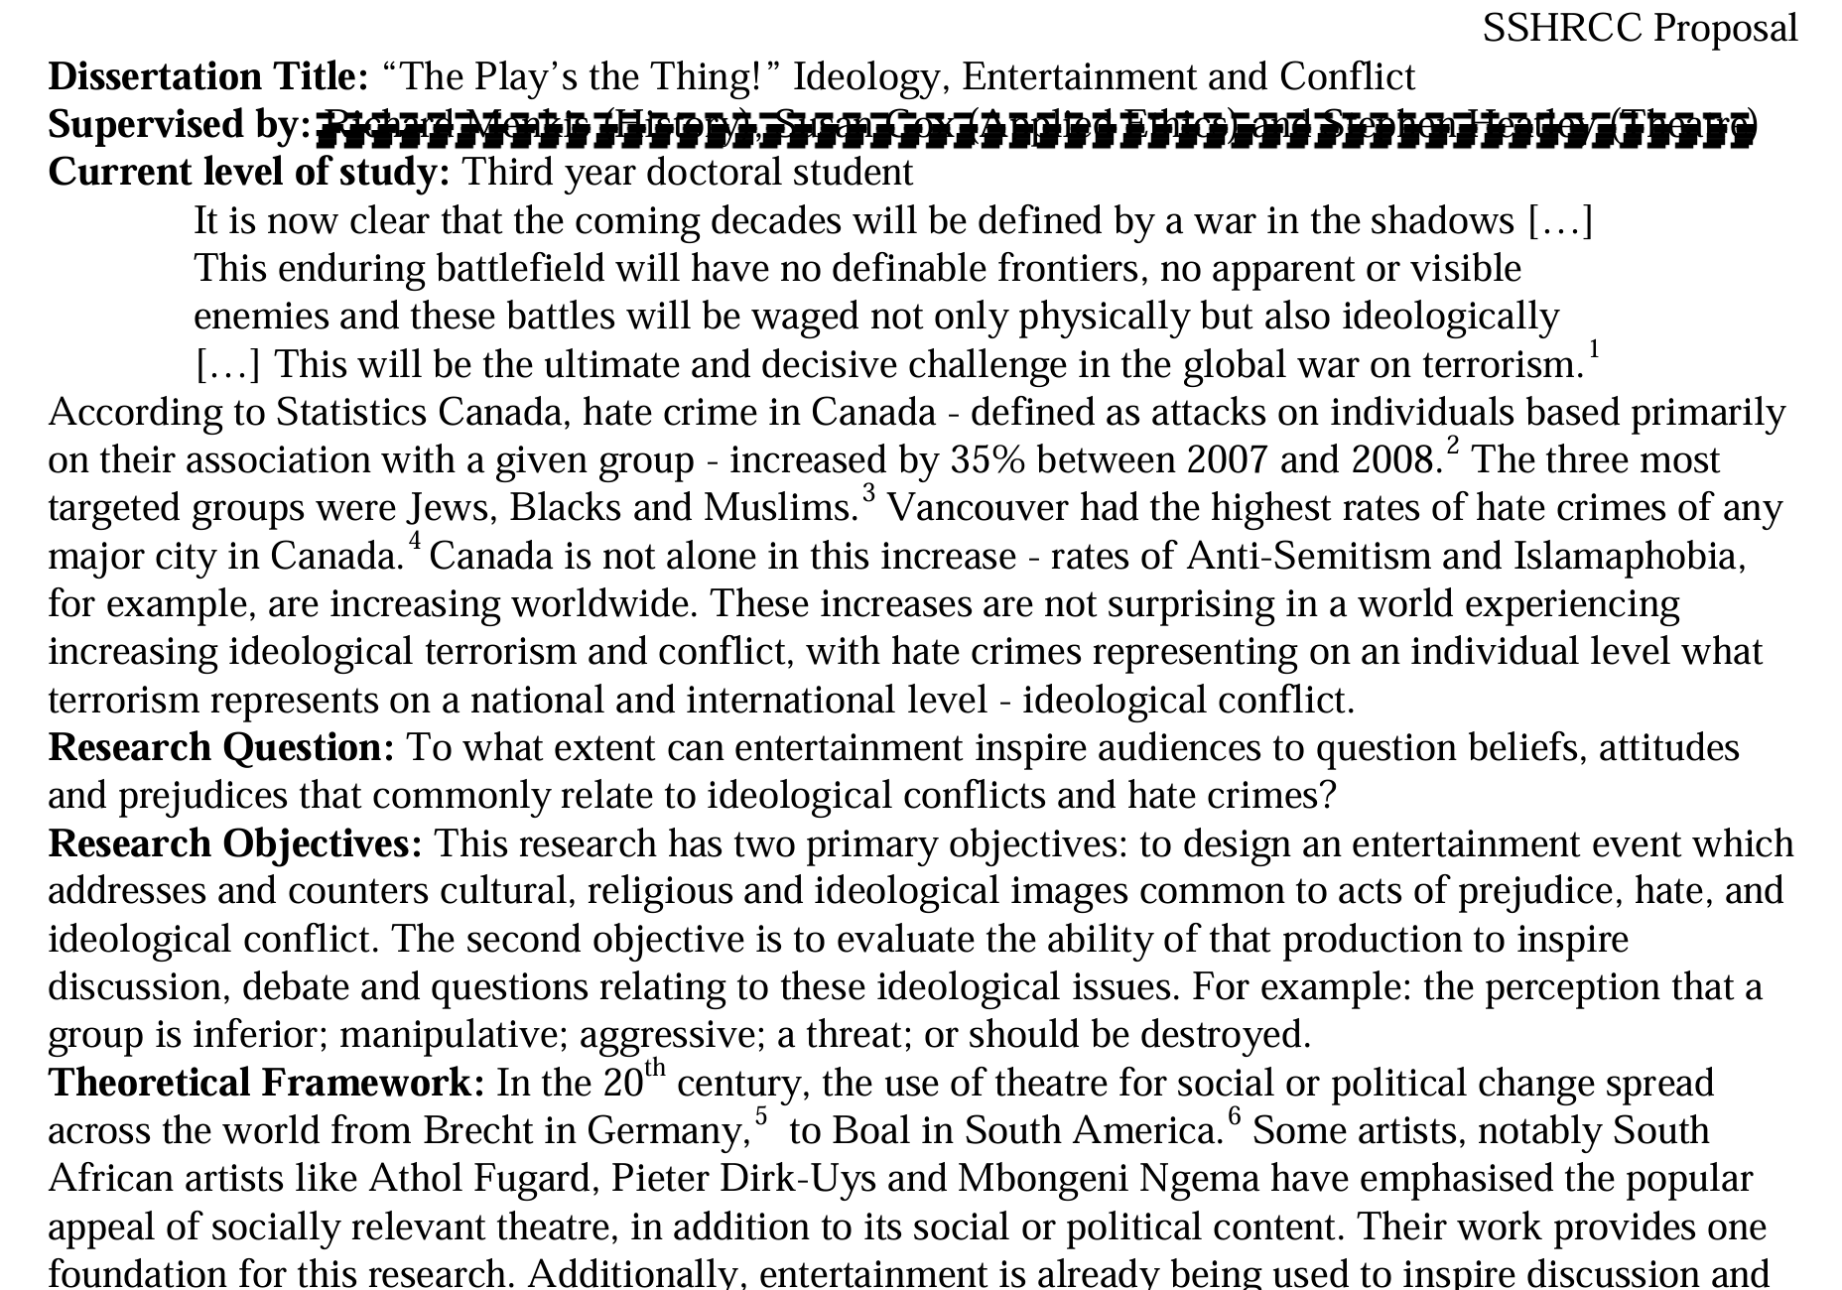
Note the Use of Subheadings (2 pp Doctoral App)
Notes:
Click on the image of the text to go to the document.
Additional subheadings used include:
Methodology
Hypothesis
Advancement of Knowledge
My Qualifications

Slide 18
What is your research question?
Take a moment to write down your research question in a single sentence. Feel free to refer to your grad school application.

Slide 19
F Feasible A good research question is feasible, which means that the question is well within the researcher’s ability to investigate. Researchers should be realistic about the scale of their research as well as their ability to collect data and complete the research with their skills and the resources available to them. It’s also wise to have a contingency plan in place in case problems arise.
I Interesting The ideal research question is interesting not only to the researcher but also to their peers and community. This interest boosts the researcher’s motivation to see the question answered.
N Novel Your research question should be developed to bring new insights to the field of study you are investigating. The question may confirm or extend previous findings on the topic you are researching, for instance.
E Ethical This is one of the more important considerations of making a research question. Your research question and your subsequent study must be something that review boards and the appropriate authorities will approve.
R Relevant Aside from being interesting and novel, the research question should be relevant to the scientific community and people involved in your area of study. If possible, your research question should also be relevant to the public’s interest.
-Hulley et al. (2007)

Slide 20
General Versus Specific
WEAK Research Qs
Will holding workshops reduce school violence?
Can high school suspension rates be changed?
Can identity be determined by carbon dating?
STRONG Research Qs
Will one-hour hands-on car seat training sessions reduce child motor vehicle injuries in Winnipeg?

Slide 21
From York University:
Notes:
https://www.yorku.ca/gradstudies/students/current-students/awards-and-scholarships/a-guide-for-developing-successful-grant-proposals/

Slide 22
From York University
Notes:
https://www.yorku.ca/gradstudies/students/current-students/awards-and-scholarships/a-guide-for-developing-successful-grant-proposals/

Slide 23
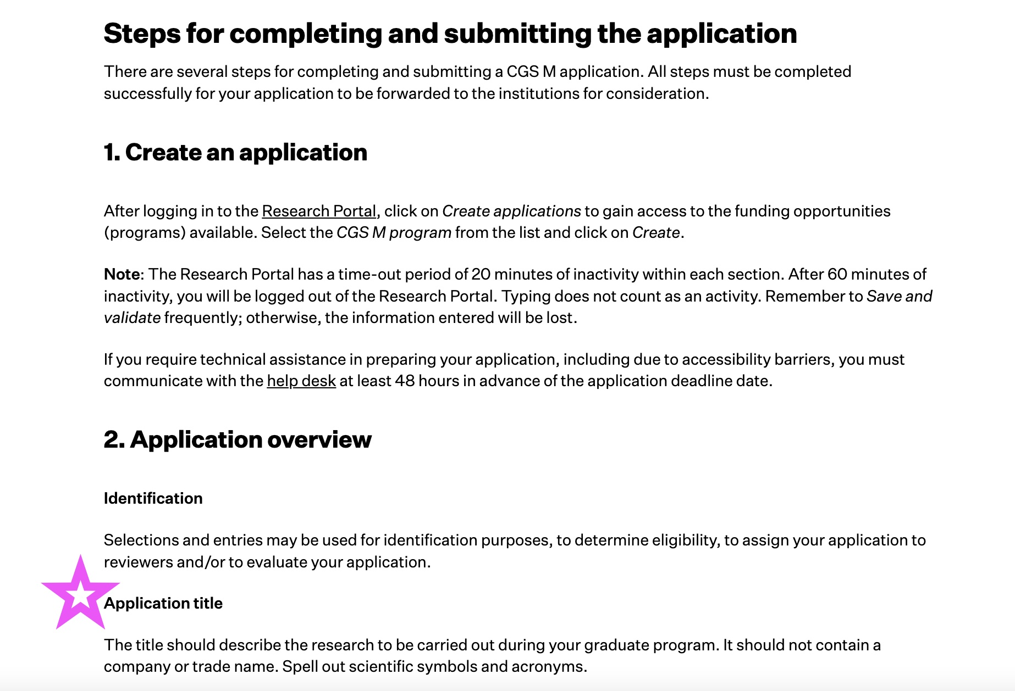
Notes:
The application title is your first chance to ignite interest. If you feel you are not good at titles, ask for help.

Slide 24
Note the Use of Subheadings (2 pp Doctoral App)
Notes:
Click on the image of the text to go to the document.
Additional subheadings used include:
Methodology
Hypothesis
Advancement of Knowledge
My Qualifications

Slide 25
Know your audience
Not necessarily in your discipline therefore:
avoid jargon, specialized language, explain concepts and methods so that they can be understood by a non-specialist
the scholarship-writing genre is unique; this is not an essay or thesis. Write in a journalistic style that emulates a magazine pitched to a specialist audience such as Nature, The Economist.

Slide 26
Common Errors
Wrote too much under the background section, should not be more than 1/3 of the page.
Methodology is weak – not enough information on how the research will be carried and whether it’s feasible within the time period of their study.
Too much jargon or too technical – the proposal needs to be written in a lay person language

Slide 27
Additional Resources
Write a Research Proposal
Organizing your research proposal
How to Write a Research Question
SSHRC Proposal Writing Tips
SFU Library writing services and resources for graduate students

Slide 28
Final Words of Advice
You can spend all your time reading “how to” guides. Don’t.
“Writing is the art of applying the ass to the seat.” Dorothy Parker

