Slide 1
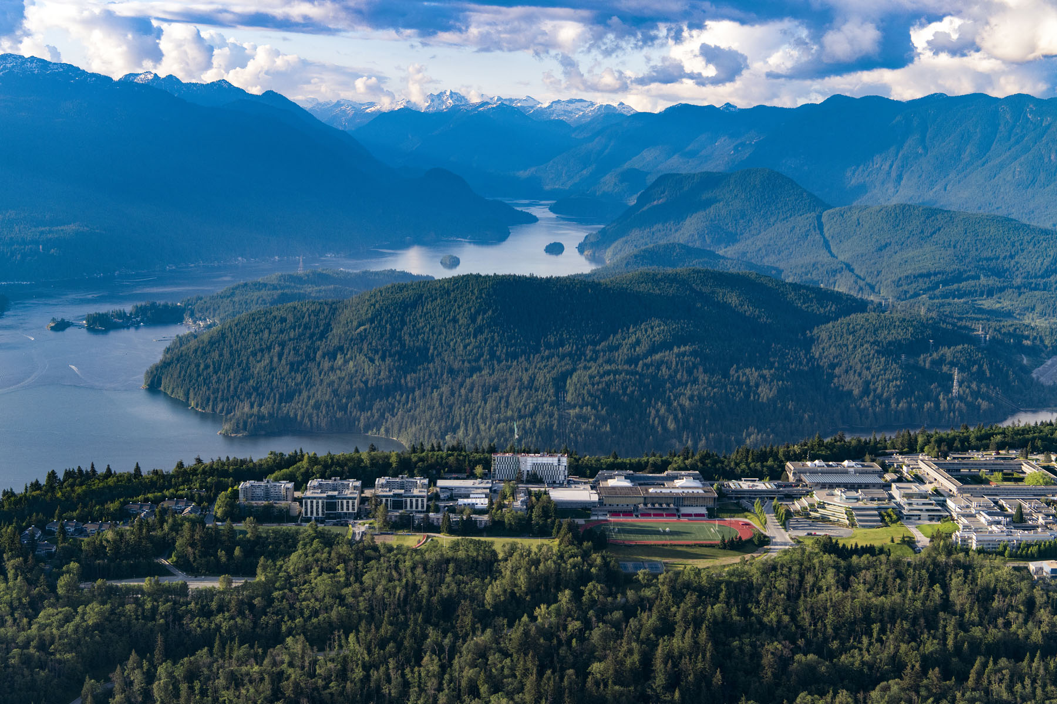
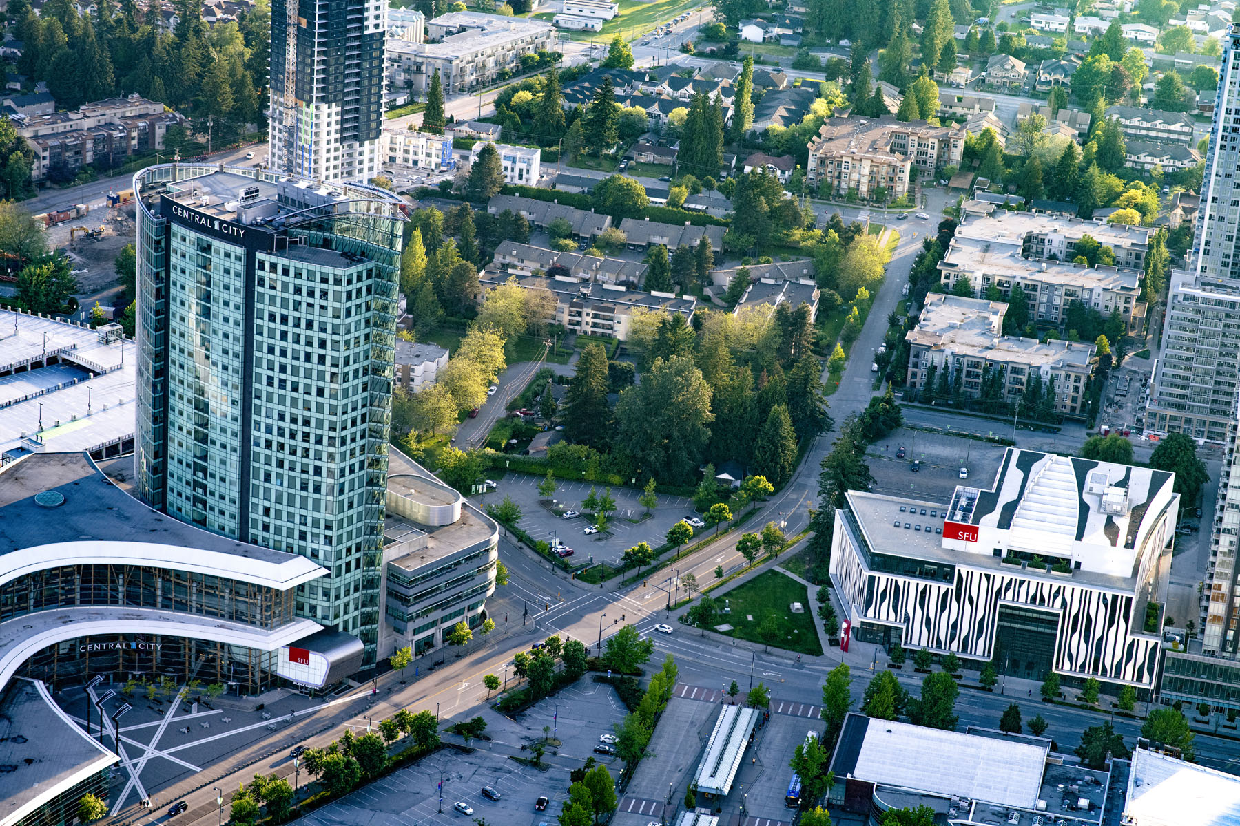
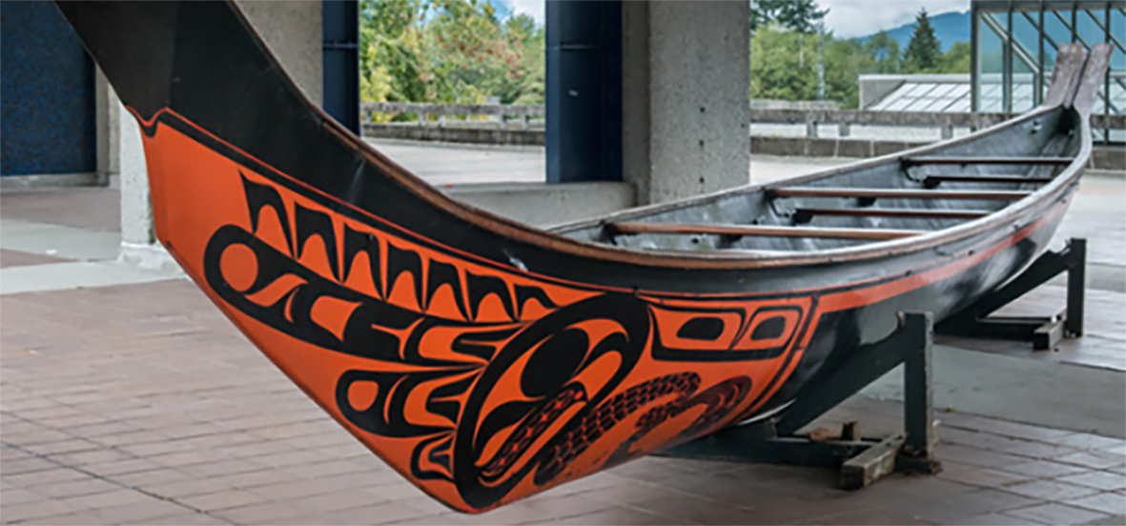
GRADUATE AWARDS + SCHOLARSHIPS Internal and External awards (including CIHR, NSERC + SSHRC)

Slide 2
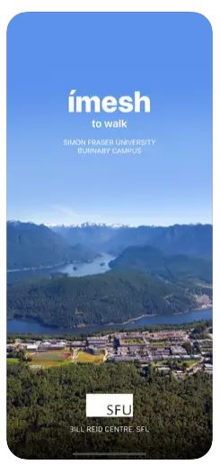
Land Acknowledgment
We encourage you to download the Bill Reid mobile app to learn more about the Indigenous Art at SFU
ímesh, meaning "to walk" in Skwxwú7mesh snichim (Squamish Language), is a mobile app being developed by the Bill Reid Centre for Northwest Coast Studies at Simon Fraser University. The app is a response to the university’s Community Engagement Strategy, and its Aboriginal Strategic Plan, and is intended to be a step, however small, toward decolonizing the university and the surrounding landscape
We respectfully acknowledge the unceded Traditional Coast Salish Lands including the Tsleil-Waututh (səl̓ilw̓ətaʔɬ), Kwikwetlem (kʷikʷəƛ̓əm), Squamish (Sḵwx̱wú7mesh Úxwumixw) and Musqueam (xʷməθkʷəy̓əm) Nations on which Burnaby Campus is located.

Slide 3
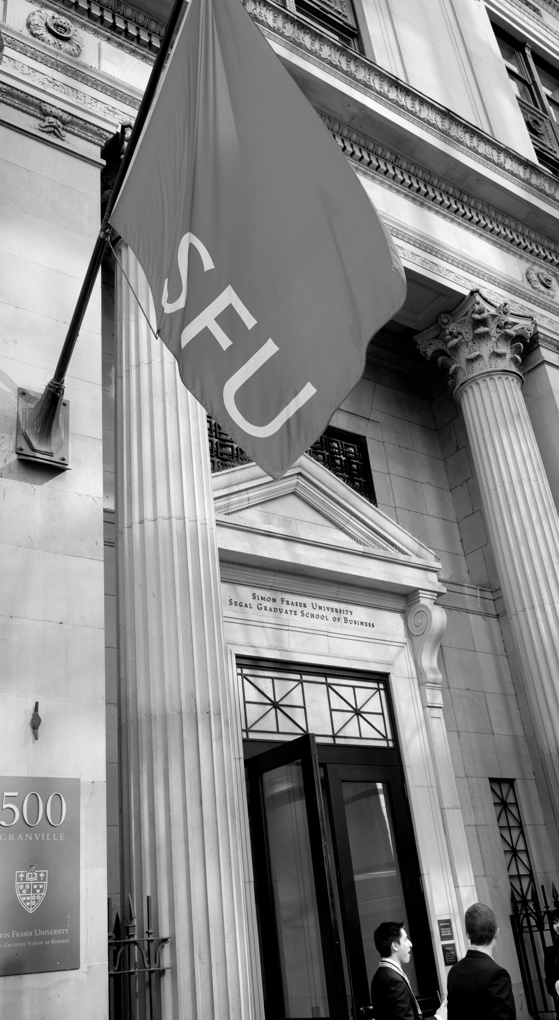
AGENDA
Award Funding Sources
Tri-agencies
Selecting the right agency & funding opportunity
Canada Graduate Scholarship Masters (CGSM)
Eligibility points & timeline
Vanier Canada Graduate Scholarship
Eligibility points & timeline
CIHR, NSERC & SSHRC Doctoral Scholarships
Eligibility points & timeline
Graduate Studies Website & Sample Document Library
Q & A

Slide 4
Award Funding Sources
INTERNAL + DONOR FUNDED AWARDS
Listed on our website by academic unit
Awards vary in value and decision process
Applied for in GA3, our awards system
In GA3, search under Dean of Graduate Studies too!
EXTERNAL + ADDITIONAL AWARDS
Listed on our website by external funding agencies
Awards vary in value and process
Applied for on external award systems
Graduate Studies usually handles award payments
TRI-AGENCY (CIHR, NSERC, SSHRC)
CGSM Canada Graduate Scholarships – Masters
Vanier Canada Graduate Scholarships – Doctoral
Agency Doctoral Scholarships - Doctoral
Various supplements and partner awards
OTHERS (not through Graduate Studies)
SFU’s Financial Aid and Awards handles bursaries, work-study, loans and emergency loans
Visit SFU’s Co-op page for paid employment experience
Register for the SFU Food Pantry prior to your visit
Notes:
The green boxes match the webpages on our website. For the External & Additional Awards, we’ve organized by research area and outlined details regarding the organization –we recommend students subscribe to the organizations that are a match so you don’t miss funding or event opportunities.

Slide 5
What are the Tri-Agencies?
Tri-agencies refers to these federal research funding agencies:
CIHR: Canadian Institutes of Health Research
NSERC: Natural Sciences and Engineering Research Council
SSHRC: Social Sciences and Humanities Research Council
Which agency do I choose?
The following webpage has general guidelines for the eligibility of subject matter + for health related research topics:
https://science.gc.ca/site/science/en/interagency-research-funding/policies-and-guidelines/selecting-appropriate-federal-granting-agency
Notes:
Pro Tip: if you have to justify why your research fits within a specific agency, use some of the wording from the science.gc.ca website

Slide 6
CGS Masters: $27,000 for 1 year
Opens: late August/early September | Deadline: December 1
Harmonized program: Eligibility, application process and deadline is the same for CIHR, NSERC or SSHRC
Application: apply on the Research Portal + users need to create a Canadian Common CV
Initiative + Supplements: applicants who are eligible for Initiatives + Supplements may need to self identify and/or upload additional information when they apply. If you are successful, there are additional awards you can apply for (MSFSS).
Instructions
The CGSM Program Resources page provides instructions for completing the application, attachments, CCV and referee assessment form. The instructions provide page limits, what to include in each section/attachment.
Visit Graduate Studies CGSM page, for SFU’s process. Step 3 includes a downloadable checklist!
Notes:
*Check the date

Slide 7
CGS Masters: notes on main eligibility points
Eligibility basics and discussion (visit CGSM eligibility for full list)
Must be Canadian citizen, permanent resident of Canada or Protected Person as of the application deadline date
be enrolled in, have applied for or will apply for full-time admission* to an eligible graduate program at the master’s or doctoral level at a Canadian institution with a CGS M allocation
have completed, as of December 31 of the year of application:
either between 0 and 12 months of full-time studies (or equivalent) in the program for which you are requesting funding
between 4 and 12 months of full-time study (equivalent) in an eligible master’s program BUT going to use award for doctoral program….
have achieved a first-class average, as determined by the host institution, in each of the last two completed years of study (full-time equivalent)
December 1
Eligible programs have a significant research component.
SFU has allocations
Sept 2024 - Dec 31, 2024 = 4 months
CGPA 3.67 = pass
If not, we calculate your last 24 -30 credits
Notes:
The ‘how many months of graduate school…” question in the application is the most INCORRECTLY answered one. If you are a full time student, your answer will be dividable by 4.
A “significant research component” is one that leads to the completion of a thesis, major research project, dissertation, scholarly publication, performance, recital and/or exhibit; component must be merit/expert reviewed at institutional level as a requirement for completing the program
If you are a part-time student, then two terms of part-time study count as one term of full-time study.

Slide 8
Selection Criteria – CGS Master’s
Academic Excellence 50%
Academic record
Scholarships and awards held
Research Potential 30%
Quality and originality of contributions to research and development
Relevance of work experience and academic training to field of proposed research
Significance, feasibility and merit of proposed research
Personal Characteristics and Interpersonal Skills 20%
Work experience
Leadership experience
Project management, including organizing conferences and meetings
Visit their website here for full description of the selection criteria.

Slide 9
TRUDEAU FOUNDATION: $30,000 – $60,000
Competition opens: October
Deadline: usually December 1
Final interviews: between February – March
Funds: Doctoral research related to the humanities or human sciences of direct relevance to the future of Canada; doctoral work must relate to at least one of the Foundation’s Four Themes: Human Rights and Dignity, Responsible Citizenship, Canada and the World, People and their Natural Environment.
Program: more than a scholarship; the foundation provides a 3 years Leadership Development Program, based on “Scientific Cycles” – a a scientific theme that has interdisciplinary dimensions and reflects a timely and significant set of issues for the future of Canada and the world.
Eligibility and Application:
Visit the Foundation’s general website: https://www.trudeaufoundation.ca/
Visit the doctoral scholarship page: https://www.trudeaufoundation.ca/scholarship
Application is on the Trudeau’s application portal: smartsimple
Notes:
Vanier is open to international students. Leadership is an important criterion! So is Academic Excellence and Research Potential.

Slide 10
TRUDEAU FOUNDATION: ELIGIBILITY
Eligibility basics
1) You must be registered or already accepted into or in year one or two (beginning year three in September 2024 or later) of a full-time doctoral program and expected to complete your doctoral studies in 2027 or later. 2) Your field of study is broadly related to the humanities or human sciences of direct relevance to the future of Canada; (please refer to the FAQ for more details and read up on past scholarship recipients) 3) Your doctoral work must relate to at least one of the Foundation’s Four Themes: Human Rights and Dignity, Responsible Citizenship, Canada and the World, People and their Natural Environment. 4) Be a Canadian citizen studying at a Canadian or foreign institution, or a non-Canadian (permanent resident of Canada or foreign national) enrolled in a doctoral program at a Canadian institution.

Slide 11
CIHR, NSERC and SSHRC Doctoral Scholarships
FALL 2024 COMPETITONS ARE OPEN
Deadline: October 1 at 4:30 PM (PST)
Harmonization: harmonized value and duration ($40,000/year for 3 years) but different systems
CGSD: top ranked applicants may be considered for a CGSD (eligibility is slightly different)
CIHR CGS Doctoral (CGSD)
$40,000/year for 3 years
Eligibility + Instructions
Application on ResearchNET + CCV
NSERC PGS + CGSD Scholarships
$40,000/year for 3 years
Eligibility + Instructions
Application on NSERCs Online system
SSHRC Doctoral Fellowships + CGSD
$40,000/year for 3 years
Eligibility + Instructions
Online system + SSHRC CV
CIHR Doctoral Foreign Study Award: for applicants who wish to hold a CIHR doctoral award abroad (visit DFSA)
Notes:
There is no more CIHR doctoral research award, it’s the CGSD and the DFSA. DFSA is direct application to CIHR.

Slide 12
CIHR, NSERC & SSHRC Doctoral Timeline
MAY
2025
APRIL
2025
NOVEMBER
21
GS pays award
NOVEMBER
10 - 16
Agency decisions
are announced.
Top ranked applicants offered CGSD
NOVEMBER
8 - 9
OCTOBER 1
4:30 PM (PST)
(SFU Internal Deadline)
University submits applications to agency
Selected students update applications
University committee review
Student applies on
Tri-Agency portal
Direct applicant deadline: October 17
If you aren’t enrolled/haven’t been enrolled in a Canadian degree program in the past year, visit
where do I submit my application?
If the SFU internal deadline falls on a weekend or on a federal statutory holiday, the deadline will be 4:30 PM (PST) on the following business day.

Slide 13
CIHR CGS Doctoral (CGSD)
FALL 2024 COMPETITION OPEN | Deadline: October 1 at 4:30 PM (PST)
Value: $40,000/year for 3 years
Application: apply using ResearchNet + Common CV account
Special Initiatives + Supplemental awards:
To be considered, you must give consent to use the self-identification data in the application and/or use the dropdown "Priority Announcements / Funding Pools (optional)" task in ResearchNet. Check to see if you are a match for the Canada Graduate Scholarship to Honour Nelson Mandela
Some additional funding is available for award winners (CGS winners can apply for MSFSS).
Information + Instructions
Visit the CIHR Doctoral website and the CGSD program page for full eligibility, process and criteria. Visit Application Instructions for how to complete the application, page limits and what to include.
Visit Graduate Studies CIHR page, for SFU’s process. Step 3 includes a downloadable Worklist!
Notes:
There is no longer a “CIHR Doctoral Research Award” – all applicants apply for the Canada Graduate Scholarship – Doctoral (CGS D).

Slide 14
CIHR - Doctoral (CGSD): notes on main eligibility points
Eligibility basics
Must be Canadian citizen, permanent resident of Canada or a protected person as of the application deadline.
Not already received a doctoral level scholarship from the tri-agencies…
have completed no more than 24 months of full-time study in your doctoral program as of December 31 of the year of application.
have completed no more than 36 months of full-time study in your doctoral program as of December 31, if you are direct entry (bachelors to PhD) or in joint professional program (MD/PhD) or another joint program (MSc/PhD).
must include a significant research component that leads to the completion of a thesis, major research project, dissertation, scholarly publication, performance, recital and/or exhibit; component must be merit/expert reviewed at institutional level as a requirement for completing the program.
By October 1, 2024
Sept 2024 - Dec 31, 2024 =
4 months completed.
Masters/PhD transfer: count starts at doctoral transfer date.
PT study is counted as half time.
Notes:
Masters to PhD transfers are called “Fast Track”
Joint programs are rare at SFU.

Slide 15
NSERC Postgraduate Scholarships (PGSD + CGSD)
FALL 2024 COMPETITION OPEN | Deadline: October 1 at 4:30 PM (PST)
Value: $40,000/year for 3 years
Application: apply using NSERC’s Online System (includes CV)
Special Initiatives + Supplemental awards:
To be considered for initiatives or supplements (eg., L’Oréal-UNESCO For Women in Science, support for Black scholars...) you must give consent to use the self-identification data in the application.
Some additional funding is available for award winners (eg. CGS winners can apply for MSFSS).
Information + Instructions
Visit the NSERC PGSD website for full eligibility, process and criteria. Visit Application Instructions for how to complete the application, page limits and what to include in each attachment.
Visit Graduate Studies NSERC page, for SFU’s process. Step 3 includes a downloadable Worklist, which will be updated in early August!
Notes:
If you are interested in a Canada Graduate Scholarship – Doctoral (CGS D), apply for a PGS D. There is no separate application form or process for the CGS D program. If your application is one of the highest scored applications, you will be offered a CGS D.

Slide 16
NSERC PGSD: notes on main eligibility points
Eligibility basics
Must be Canadian citizen, permanent resident of Canada or a protected person as of the application deadline.
Not already received a doctoral level scholarship from the tri-agencies…
have completed no more than 24 months of full-time study in your doctoral program as of December 31 of the year of application.
have completed no more than 36 months of full-time study in your doctoral program as of December 31, if you are direct entry (bachelors to PhD) or in joint professional program (MD/PhD) or another joint program (MSc/PhD).
must include a significant research component that leads to the completion of a thesis, major research project, dissertation, scholarly publication, performance, recital and/or exhibit; component must be merit/expert reviewed at institutional level as a requirement for completing the program.
By October 1, 2024
Sept 2024 - Dec 31, 2024 =
4 months completed.
Masters/PhD transfer: count starts at doctoral transfer date.
PT study is counted as half time.
Joint programs are rare at SFU.
Notes:
Yes, the summer months count. For Part Time – 2 terms of Part time count as one term of full time. The agencies count all studies toward the doctoral degree for which funding is requested, whether or not they were completed at the degree-granting institution.

Slide 17
SSHRC Doctoral Fellowships and CGSD
FALL 2024 COMPETITION OPEN | Deadline: October 1 at 4:30 PM (PST)
Value: $40,000/year for 3 years
Application: apply using SSHRC’s Online System (includes CV)
Special Initiatives + Supplemental awards:
Some supplements are based on self identification within the application, for jointly funded/special initiatives, interested candidates include additional information in their application (max 1 page).
Some additional funding is available for award winners.
Information + Instructions
Visit the SSHRC Doctoral website for full eligibility, process and criteria. Visit Application Instructions for how to complete the application, page limits and what to include in each attachment.
Visit Graduate Studies SSHRC page, for SFU’s process. Step 3 includes a downloadable Worklist, which will be updated in July!
Notes:
Applicants apply for the SSHRC Doctoral Fellowships may be considered for the CGSD

Slide 18
SSHRC Doctoral: notes on main eligibility points
Eligibility basics
Must be Canadian citizen, permanent resident of Canada or a protected person as of the application deadline.
Not already received a doctoral level scholarship from the tri-agencies…
have completed no more than 48 months of full-time study in your doctoral program as of December 31 of the year of application
must include a significant research component that leads to the completion of a thesis, major research project, dissertation, scholarly publication, performance, recital and/or exhibit; component must be merit/expert reviewed at institutional level as a requirement for completing the program.
By October 1, 2024
Sept 2024 - Dec 31, 2024 =
4 months completed.
All doctoral studies are counted.
Masters/PhD transfer: count starts at doctoral transfer date.
PT study is counted as half time.

Slide 19
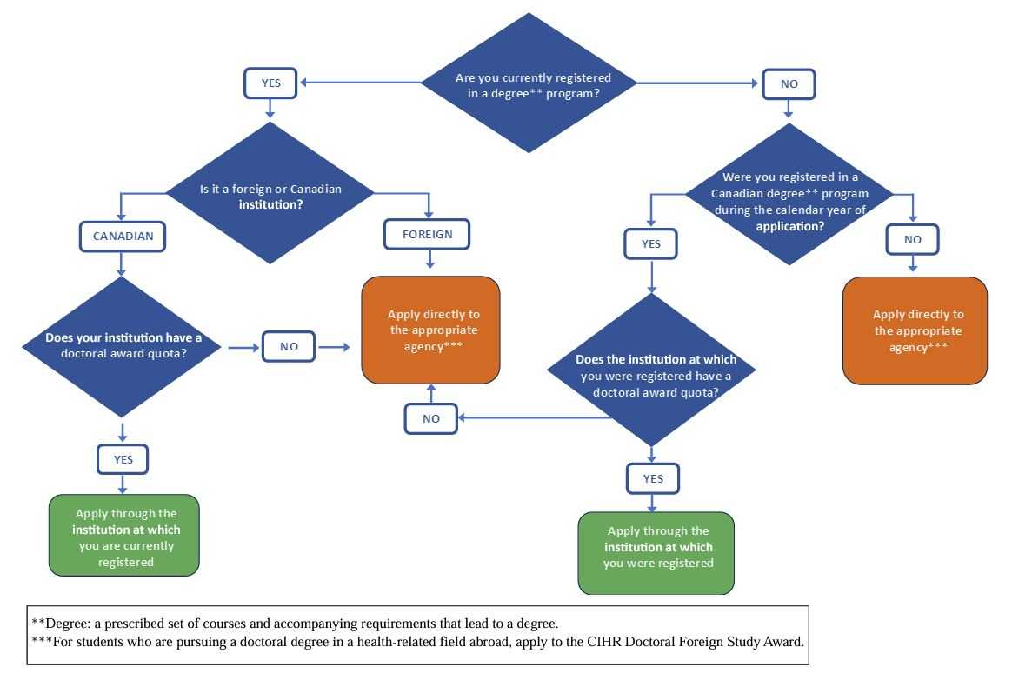
Where to Submit My Application

Slide 20
Selection Criteria – CGS Doctoral
Research ability and potential 50%
quality of research proposal
specific, focused and feasible research question(s) and/or objective(s)
clear description and soundness of the proposed methodology
significance and expected contributions to research
relevant training, such as academic training, lived experience and traditional teachings
demonstration of ability and potential to carry out proposed research relative to the stage of study, lived experience and knowledge systems
Relevant experience and achievements obtained within and beyond academia 50%
scholarships, awards and distinctions
academic records (i.e. transcripts)
professional, academic and extracurricular activities as well as collaborations with supervisors, colleagues, peers, students, and members of the community, such as teaching, mentoring, supervising, etc.
Visit their website here for full description of the selection criteria.

Slide 21
Tips
Transcripts
Order official transcripts early – you will need to scan and upload into 1 PDF, except for the Vanier. Our office would be the one to upload the official transcripts for the Vanier competition.
Although the Tri-Agency has been flexible regarding official vs. non-official transcripts over the past few years due to COVID, all transcripts will still need to be verified by our office to make sure that they are acceptable by the Tri-Agency.

Slide 22
Tips
Referees:
They need to be able to provide concrete examples of your experiences that aligns with the evaluation criteria
One referee should be from a person very familiar with your research and other abilities, i.e. current academic supervisor. Second referee should be from a person who’s also familiar with your research and other abilities to provide a meaningful commentary
If your current or past supervisor is unable to provide you with a report on the applicant, you may use the “Special Circumstance” section to provide an explanation, depending on the competition.
Advise referees to use inclusive language (e.g. “the applicant” or “they” instead of “he/she”) to help with unconscious bias during the evaluation process.
Applicants will not be able to submit application without both letters – inform your referees to complete their reference letters before the SFU internal deadline (for doctoral competitions), but for the CGS M, the student’s deadline is December 1 to submit a complete application.

Slide 23
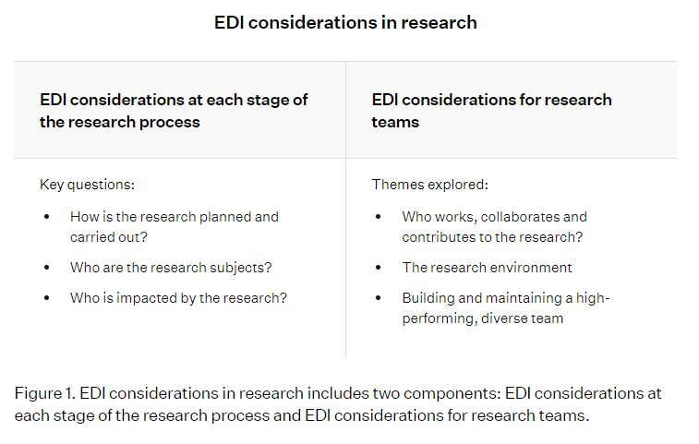
Tips
EDI/Indigenous Considerations
NSERC Guidelines can be found here.
Indigenous Considerations
https://ethics.gc.ca/eng/policy-politique_tcps2-eptc2_2022.html
Black Scholars Funding
FAQs can be found here.

Slide 24
Common Mistakes
Applicants don’t follow the presentation standards and attachments, therefore the system give an error message when trying to upload a document.
Research proposal:
Wrote too much under the background section, should not be more than 1/3 of the page.
Methodology is weak – not enough information on how the research will be carried and whether it’s feasible within the time period of their study.
Too much jargon or too technical – the proposal needs to be written in a lay person language

Slide 25
Questions for Graduate Studies?
Award Drop in Sessions July 29 - September 16 Mondays 10 – 12 noon Zoom: https://sfu.zoom.us/j/8782550629 Meeting ID: 878 255 0629 | Sample Document Library Access award winning applications, CVs, proposals etc (SFU log in required): Document Library | Graduate Studies Contact the award & finance teams at: gradawards@sfu.ca

Slide 26
What happens if I win a Trudeau + Tri-agency or other award?
You accept them all – SFU does not limit the number of external awards a student receives. There is a 60K funding cap on awards, but that applies to awards from SFU and Donor funds.
How important are publications? What if I don’t have any?
Applications without publications can be successful! Be sure to highlight your other experiences (research, leadership etc). Some applicants have their referees speak to publications, mentioning there is one in progress and/or that publications are not common in this field of research.
My CV/CCV is quite blank! How can I show I am positioned for this research?
Some training modules related to research are available online. Check Tri-agency Training Modules (Sex and Gender considerations, Ethics, Indigenous Research). Also, check out what SFU offers on Canvas.

