Slide 1
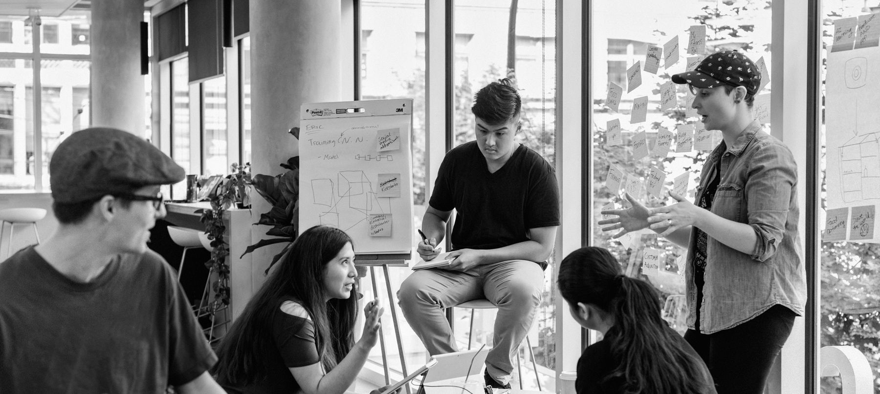

SIMON FRASER UNIVERSITY
ANDREW PETTER, SFU PRESIDENT AND VICE CHANCELLOR
Notes:
HOW TO CHANGE IMAGE:
Click on image box.
Go to “Picture Format” tab
Click “Change Picture”
FONT:
Impact, uppercase
Do not extend text outside of white section.
SUBHEADS / DAY MONTH YEAR:
Trebuchet MS, bold, uppercase

Slide 2
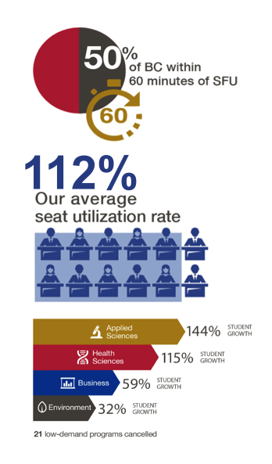
SFU: CANADA’S ENGAGED UNIVERSITY
Tri-semester system
Campuses in BC’s 3 largest municipalities
35,000 students in 8 faculties; 155,000+ alumni
Highest utilization rate of BC universities
Programs responsive to changing demand
Canada’s leading comprehensive university for 10 of last 11 years (Maclean’s)
Ashoka Changemaker Campus (1 of 45 worldwide)
Notes:
On-brand bullet points
* copy and paste to reuse *
FONT:
Header:
Impact, uppercase
Subheads and Table:
Trebuchet MS, bold, uppercase
Body:
Times, sentence-case

Slide 3
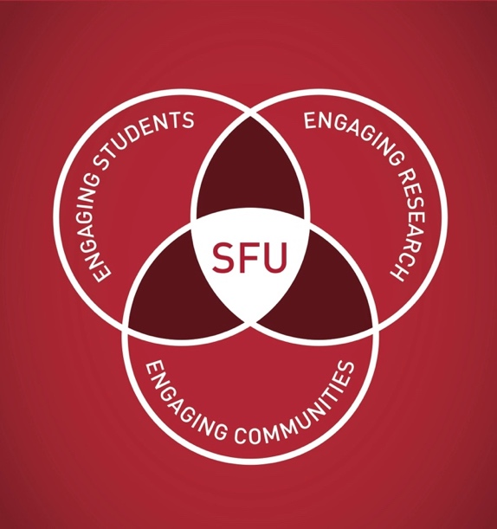
SFU: THE VISION
“To be the leading engaged university defined by its dynamic integration of innovative education, cutting-edge research, and far-reaching community engagement.”
Notes:
FONT:
Header:
Impact, uppercase
Subheads:
Trebuchet MS, bold, uppercase
Body:
Times, sentence-case
HOW TO CHANGE IMAGE:
Click on image box.
Go to “Picture Format” tab
Click “Change Picture”

Slide 4
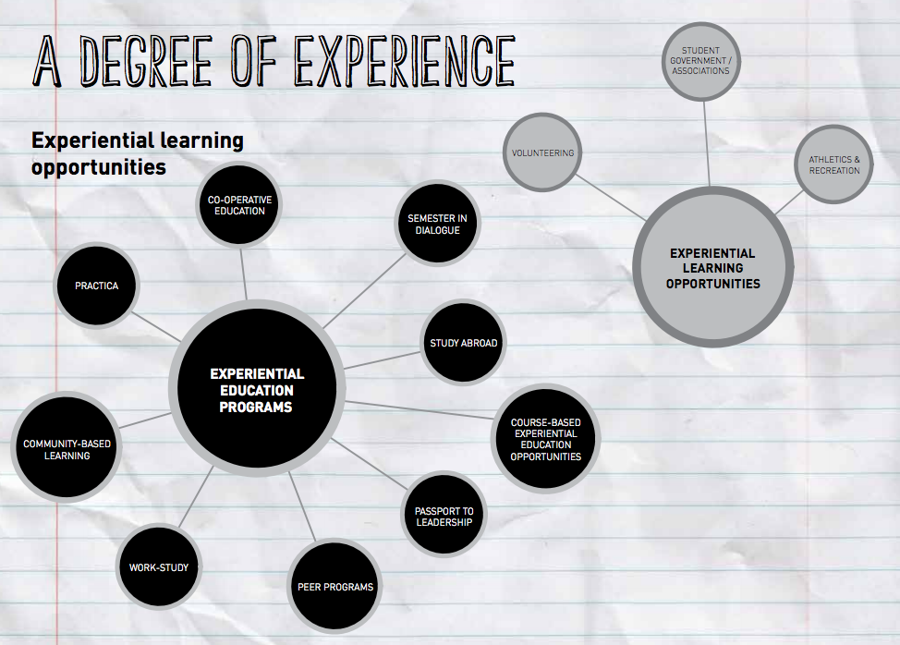
SFU: ENGAGING STUDENTS
Leader in experiential and community-based education:
9,500 co-op students annually – 25% increase in five years
Semester in Dialogue, City Studio, Change Lab
Wide range of service learning and leadership programs
Entrepreneurship certificate programs available to all undergraduate students and to graduate students in science and engineering
Venture Connection: Western Canada’s first university-wide student incubator – engaged over 8000 students
Notes:
On-brand bullet points
* copy and paste to reuse *
FONT:
Header:
Impact, uppercase
Subheads and Table:
Trebuchet MS, bold, uppercase
Body:
Times, sentence-case

Slide 5
SFU: ENGAGING RESEARCH
Over $1 billion in research funding received in the last 10 years
Community-engaged research across all faculties
SFU Innovates – university-wide innovation strategy:
    4D Labs: state-of-the-art material sciences lab
    Venture Labs: BC’s leading business accelerator
    RADIUS: social innovation lab and venture incubator
    RBC First Peoples’ Enterprise Accelerator
Strengths in Big Data and High Performance Computing
“Tech Challenger” (Times Higher Education – 1 of 55 worldwide)
Notes:
On-brand bullet points
* copy and paste to reuse *
FONT:
Header:
Impact, uppercase
Subheads and Table:
Trebuchet MS, bold, uppercase
Body:
Times, sentence-case

Slide 6
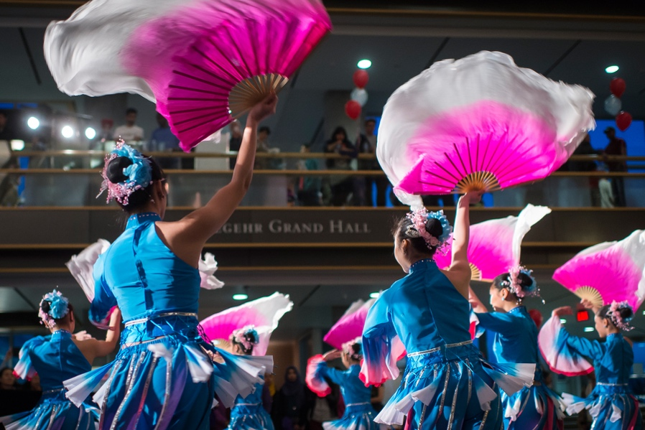
SFU: ENGAGING COMMUNITIES
  COMMITMENT TO ENGAGING AND BUILDING COMMUNITIES:
Extensive Continuing Studies Programs, including
Philosophers’ Café
Morris J. Wosk Centre for Dialogue
SFU Public Square
Vancouver and Surrey Community Engagement Centres
Community festivals:
    Burnaby Festival of Learning
    Surrey Fusion Festival
    India Summer Festival
K-12 engagement and outreach
UniverCity – a model sustainable community
Notes:
On-brand bullet points
* copy and paste to reuse *
FONT:
Header:
Impact, uppercase
Subheads and Table:
Trebuchet MS, bold, uppercase
Body:
Times, sentence-case

