Slide 1
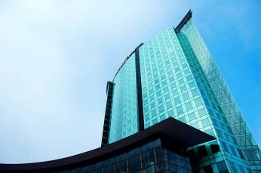
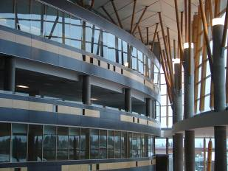
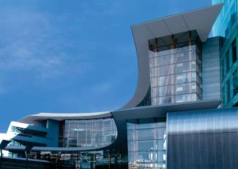
IAT 106
Spatial Thinking and Communicating
Spring 2021

Slide 2
FINAL EXAM
April 20th, Tuesday
3:30 PM – 6:30 PM

Slide 3
OnShape Quiz
March 15th, Monday
During the labs (60 mins)

Slide 4
Mechanisms
Lots of different mechanisms:
Levers
Cams
Gears
Cranks
Linkages

Slide 5
Mechanisms
Lots of different mechanisms:
Levers
Cams
Gears
Cranks
Linkages

Slide 6
Mechanism: Linkages
http://www.engr.sjsu.edu/minicurric/images/lecture_powerpoints/mechanisms.pdf

Slide 7
Mechanism: Linkages
http://www.engr.sjsu.edu/minicurric/images/lecture_powerpoints/mechanisms.pdf

Slide 8
Mechanism: Linkages
http://www.engr.sjsu.edu/minicurric/images/lecture_powerpoints/mechanisms.pdf

Slide 9
Mechanism: Linkages
http://www.engr.sjsu.edu/minicurric/images/lecture_powerpoints/mechanisms.pdf

Slide 10
Mechanism: Linkages
http://www.engr.sjsu.edu/minicurric/images/lecture_powerpoints/mechanisms.pdf

Slide 11
Terms
Floating or coupler link
Output or rocker link
Input, grounded or crank link
Ground or fixed link

Slide 12
Mechanisms: Linkages
http://en.wikipedia.org/wiki/Four-bar_linkage

Slide 13
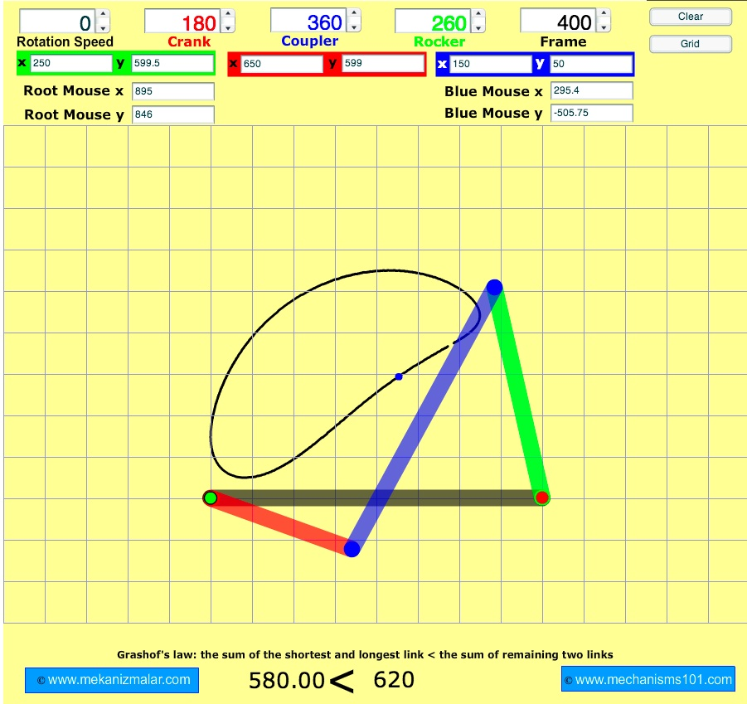
Four Bar Linkage Simulator
http://www.mekanizmalar.com/fourbar01.html

Slide 14
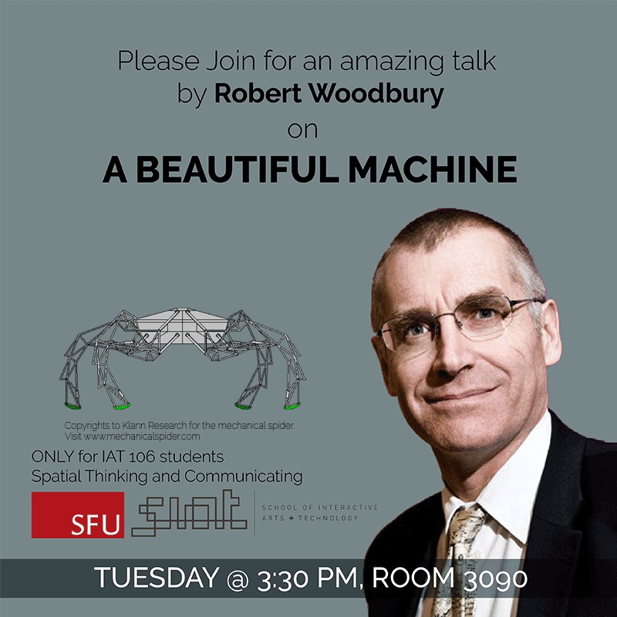
Guest Lecture
ONE image of a “simple machine” as per your understanding.
UPLOAD on Canvas → Discussion → Simple Machine.

Slide 15
See you on Monday!
Thank you!
☺

