Slide 1
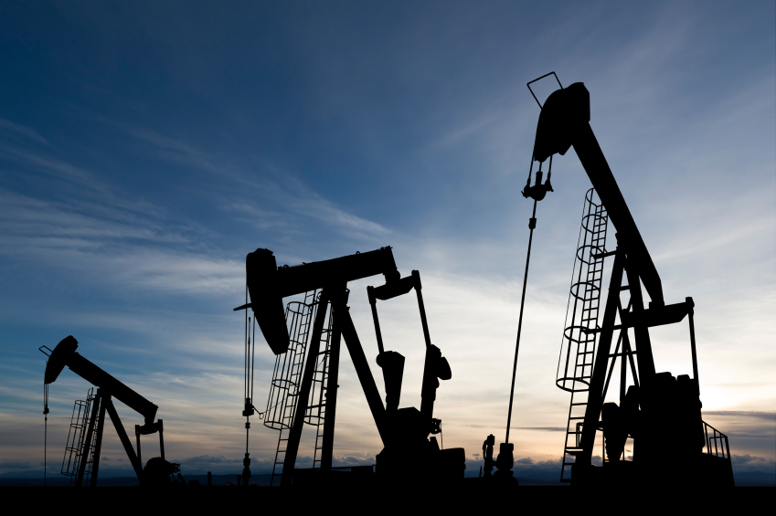
Canadian Oil & Gas
Canadian Oil & Gas
Business 419
Cecilia Mei, Binardy Tjuatja, Carmen Li, Maryam Hendi

Slide 2
Industry Overview
Oil sands-based liquids supply and shale gas production form the foundation of Canada's energy supply outlook
Conventional sources of crude oil and natural gas output are in decline, with little immediate prospect of a reversal in this trend
Long-term volumes of oil and gas protect Canada's position as a key supplier to the US
Overall Canadian liquids production will be at 3.96 million barrels per day by 2016

Slide 3
Main Trends and Developments
A threefold increase in gas power generation over the next decade - rising energy use at the oil sands facilities
Driven by the needs of oil sands industry, Canadian gas demand could rise by average of 2.3% per annum
Consumption of gas at least 110 billion cubic metres by 2020
Overall Canadian gas production will be largely unchanged from the current level by 2020, with increasing risk of an appreciable decline over the next 2 - 3 years
CAPP forecast: Significant growth in Canadian crude oil production, driven largely by oil sands

Slide 4
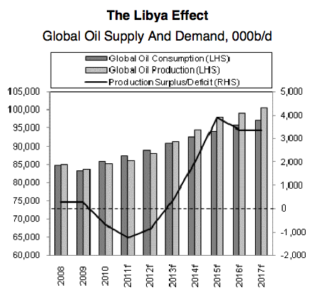
Global Energy Market Outlook
Loss of Libyan volumes in February, worries over demand outlook
Macroeconomic weakness feeds through into oil demand
Worsening macroeconomic conditions and demand destruction resulting from high oil prices, that hit oil consumption
Despite of low growth in Western economies, demand remained robust in emerging economies, led by China

Slide 5
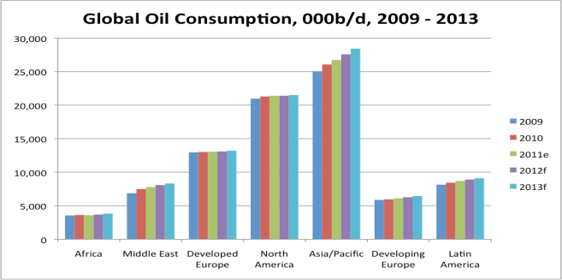
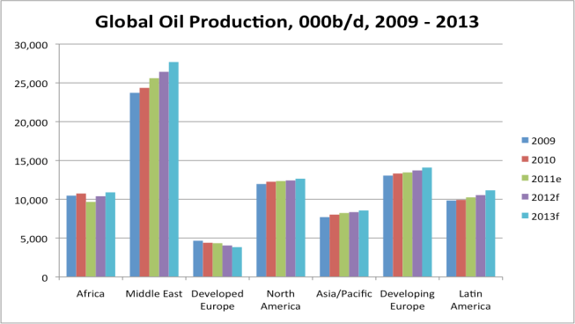

Slide 6
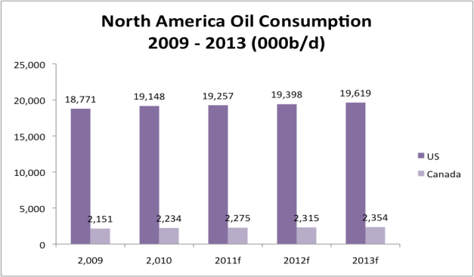
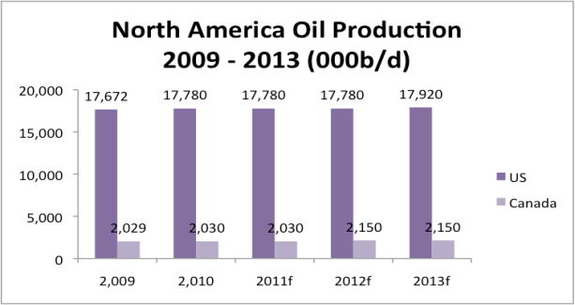

Slide 7
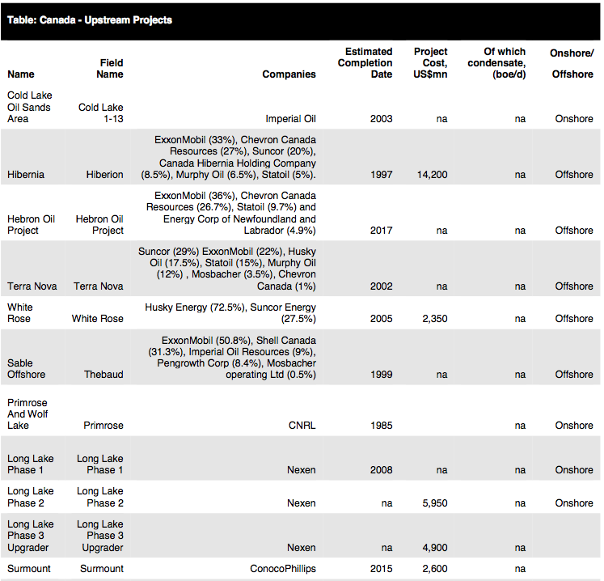

Slide 8
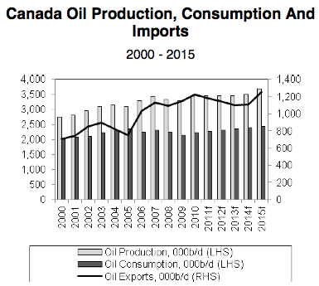
Oil Production & Consumption
The Canada-Newfoundland and Labrador Offshore Petroleum Board (C-NLOPB) approved the Exxon-led Hibernia Southern Extension project in 2010
The project seeks to bring about 220 million barrels of new reserves onstream
Conoco Phillips proceeded with the development of the Surmont oil sands project in the Athabasca area
Conoco operates Surmont under a 50:50 Joint Ventures with Total

Slide 9
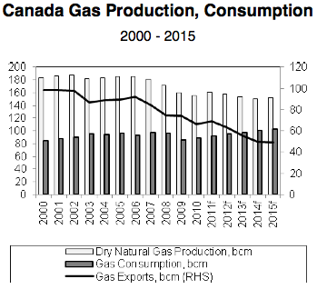
Gas Production & Consumption
Gas is the fuel of choice for residential and commercial customers in both Canada and the US
Demand from residential and commercial customers is forecast to be relatively flat, largely due to the continued replacement of older gas systems with newer ones
Rise in drilling costs and the weakness of North American gas prices undermine investment and output growth trend of Canadian gas production

Slide 10
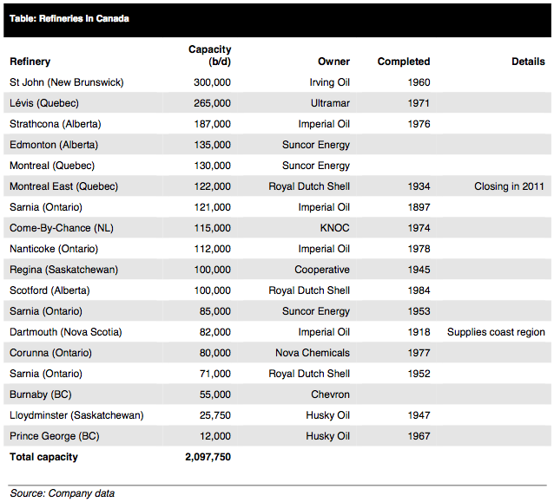
List of Refineries in Canada

Slide 11
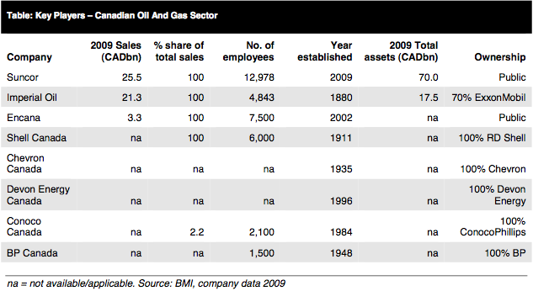
Canadian Sectors
Fully privatized energy sector, the last federal government shares in Petro-Canada sold in 2004
large, competitive upstream oil and gas segment featuring domestic independents and integrated companies

Slide 12
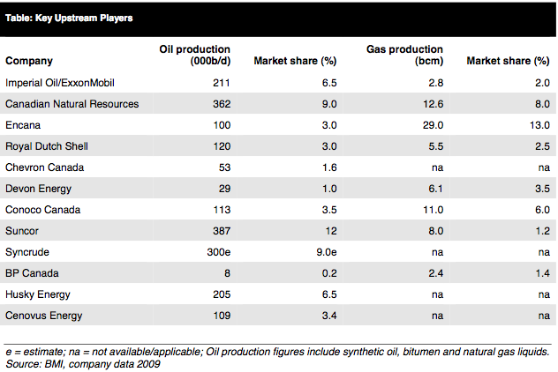
Key Upstream Players
Notes:
Suncor acquired Petro-Canada through an all-stock CAD 19 billions deal finalised in mid-2009

Slide 13
Organization of the Petroleum Exporting Countries (OPEC)
Permanent inter-governmental organization of 12 oil-exporting developing nations that coordinates and unifies petroleum policies of its member countries
OPEC Secretariat, the executive organ and headquarter of OPEC is located in Vienna
Founded in Baghdad in September 1960 by five countries during a time of transition marked by extensive decolonization and the birth of many new independent states in the developing world

Slide 14
Regulatory Environment
National Energy Board (NEB): Independent federal agency established in 1959 by the Parliament of Canada to regulate international and interprovincial aspects of the oil, gas and electric utility industries
Provincial and Federal Government

Slide 15
Canadian Association of Petroleum Producers (CAPP)
The voice of Canada's upstream oil, oil sands and natural gas industry
Represents member companies that produce about 90 per cent of Canada’s natural gas and crude oil
Mission: to enhance the economic sustainability of the Canadian upstream petroleum industry in a safe and environmentally and socially responsible manner, through constructive engagement and communication with governments, the public and stakeholders in the communities in which we operate

Slide 16
Major Risk Factors
Operational Risk - Arising from execution of company's business functions.
Reserve Replacement - Feasibility of extraction and production, contingent resources.
New Operational Challenges, unfamiliar environments - Due to increased E&P in Arctic and deep-water areas.
Environmental Regulations
Competition from new technologies, alternative fuels

Slide 17
Major Risk Continued
Human Capital Deficit - insufficient growth in human resources
The Economy and Price Volatility
Political Events
Credit and Liquidity Risk
Interest Rate and Foreign Exchange risk

Slide 18
How Risk Can Be Measured
Qualitative Techniques
Risk mapping
Probability impact table
Quantitative Techniques
Decision Trees
Monte Carlo Simulation
Sensitivity Analysis
Probability Estimates
Value at Risk (VaR)

Slide 19
Risk Management Instruments
OTC Forward Contractsž
Exchange-Traded Energy Futures
FX Futures and Interest Rate SWAPSž
Price Risk Hedging through Options and SWAPS:
Fixed for Floating Swaps
Participation Swaps
Spread Swaps
Caps and Floors
Costless Collars (most popular choice)

Slide 20
Risk Management Instrument continued…
Hybrid Strategies:
Extendable swaps
Double-up or double-down swaps
Participating collars
Swap options (Swaptions)
Cross-commodity indexed swaps
Range swaps (or other instruments utilizing digital options)
Barrier or "knock-out" options

Slide 21
Other Techniques for Risk Management:
Insurance
Management and Employee stock options and
warrants as part of compensation
Business Diversification

Slide 22
Potential Hazards: Risk Management
Forward Contracts:
Difficult to find counterparty (no liquidity)
Requires tying up capital
Subject to default risk
Futures Contracts:
Written for fixed amounts and terms
Offers only a partial hedge
Subject to basis risk

Slide 23
P
PENN WEST EXPLORATION

Slide 24
Corporate Profile
Financial Portfolio
Enterprise Value | $13.2 Billion
Market Capitalization | $ 10.3 Billion
Shares Outstanding | $471 million
Total Debt | 42.9 billion
Quarterly Dividend | $0.27 per share
Market Data
TSX NYSE
Stock Symbol | PWT | PWE
Share Price | CDN $21.85 | US $21.76
Avg Daily Vol (6mo)) | 1.4 M | 2.3 M
Avg Daily Traded Value | CDN $27 M | US $42 M

Slide 25
PENN WEST
Corporate Profile

Slide 26
Management
Murray R.Nunns
President & CEO since 2008
Professional Geologist
The member of the board of director from 2005 to 2008
Compensation: $1,820,327
Hilary Foulkes
Executive Vice President & Chief Operating Officer
Over 30 years of oil and gas industry experience
Compensation: $131,293
Todd Takeyasu
Executive Vice President & Chief Financial Officer
Chartered accountant with more than 25 years of experience
Has been with Penn West since 1994
$1,320,297

Slide 27
Historical Prices

Slide 28
STRATEGY-2011 CAPITAL FOCUS

Slide 29
Business Opportunities

Slide 30
Reserves

Slide 31
Production Breakdown
Production Revenues

Slide 32
Production Revenues

Slide 36
Risk Management Philosophy
“Penn West considers price hedging of oil and natural gas production to be a careful tool of risk management. Its uses include protecting planned capital budgets, safeguarding the economics of acquisitions and providing downside cash flow protection to support planned distributions”
Hedging to fix the cost of electric power
Improving the ability to project operating costs, netbacks and cash flow
“Penn west is careful and judicious in its hedging activities in order to preserve exposure to commodity price upside and avoid unreasonable opportunity cost”

Slide 37
Business Risk Factors
Business Risk Factors
Commodity Price Risk
Foreign Currency Rate Risk
Credit Risk
Interest Rate Risk
Environmental and Climate Change
Liquidity Risk

Slide 38
Commodity Price Risk
Crude oil prices: are influenced by worldwide factors such as OPEC actions, world supply and demand fundamentals, and geopolitical events
Natural gas prices: are influenced by the price of alternative fuel sources such as oil or coal and by North American natural gas supply and demand fundamentals including the levels of industrial activity, weather, storage levels and liquefied natural gas activity
Risks Management Strategy: swaps, collars or other financial instruments up to a maximum of 50 percent of forecast sales volumes, net of royalties, for the balance of any current year plus one additional year forward and up to a maximum of 25 percent, net of royalties for one additional year thereafter

Slide 39
Commodity Price Hedging
Liquids Hedging
(As of February 22, 2012)
Natural Gas Hedging (as of January 12,2012)

Slide 40
Foreign Currency Rate Risk
Prices received for crude oil are denominated directly in US dollars, therefore realized oil prices are impacted by Canadian dollar to US dollar exchange rates.
Foreign Exchange Forward on Revenues (As of December 31 2011)
Foreign Exchange Forwards on Senior Notes (As of December 31 2011)
Cross Currency Swaps (as of December 31,2011)

Slide 41
Credit Risk
Credit risk is the risk of loss if purchasers or counterparties do not fulfill their contractual obligations
Penn West’s accounts receivable is subject to normal Credit risk, which includes the ability to recover unpaid receivables by retaining the partner’s share of production when Penn West is the operator.
For oil and natural gas sales and financial derivatives, counterparty risk is followed whereby each counterparty is reviewed on a regular basis for the purpose of assigning a credit limit and may be requested to provide security if determined to be prudent
As as December 31, 2010, the maximum exposure to credit risk was $386 million (2009- $371 million) being carrying value of the accounts receivable.

Slide 42
Interest Rate Risk
Maintains a portion of debt capital in floating-rate bank facilities
Uses financial instruments to swap floating interest rate for fixed rate
Collar interest rates
Interest Rate Swap
As of December 31 2011

Slide 43
Liquidity Risk
The risk of not being able to meet the financial liabilities as they come due.
“Management utilizes short and long-term financial and capital forecasting programs to ensure credit facilities are relatively sufficient relative to forecast debt levels, dividend and capital program levels are appropriate, and that financial covenants will be met”

Slide 44
Environmental and Climate Change Risk
Environmental legislation includes, but is not limited to, operational controls, site restoration requirements and restrictions on emissions of various substances produced in association with oil and natural gas operations.
failure to comply may result in fines and penalties
Penn West environmental programs include resource conservation, stakeholder communication, water management and site abandonment/reclamation.
“We are dedicated to reducing the environmental impact from our operations”

Slide 45
Financial Instruments (December 31,2010)

Slide 46
Sensitivity Analysis

Slide 47
Risk Management Effects

Slide 48
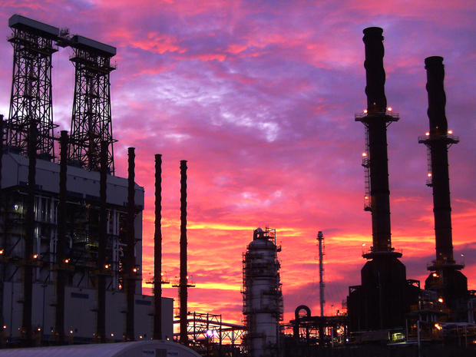
Canadian Natural Resources Ltd.

Slide 49
Company Profile
Founded in Calgary, Alberta (1973)
North America and International crude oil and natural gas exploration and production
Operates across North America, and internationally
One of the largest heavy oil producer in Canada – 15% production growth in crude oil over 2009 levels
Second largest independent natural gas producer in Canada
Notes:
Essential to this growth was the company’s record drilling program of 654 net primary heavy crude oil wells where it grew production by 8%.

Slide 50
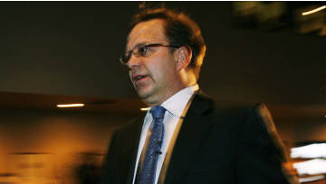
Management
Steve W. Laut
President & Director
Bachelor of Science in Mechanical Engineering
Joined CNR Ltd. In 1991
President since April 2005
Compensation for 2010: $13,136,280
Douglas A. Proll, CA
CFO/Senior VP Finance Since April 2010
Previously: Senior VP Finance of Renaissance Energy (until August 2010) and VP Finance of Husky Energy Inc. (2000-2001)
Compensation for 2010: $3,691,503
Tim S. McKay
COO
Since January 2003
Compensation for 2010: $4,536,677
Notes:
President: Steve W. Laut
CFO/Senior VP Finance: Douglas A. Proll
COO: Tim S. McKay
Compensation for 2010
Total: $13,136,280
Of which:
Salary: $586,923
Option Awards: $6,990,000
Non-Equity Incentive Plan Compensation: $4,022,930
All Other: $1,526,427

Slide 51
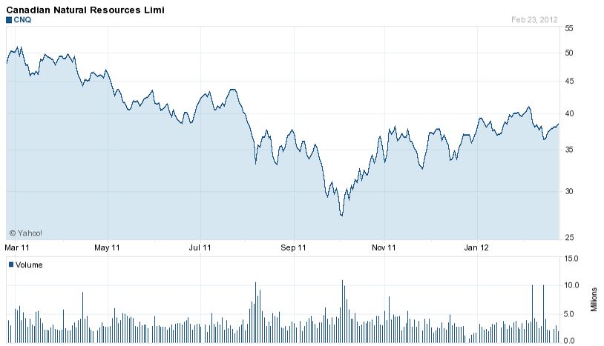
Historical Prices: NYSE

Slide 52
Trading and Share Statistics

Slide 53
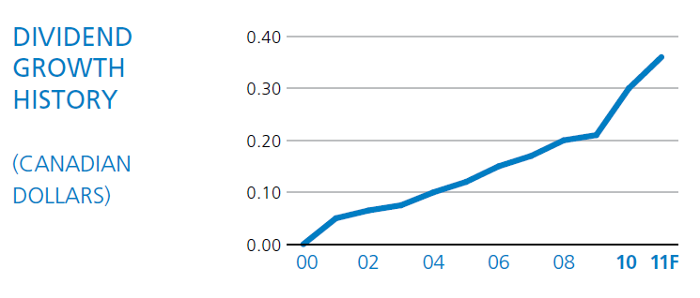
Dividend Growth History
11 consecutive years of dividend increases

Slide 54
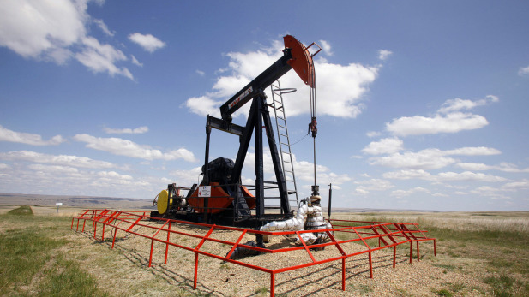
Growth Strategy: Thermal Oil
Large, high quality land base in the Cold Lake and Athabasca region of Alberta
Target to grow production capacity from 120,000 (current) to 445,000 bbl/d by 2024.
30,000 to 60,000 bbl/d addition every 2-3 years
Notes:
*Canadian Natural is entering the next stage of evolution where prior capital spending begins to turn into significant free cash flow generation. At the same time the Company maintains a vast number of projects that will provide value growth for decades.

Slide 55
Natural Gas
One of the largest natural gas producers in Western Canada
As at 2010, 1.2 billion cubic feet per day of natural gas produced
However, due to unfavourable natural gas pricing, the company will reduce its natural gas drilling program.
Drilling program now is only 8% of what it used to be 5 years ago

Slide 56
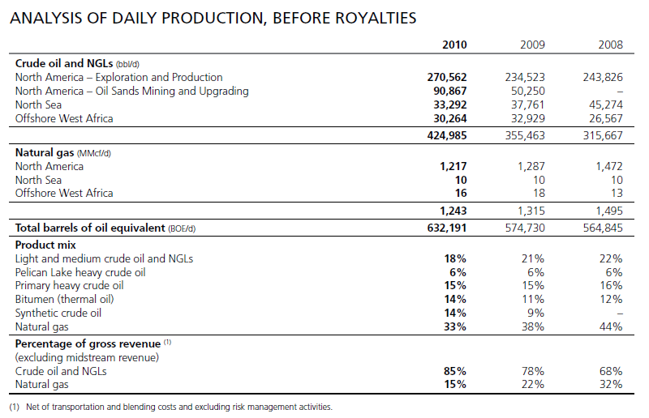
Analysis of Daily Production
Notes:
**NOTE:
bbl/d = barrels/day
BOE = barrels of oil equivalent
MMcf/d =million cubic feet per day
NGL = Natural Gas Liquids

Slide 57
Consolidated Balance Sheet As at December 31, 2010

Slide 58
Consolidated Income Statement December 31, 2010
Notes:
**Realized portion

Slide 59
Consolidated Comprehensive Income FYE December 31, 2010
Notes:
**Unrealized portion in OCI

Slide 60
Consolidated Statement of Cash Flows

Slide 61
Risk Management Philosophy
The company utilizes various derivative financial instruments to manage its commodity price, foreign currency and interest rate exposures. These derivative instruments are not intended for trading or speculative purposes.
Notes:
All derivative financial instruments are recognized in the consolidated balance sheets at their estimated fair
value as determined based on appropriate internal valuation methodologies and/or third party indications.
Fair values determined using valuation models require the use of assumptions concerning the amount and timing of future cash flows and discount rates.

Slide 62
Risk Management Gains and Losses
Net Gains (losses) from risk management activities for the year ended Dec 31 in $million:
 | 2010 | 2009 | 2008
Net realized risk management gain (loss) | (96) | (1,253) | 1,860
Net unrealized risk management gain (loss) | (25) | 1,991 | (3,090)
 | (121) | 738 | (1,230)
Notes:
All derivative financial instruments are recognized in the consolidated balance sheets at their estimated fair
value as determined based on appropriate internal valuation methodologies and/or third party indications.
Fair values determined using valuation models require the use of assumptions concerning the amount and timing of future cash flows and discount rates.

Slide 63
Financial Risk Factors
Market Risk – Risk that the fair value or future cash flows of a financial instrument will fluctuate due to changes in market prices. Commodity Price Risk, Interest Rate Risk, Foreign Currency Exchange Risk
Credit Risk – Risk that a party to a financial instrument will fail to discharge an obligation
Liquidity Risk – Risk that the company will have difficulties meeting its financial liabilities
Notes:
Market risk is the risk that the FV of future CFs of a financial instrument will fluctuate because of changes in market prices

Slide 64
Derivative Instruments for Hedging Market Risk
Commodity Risk
Commodity Hedging
Interest Rate Risk
Interest Rate Swaps
Foreign Exchange Risk
Cross Currency Swaps
Notes:
The Company’s outstanding commodity derivative financial instruments are expected to be settled monthly based on the applicable index pricing for the respective contract month.

Slide 65
Commodity Price Hedging
Commodity derivative instruments are used to hedge exposure to commodity price risk associated with the sale of future crude oil and natural gas production, and with natural gas purchases.
Outstanding derivatives as at December 31, 2010:
Notes:
WTI = West Texas Intermediate (grade of crude oil used as benchmark/index in oil pricing)
AECO = Alberta Natural Gas Reference Price (monthly weighted average field price of all Alberta gas sales)
As at December 31, 2010, in accordance with the policy, approximately 11% of budgeted crude oil volumes were hedged using collars for 2011. Further details related to the Company’s commodity related derivative financial instruments outstanding at December 31, 2010 are discussed in note 12 to the Company’s consolidated financial statements.

Slide 66
Commodity Price Hedging
The Company’s commodity hedging program reduces the risk of volatility in commodity prices and supports the Company’s cash flow for its capital expenditures programs.
Hedging up to 60% of near 12 months budgeted production and up to 40% of the following 13 to 24 months estimated production

Slide 67
Interest Rate Management
Interest Rate Swaps are used to manage fixed floating interest rate mix on a portion of the company’s long-term debt .
Notes:
Manage fixed floating interest rate mix on a portion of the company’s long-term debt.
The Company is exposed to interest rate price risk on its fixed rate long-term debt and to interest rate cash flow risk on its floating rate long-term debt. The Company periodically enters into interest rate swap contracts to manage its fixed to floating interest rate mix on long-term debt. The interest rate swap contracts require the periodic exchange of payments without the exchange of the notional principal amounts on which the payments are based.

Slide 68
Interest Rate Swaps
The Company is exposed to interest rate price risk on its fixed rate long-term debt and to interest rate cash flow risk on its floating rate long-term debt.
Interest rate swap contracts outstanding as at December 31, 2010:

Slide 69
Foreign Exchange Rate Risk Management
The company is exposed to foreign currency exchange rate risk due to:
Its US dollar denominated long-term debt and working capital
Transactions conducted in other currencies in its subsidiaries
Carrying value of its self-sustaining foreign subsidiaries
Notes:
The net unrealized gain for each of the periods presented included the impact of cross currency swaps (three months ended September 30, 2011 – unrealized gain of $150 million, June 30, 2011 – unrealized loss of $16 million, September 30, 2010 – unrealized loss of $62 million; nine months ended September 30, 2011 – unrealized gain of $84 million, September 30, 2010 – unrealized loss of $30 million).
The net realized foreign exchange gain for the nine months ended September 30, 2011 was primarily due to the settlement of the 6.7% US dollar denominated debt securities and foreign exchange rate fluctuations on settlement of working capital items denominated in US dollars or UK pounds sterling. The Canadian dollar ended the third quarter at US$0.9626 (June 30, 2011- US $1.0370; December 31, 2010 – US$1.0054; September 30, 2010 – US$0.9711).

Slide 70
Cross Currency Swaps
The company enters into cross currency swaps to manage its foreign exchange risks
Cross currency swap contracts outstanding as at December 31, 2011:

Slide 71
Financial Instrument Sensitivities
Notes:
WTI = West Texas Intermediate (grade of crude oil used as benchmark/index in oil pricing)
AECO = Alberta Natural Gas Reference Price (monthly weighted average field price of all Alberta gas sales)

Slide 72
Sensitivity Analysis: 2010 Annualized
Notes:
Each separate line item in the sensitivity analysis shows the effect of a change in that variable only with all other variables being held constant.
WTI = West Texas Intermediate (grade of crude oil used as benchmark/index in oil pricing)
AECO = Alberta Natural Gas Reference Price (monthly weighted average field price of all Alberta gas sales)
bbl/d = barrels/day
MMcf/d =million cubic feet per day

Slide 73
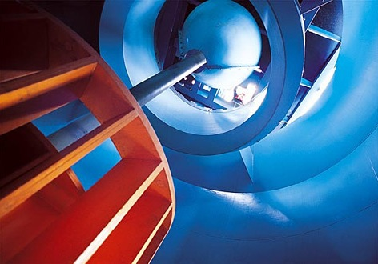
Canadian Oil & Sands

Slide 74
Corporate Overview
Sole income producing asset is its percentage ownership share in Syncrude
36.74% ownership in the Syncrude Project
Syncrude is a leader in Canada’s oil sands industry, operating since 1978 with a productive capacity today of 350,000 barrels per day of light, high-quality crude oil.

Slide 75
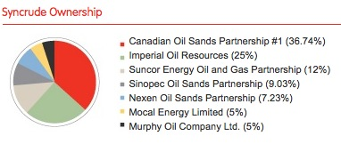
Syncrude Ownership

Slide 76
Reserves and Resources

Slide 77
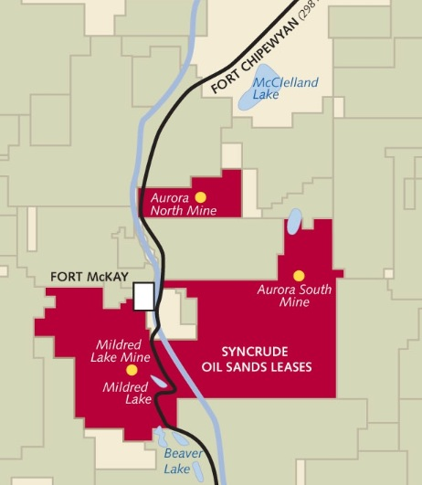
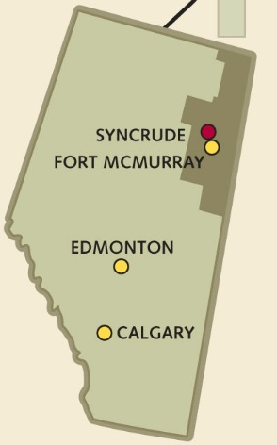
Oil Sands Lease Map

Slide 78
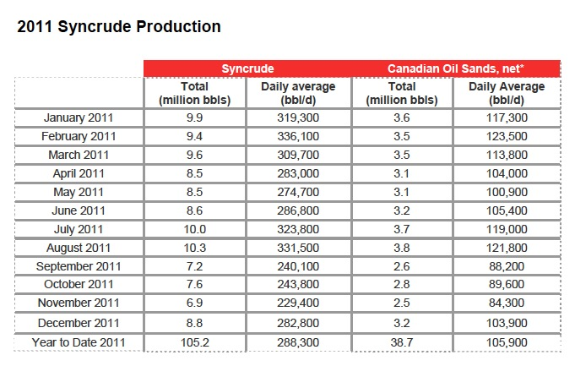
2011 Syncrude Production

Slide 79
Management
Marcel R. Coutu.
President and Chief Executive Officer
Chairman of the Board of Syncrude Canada Ltd
More than 25 years of experience in the energy sector
Compensation: C$3,485,730
Ryan M. Kubik
Chief Financial Officer
Chair of the Syncrude Joint Venture Audit and Business Controls Sub-Committee.
Prior work experience: senior finance positions with EnCana Corporation, PanCanadian Energy and PricewaterhouseCoopers
Compensation: C$1,026725
Allen R. Hagerman
Executive Vice President
Responsible for overseeing Canadian Oil Sands’ crude oil marketing operations
More than 25 years of experience in the financial management of energy companies
Compensation: C$485,230

Slide 80
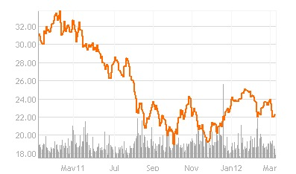
Historical Price

Slide 81
Financial Strategy
Aim to maintain a strong balance sheet with relatively low debt levels when not funding growth project
Direct the cash the corporation generate to fund growth opportunities.
However, during periods of lower investment, the corporation return that cash to investors.
This strategy has underpinned the ability to deliver strong returns to
investors, averaging 25% annual total return since 1995.

Slide 82
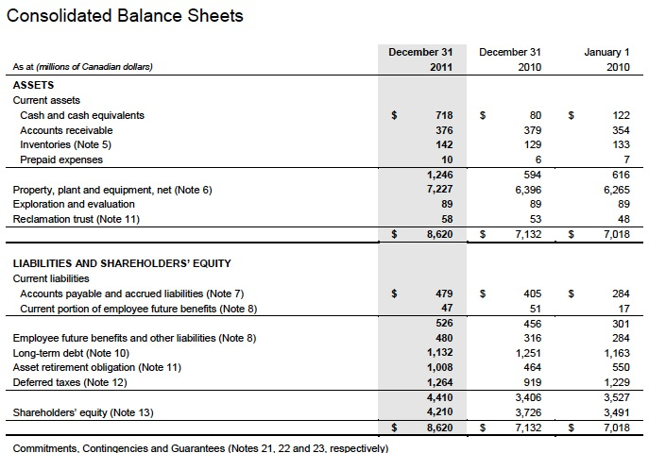

Slide 83
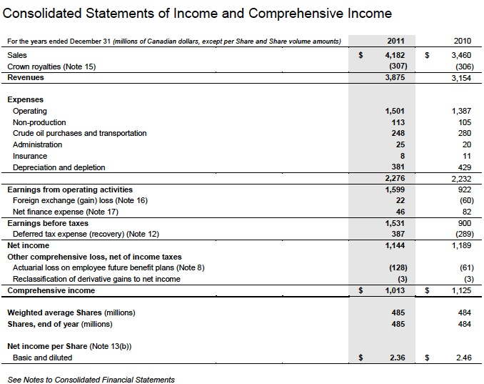

Slide 84
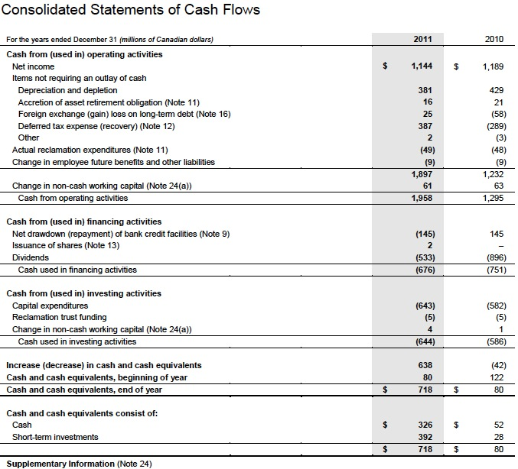

Slide 85
Sensitivity Analysis

Slide 86
Risk Management Philosophy
“Canadian Oil Sands prefers to remain un-hedged on crude oil prices; however, during periods of significant capital spending and financing requirements, management has in the past, and may again, hedge prices and exchange rates to reduce revenue and cash flow volatility to the Corporation. Canadian Oil Sands did not have any crude oil price hedges in place for 2010 or 2009. Instead, a strong balance sheet was used to mitigate the risk around crude oil price movements. As at February 23, 2011, and based on current expectations, the Corporation remains un-hedged on its crude oil price exposure.”
-- Canadian Oil Sands, Annual Report (2010)

Slide 87
Risk Management Philosophy
“There are a number of risks that could impact Canadian Oil Sands’ net income and cash from operating activities and, therefore, the dividends ultimately paid to Shareholders. Cash from operating activities is highly sensitive to a number of factors including: Syncrude production; sales volumes; oil and natural gas prices; price differentials; foreign currency exchange rates; operating, administrative, and financing expenses; non-production costs; Crown royalties; and regulatory and environmental risks. Dividends may also be impacted by Canadian Oil Sands’ financing requirements for capital expenditures.”
--COS Annual Report

Slide 88
Risk Management Philosophy
Purchased natural gas is a significant component of the bitumen production and upgrading processes. Increases in natural gas prices, therefore, introduce the risk of higher operating costs. Similar to crude oil prices, monthly average AECO natural gas prices have experienced significant movements over the last three years, ranging from a high of $11.15 per GJ to a low of $1.92 per GJ. To the extent crude oil and natural gas prices move together, the risk of natural gas price increases is mitigated, as the Corporation is significantly more levered to oil price increases. The main risk involves a de-linking of crude oil and natural gas price movements. The Corporation has previously used hedge positions to mitigate natural gas price risk and will continue to assess this strategy as a means to manage short-term operating costs. No natural gas price hedges were utilized in 2010 or 2009 and as at February 23, 2011, there were no natural gas price hedges in place

Slide 89
Risk Management Philosophy
In the past, the Corporation has hedged foreign currency exchange rates by entering into fixed rate currency contracts. The Corporation did not have any foreign currency hedges in place during the first nine months of 2011 or 2010, and does not currently intend to enter into any new currency hedge positions. The Corporation may, however, hedge foreign currency exchange rates in the future, depending on the business environment and growth opportunities.

Slide 90
Risk Management Philosophy
Our revenue exposure [to changes in the US to Canadian dollar exchange rate] is partially offset by U.S. dollar obligations, such as interest costs on U.S. dollar denominated long-term debt (Senior Notes) and our share of Syncrude’s U.S. dollar vendor payments. In addition, when our U.S. dollar Senior Notes mature, we have exposure to U.S. dollar exchange rates on the principal repayment of the notes. This repayment of U.S. dollar debt acts as a partial economic hedge against the U.S. dollar denominated revenue payments we receive from our customers.

Slide 91
Risk Management Philosophy
Canadian Oil Sands’ net income and cash flow from operations are impacted by U.S. and Canadian interest rate changes because our credit facilities and investments are exposed to floating interest rates. In addition, we are exposed to the refinancing of maturing long-term debt at prevailing interest rates. As at September 30, 2011, there were no amounts drawn on the credit facilities ... and the next long-term debt maturity is in August 2013. The Corporation did not have a significant exposure to interest rate risk based on the amount of floating rate debt or investments outstanding during the quarter.

Slide 92
Financial Risk Factors
Commodity Risk
Crude Oil Price Risk
Natural Gas Price Risk
Operational Risk
Capital Expenditure Risk
Financial Market Risk
Foreign Currency Risk
Interest Rate Risk
Liquidity Risk
Credit Risk
Syncrude Joint Venture Ownership Risk
Marketing and Transportation of Synthetic Crude Oil Risk
Environmental Risk

Slide 93
Commodity Risk
Over the last three years, daily WTI prices and natural gas prices have experienced significant volatility,
ranging from U.S. $114 per barrel to U.S. $34 per barrel. (WTI prices)
The Corporation did not have any crude oil price nor natural gas price hedges in place during 2011 or 2010. Instead, a strong balance sheet was used to mitigate the risk around crude oil price movements.

Slide 94
Operational Risk
Equipment failures
Operator errors
Weather-related shutdowns
Catastrophic events

Slide 95
Capital Expenditure Risk
Capital maintenance
historically minimized this risk by accessing diverse funding sources, including credit facilities and cash from operating activities
Estimating costs for major projects
typically evolve over time and updates for timing and cost estimates are often provided during project construction

Slide 96
Foreign Currency Risk
Affected by fluctuations in the U.S./Cdn currency exchange rates
WTI benchmark price in U.S. dollars while operating expenses and capital expenditures are denominated primarily in Canadian dollars
In the past, the Corporation has hedged foreign currency exchange rates by entering into fixed rate currency contracts. The Corporation did not have any foreign currency hedges in place at December 31, 2010, and as at February 23, 2011, we do not intend to enter into any new currency hedge positions. The Corporation may, however, hedge foreign currency exchange rates in the future, depending on the business environment and growth opportunities.

Slide 97
Interest Rate Risk
Impacted by U.S. and Canadian interest rate changes because our credit facilities and investments are exposed to
Exposed to the refinancing of maturing long-term debt at prevailing interest rates
As at December 31, 2010, $145 million was drawn on the credit facilities ($nil – December 31, 2009) and the next long-term debt maturity is in 2013.

Slide 98
Liquidity Risk
Actively manages its liquidity through cash, debt and equity management strategies

Slide 99
Credit Risk
Canadian Oil Sands is exposed to credit risk primarily through its trade accounts receivable balances with customers, with financial counterparties with whom the Corporation has invested its cash and from whom it has purchased term deposits, and with its insurance providers in the event of an outstanding claim.
Mitigated as accounts receivable with customers typically are settled in the month following the sale.
The Corporation’s maximum credit exposure related to customer receivables was $354 million at December 31, 2010 (2009 - $329 million).

Slide 100
Syncrude Joint Venture Ownership Risk
Syncrude is a joint venture that is currently owned by seven participants with varying interests.
the obligations of the Syncrude owners are stated to be joint and not several under the terms of the joint venture agreement, a number of the environmental regulatory requirements impose joint and several liability on all land owners and, as such, the Syncrude owners.
Mitigating this is the credit strength of the other joint venture owners, as well as the ability of the joint venture owners to take the production of any defaulting joint venture owner to satisfy any such obligation

Slide 101
Marketing and Transportation of Synthetic Crude Oil Risk
If the regional or global supply of crude oil or refined products increases, if North American demand for crude oil or refined products decreases, or if planned or unplanned shutdowns of refineries occurs, then the price received for our SCO or our ability to deliver our SCO may be limited with negative implications on revenues and cash from operating activities.

Slide 102
Environmental Risk
Tailings Management
Fine tailings, a byproduct of the oil sands mining extraction process, are comprised of silts, clays and hydrocarbon residues (collectively “fines”) suspended in water
Greenhouse Gas Emissions
The Syncrude operations emit greenhouse gases so legislation or regulations that significantly restrict or penalize current emission levels could have a material impact on our operations. The costs of meeting such thresholds would increase operating costs and/or capital costs, and as such, may impact the profitability of the operations.

Slide 103
Risk Management Effect
As at December 31, 2010 and 2009, respectively, Canadian Oil Sands had no financial risk management positions outstanding.

Slide 104
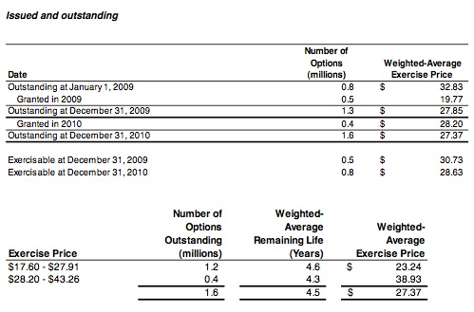
Employee Stock Option

Slide 105
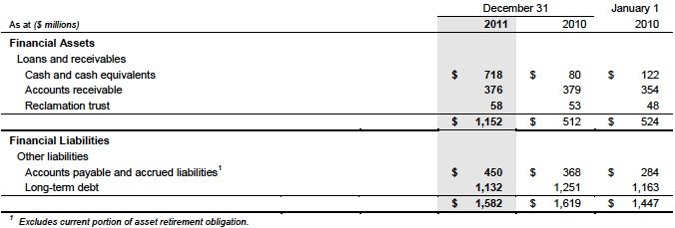
Financial Instrument
The Corporation’s financial instruments include cash and cash equivalents, accounts receivable, reclamation trust investments, accounts payable, accrued liabilities and long-term debt. The carrying values of the Corporation’s financial instruments and their related categories at December 31, 2011 and 2010 and January 1, 2010 were as follows:

Slide 106
THANK YOU！

