Slide 1
Global Airlines
Presented by:Wayne Hung
Alice Yuan
Oscar

Slide 2
Agenda
Industry
History & Regulation
Modes
Industry Analysis
Ryanair
Cathay Pacific
Southwest

Slide 3
terminology
ATK: Available Tonne Kilometer (Capacity) capacity in tonnes × km flown
ASK: Available Seat Kilometer (Capacity) Number of seats X kilometers flown
RPK: Revenue Passenger Kilometer (Traffic) Number of paying passengers X kilometers flown
LF: Load Factor (Capacity Utilization) RPK / ASK
Break Even Load Factor: Unit cost / Yield Operating cost = Operating Revenue
FTK: Freight Tonne Kilometer (Traffic) Freight tonnes carried X kilometers flown
YIELD: Revenue / Revenue Passenger Kilometer

Slide 4
History and Regulation

Slide 5
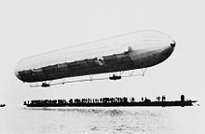
History
Deutsche Luftschiffahrts-Aktiengesellschaft was the world's first airline, founded on November 16, 1909 in German.

Slide 6
Regulation Shaping the Industry 1918 - 1945
1911: demonstrations of airplane mail service were made in India, England and the United States.
1918: May 15, the first air mail route in the United States was established between New York, N. Y., and Washington, D. C.
1924:coast to coast air travel had been developed.
1925: Contract Air Mail Act -> Air mail went to private ownership.

Slide 7
Regulation Shaping the Industry 1918 - 1945
1926: Air Commerce Act for Safety improvements
1934 Bureau of Air Commerce for Air traffic Control
1940 Two agencies:
Civil Aeronautics Administration (CAA) →Air traffic control
Civil Aeronautics Board (CAB) →Economic regulation:
Ensure adequate Service (Regulate entry and exit of carriers)
Regulate fares
Regulate schedules

Slide 8
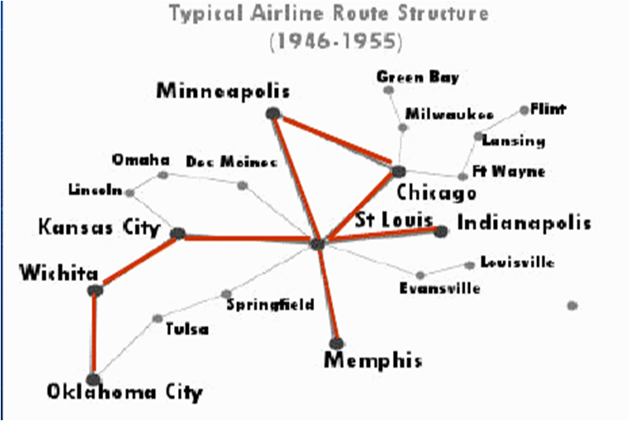
After WWII
Open skies competition for international routes
Open skies refers to a libateral Air Transport Agreement which
Liberalizes the rules for international aviation markets and minimizes government intervention
Adjusts the regime under which military and other state-based flights may be permitted
Notes:
change

Slide 9
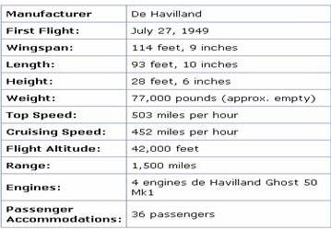
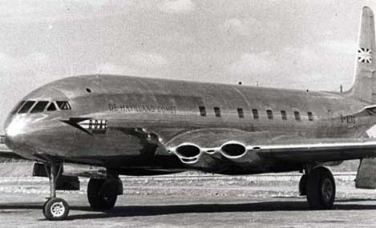
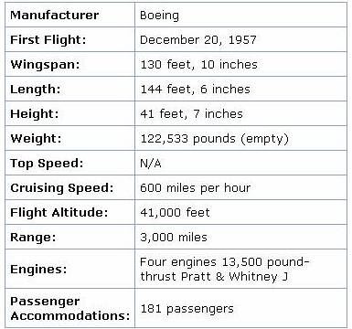
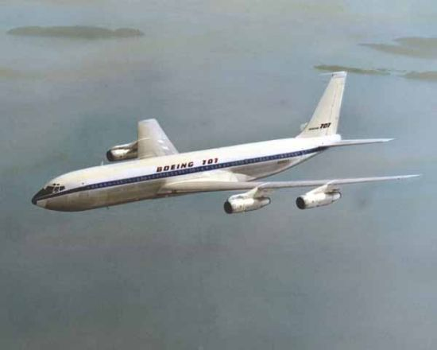
The Jet Era: 1950’s – 1960’s De Havilland Comet (First Commercial flight, May 2, 1952 - London to Johannesburg)
Boeing 707

Slide 10
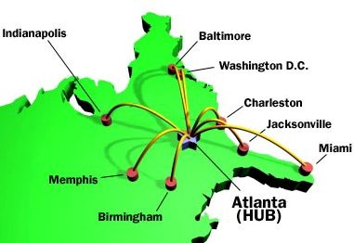
Airline Deregulation Act of 1978
The Airline Deregulation Act is a United States federal law signed into law on October 24, 1978.
The main purpose of the act was to remove government control over fares, routes and market entry from commercial aviation.
The Civil Aeronautics Board’s (CAB’S) powers of regulation were to be phased out, eventually allowing passengers to be exposed to market forces in the airline industry.
Hub and Spoke System implemented
Notes:
change

Slide 11
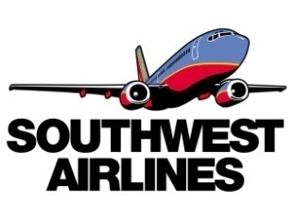
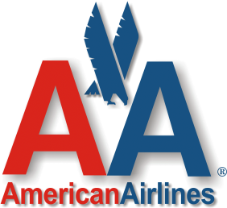
Types of Airlines
Cargo Airlines
Low Cost Airlines
Regional & National
Network- Legacy
National and International

Slide 12
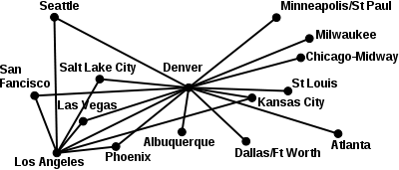
Airline Business Model
Hub and Spoke Model:
Hub is the center of this distribution, allowing passengers to be transported from one spoke to another without a direct service.
allows the airlines to maximize passenger load factor on each flight by offering connections to both domestic and international destinations.
provides customers with a much larger number of route option, which in turn maximizes revenue opportunities.
The downside to this is the increase in aircraft wait time and lower aircraft utilization time, which increases the airlines' unit cost.
Often used in international airlines: US Airways, Delta, Continental, and Northwest.

Slide 13
Airline Business Model
Point to Point Model: travels directly to a destination
based on flights that are provided to & from a city.
Unit costs are lower in this model as aircrafts are utilized more because
do not have to wait for connecting flights, faster turnaround time
Usually Short-haul: under 3 hours.
Southwest and Ryanair are examples

Slide 14
Network (Legacy) carrier
Hub and Spoke System
Higher fares
Legacy carriers typically offer:
First class/Business class
Lounges: private meeting rooms, phone, fax, wireless and Internet access and other business services
Frequent-flyer programs
Alliances
Frills/perks throughout the cabin (food, beverage, better service)

Slide 15
Low Cost Carriers
Point-to-point system
Lower fares
Single passenger class
Flying early in the morning or late in the evening to avoid air traffic delays and take advantage of lower landing fees
Unreserved seating
No frills and no alliance

Slide 16
Low Cost vs. legacy
Low Cost Airlines |  | 2003 | 2004 | 2005 | 2006 | 2007 | 2008 | 2009 | 2010
Ryanair | Return on Assets | 10.99% | 7.64% | 7.91% | 7.26% | 8.44% | 6.50% | -2.66% | 3.40%
 | EBT Margin | 31.30% | 23.40% | 24.70% | 22.20% | 21.10% | 19.80% | 3.10% | 15.30%
Southwest | Return on Assets | 4.69% | 2.95% | 4.29% | 3.61% | 4.27% | 1.15% | 0.69% | 0.69%
 | Operating Margin | 8.10% | 8.50% | 10.80% | 10.30% | 8.00% | 4.10% | 2.50% | 2.50%
WestJet | EBT Margin | 11.30% | -1.50% | 3.70% | 9.30% | 11.10% | 10.00% | 6.00% | 6.00%
 | Return on Assets | 5.35% | -1.02% | 1.17% | 4.64% | 6.75% | 5.69% | 2.90% | 2.90%
LegacyAirlines
Cathy Pacific | Return on Assets | 3.75% | 1.78% | 5.88% | 4.30% | 4.51% | 6.12% | -6.91% | -6.91%
 | EBT Margin | 14.40% | 7.50% | 13.40% | 8.10% | 8.60% | 10.30% | -9.20% | -9.20%
Delta | EBT Margin | -8.90% | -26.60% | -23.80% | -40.60% | 9.50% | -39.80% | -5.60% | -5.60%
 | Return on Assets | -3.09% | -21.67% | -18.34% | -31.29% | 6.19% | -23.04% | -2.79% | -2.79%
British Airway | Return on Assets | 0.53% | 1.01% | 2.14% | 3.84% | 2.46% | 6.04% | -3.47% | -3.47%
 | EBT Margin | 3.80% | 5.40% | 6.90% | 8.30% | 7.10% | 10.00% | -2.40% | -2.40%

Slide 17
Industry Analysis

Slide 18
Porter’s Five Forces
Threat of Entrants: Low
Huge capital investment required
High standard of safety regulation
Low Operating margin
Substitute: High
Less brand loyalty, pax choose based on price
No switching cost, little for pax who are members of airline alliance
Other alternatives: ship? Car? Walk?

Slide 19
Porter’s Five Forces
Buyer’s Bargaining Power: Low
Customers are not concentrated so no influence over price
Suppliers’ Bargaining Power : High
Only 2 aircrafts supplier: Boeing and Airbus
Switching cost is high (Retraining of pilots, knowledge of maintenances)
Airport is a must so high bargaining power

Slide 20
Porter’s Five Forces
Competition: High
Many airlines
Prices are interdependent: when one lower its price, others are likely to follow.

Slide 21
General environmental factors
Subject to fuel price as it accounts for approximately 30% operating costs.
Subject to weather. (huge snow & storm) force to cancel flights
Seasonal fluctuation. High load factor in Dec.
Limited aircraft slots in airports

Slide 22
General environmental factors
Regulation on CO2 emission
Subject to currency exchange. Purchase aircrafts from Boeing/Airbus & oil.
Terrorism actions negatively impact airlines
Occurrence of airborne disease. SARS, Swine Flu.

Slide 23
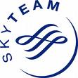
Alliance
An airline alliance is an agreement between two or more airlines to cooperate on a substantial level. The three largest passenger alliances are the Star Alliance, SkyTeam and Oneworld.

Slide 24
Benefits of Airline Alliance
An extended and optimized network
Cost reduction from sharing of
Sales offices
Maintenance facilities
Operational facilities
Operational staff
Investment and purchases
Benefits Traveler
Lower Price
More choice of departure and destination
Faster mileage reward

Slide 25
Airline Index

Slide 26
Jet Fuel Price
Notes:
Recession from the end of 07 to 08
Fuel price increase from beginning of 08 to September 08

Slide 27
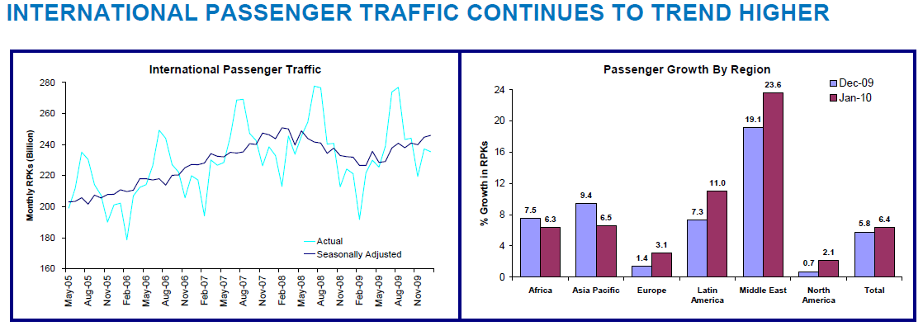
Passenger Trend

Slide 28
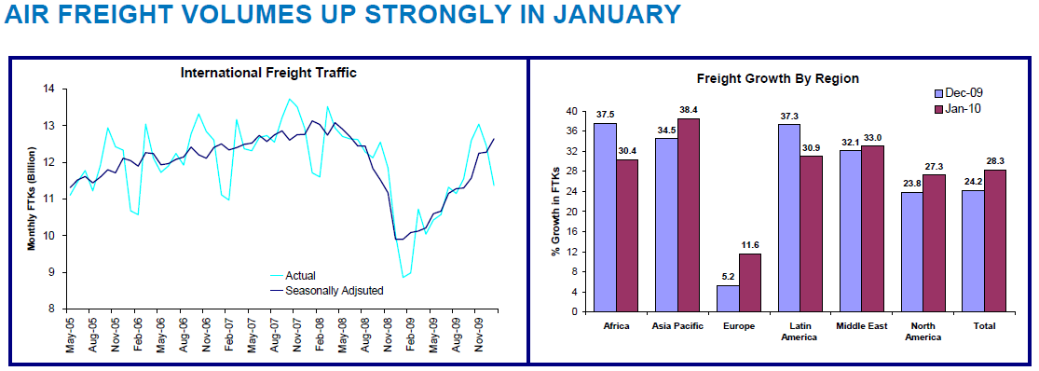
Air Freight Volume Trend

Slide 29
Passenger Load Factor

Slide 30
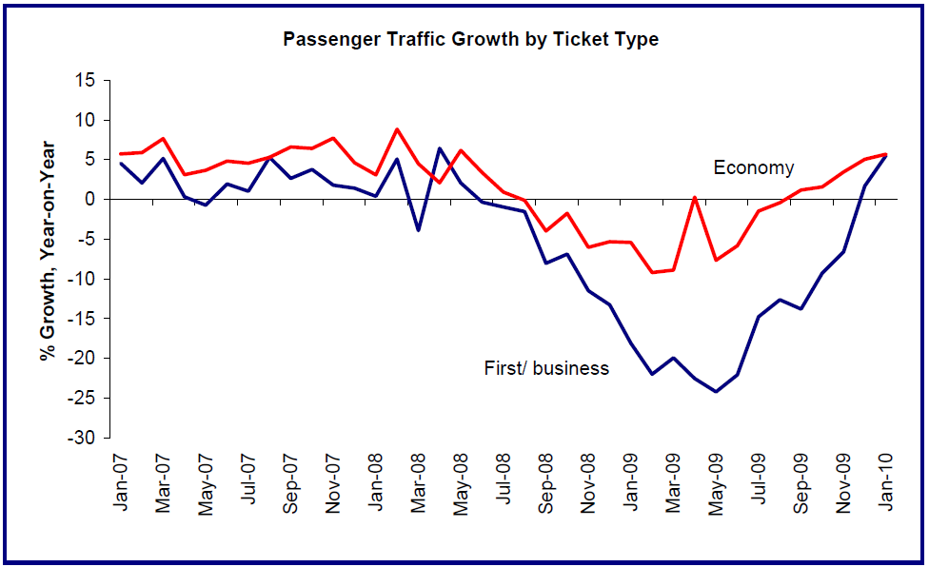
Premium Traffic Growth

Slide 31
Comparison: Premium and Economy passenger

Slide 32
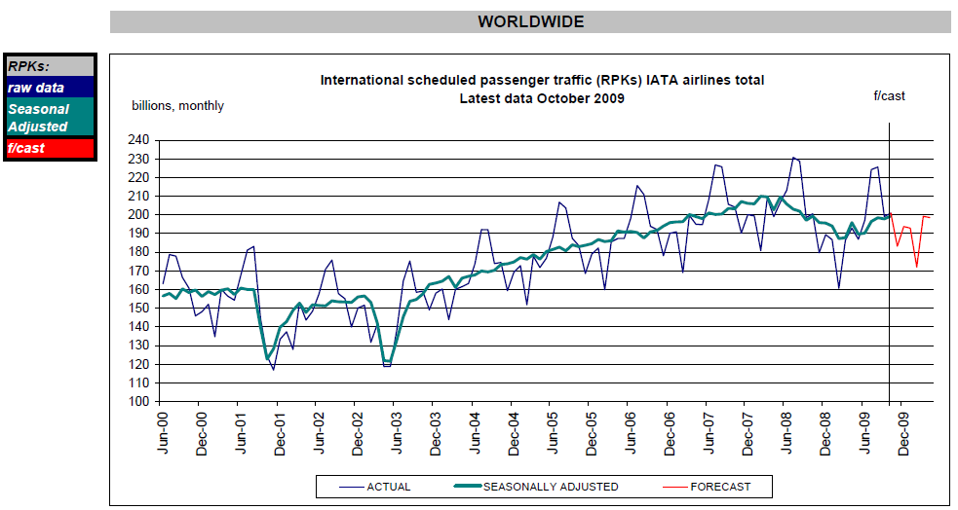
RPKs: Revenue Passenger Kilometers

Slide 33
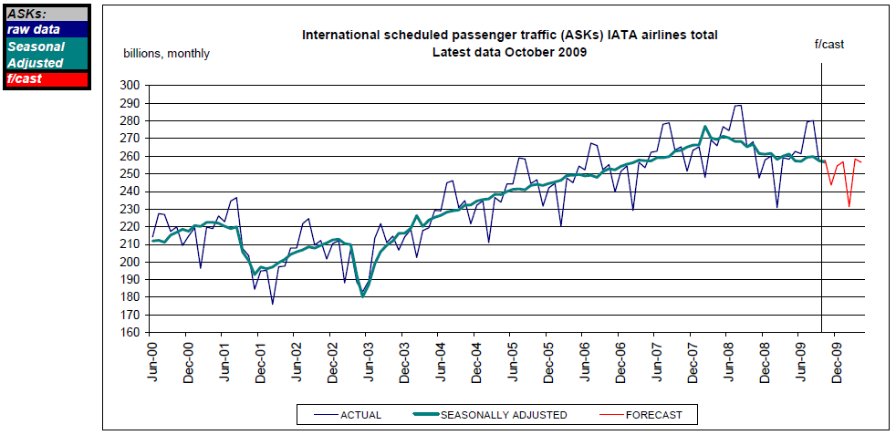
ASKs: Available Seat Kilometers

Slide 34
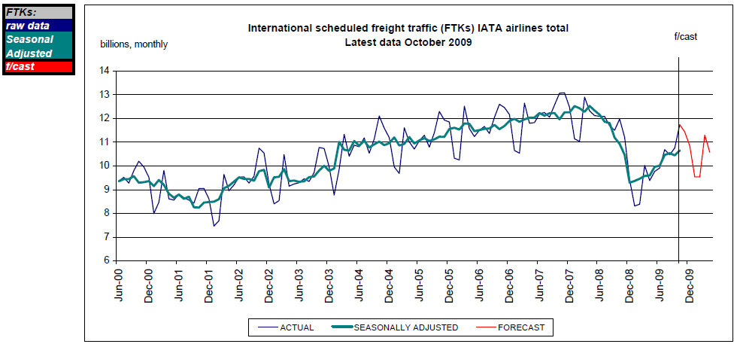
FTKs: Freight Tonnie Kilometers

Slide 36
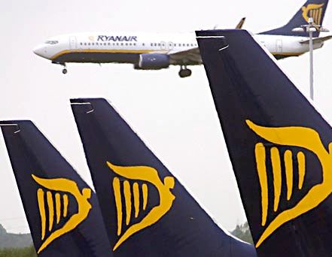
Ryanair (Ryaay)
Ryanair Holding Plc
Exchange: NASDAQ (ADR)
&LSE
Its Logo:
“The low fares airline”
“Ryanair.com The low fares website”
1 Euro=1.363 USD
Notes:
National Association of Securities Dealers Automated Quotations
London Stock Exchange

Slide 37
Ryanair Background
An Irish low cost airline, with its head office at Dublin Airport, Ireland, and with primary operational bases at Dublin Airport and London Stansted Airport.
Ryanair was founded in 1985 by Christy Ryan, Liam Lonergan, and Tony Ryan
In 1994 Development of low-cost model originated by Southwest
In 1997,deregulation of the airline industry
The above 2 factors →Ryanair began to grow rapidly!!!

Slide 38
Organization Today
Ryanairis the largest airline in Europe in terms of passenger numbers and the largest in the world in terms of international passenger numbers.
40+ bases
1000+ routes across 26 countries
Uniform Fleet of 221 Boeing 737-800 aircrafts
Over 2000 pilots

Slide 39
Ryanair Routes map

Slide 40
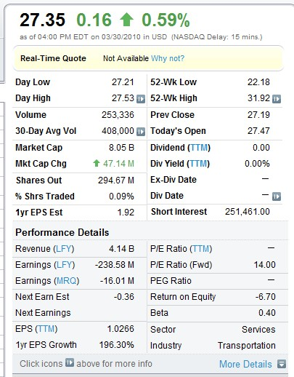
Stock Info

Slide 41
Earning Per Share
In NASDAQ (ADR) (USD)
In LSE (British Pound)
In Million | 2006 | 2007 | 2008 | 2009 | TTM
Net Income | 376.1 | 557 | 551.8 | -240.2 | 307.4
Diluted EPS$ | 1.21 | 1.79 | 1.81 | -0.81 | 1.03
Shares | 308 | 311 | 304 | 295 | 296
In Million | 2006 | 2007 | 2008 | 2009 | TTM
Net Income | 306.7 | 435.6 | 390.7 | -169.2 | 216.8
Diluted EPS$ | 0.2 | 0.28 | 0.26 | -0.11 | 0.15
Shares | 1543 | 1557 | 1524 | 1478 | 1480

Slide 42
Equity Per Share
In NASDAQ (ADR) (USD)
 | 2009 | 2008 | 2007 | 2006
Equity per share | 10.92666373 | 13.24694795 | 10.96238001 | 7.824940826
StockPrice in March 1 | 22 | 29 | 43 | 27
In LSE (British Pound)
 | 2009 | 2008 | 2007 | 2006
Equity per share | 1.640248175 | 1.654877078 | 1.666535433 | 1.27938343
Stock Price in March 1 | 3 | 3.15 | 5.6 | 3.9

Slide 43
1 year Stock Price
Notes:
20%

Slide 44
5 year Stock Price
Notes:
20.20%

Slide 45
1 year Stock Price Ryanairvs. NASDAQ

Slide 46
5 year Stock Price Ryanair vs. NASDAQ

Slide 47
The airline has been characterized by rapid expansion
As of August 31, 2007,
Serving 125 locations throughout Europe and Morocco
A fleet of 137 aircraft
Flying approximately 440 routes.
As of June 30, 2009,
Serving 145 locations throughout Europe and Morocco
A fleet of 196 aircraft
Flying approximately 845 routes
As of December 31, 2009
Serving 150 locations
a fleet of 218 aircraft
Flying approximately 1000 routes

Slide 48
Passenger Numbers
 | # of Overall Passengers Carried | # of passenger each year |  | # of Employee
1997 | 3,730,000 | 780,000 |  | 659
1998 | 4,269,000 | 539,000 | -30.90% | 892
1999 | 5,358,000 | 1,089,000 | 102.04% | 1094
2000 | 7,002,000 | 1,644,000 | 50.96% | 1,262
2001 | 9,355,000 | 2,353,000 | 43.13% | 1,467
2002 | 13,419,000 | 4,064,000 | 72.72% | 1,547
2003 | 19,490,000 | 6,071,000 | 49.38% | 1,746
2004 | 24,635,000 | 5,145,000 | -15.25% | 2,288
2005 | 30,946,000 | 6,311,000 | 22.66% | 2,700
2006 | 42,509,000 | 11,563,000 | 83.22% | 3,991
2007 | 50,931,000 | 8,422,000 | -27.16% | 5,262
2008 | 58,569,000 | 7,638,000 | -9.31% | 6,369
2009 | 66,000,000 | 7,431,000 | -2.71% | 7,000
Annual Pax number
10 times more in
Decade.
Employee # 10 times more.

Slide 49
Passenger Numbers Chart

Slide 50
Growth past 10 years
in Europe | 2000 | 2001 | 2002 | 2003 | 2004 | 2005 | 2006 | 2007 | 2008 | 2009
Revenue | 370.1 | 487.4 | 624.1 | 842.5 | 1,074.20 | 1,336.60 | 1,692.50 | 2,236.90 | 2,713.80 | 2,942.00
%Δ in revenue |  | 31.69% | 28.05% | 34.99% | 27.50% | 24.43% | 26.63% | 32.17% | 21.32% | 8.41%
COGS | 193.8 | 250.9 | 181.8 | 393.9 | 579.5 | 745.6 | 929.2 | 1,270.60 | 1,576.30 | 2,132.0
Gross Profit | 176.3 | 236.6 | 442.2 | 448.6 | 494.7 | 591 | 763.4 | 966.4 | 1,137.50 | 809.9
%Δ in GP |  | 34.20% | 86.90% | 1.45% | 10.28% | 19.47% | 29.17% | 26.59% | 17.70% | -28.80%
G&A | 48.5 | 60.7 | 219.6 | 14.6 | 16.2 | 19.6 | 16.9 | 226.6 | 302.5 | 322.1
Other | 43.8 | 61.9 | 59.7 | 170.6 | 227.2 | 242 | 371.5 | 268 | 297.9 | 395.3
Operating Income | 84.1 | 114 | 162.9 | 263.5 | 251.3 | 329.5 | 375.1 | 471.8 | 537.1 | 92.6
Net Int Inc & Other | 6 | 9.4 | 9.4 | 1.1 | -22.8 | -33.6 | -36.2 | -20.7 | -98.2 | -273.1
Earnings Before Taxes | 90.1 | 123.4 | 172.4 | 264.6 | 228.5 | 295.9 | 338.9 | 451 | 438.9 | -180.5
Notes:
Red: Rapid increase in Jet fuel price
One of the few airlines that still had a positive operating income

Slide 51
Load Factor
 | 2006 | 2007 | 2008 | 2009
Jan | 74% | 71% | 69% | 69%
Feb | 78% | 77% | 75% | 78%
Mar | 79% | 78% | 79% | 77%
Apr | 85% | 83% | 79% | 82%
May | 82% | 80% | 80% | 81%
Jun | 87% | 85% | 84% | 85%
Jul | 90% | 90% | 89% | 89%
Aug | 91% | 91% | 90% | 90%
Sep | 86% | 85% | 84% | 85%
Oct | 83% | 85% | 85% | 85%
Nov | 79% | 78% | 79% | 80%
Dec | 81% | 79% | 79% | 81%
Average | 83% | 82% | 81% | 82%

Slide 52
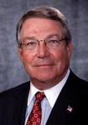
Management Team
Michael Cawley
Deputy Chief Executive; Chief Operating Officer
Appointed on January 1, 2003
Chief Financial Officer and Commercial Director since February 1997.
From 1993 to 1997, Group Finance Director of Gowan Group Limited, one of Ireland’s largest private companies and the main distributor for Peugeot and Citröen automobiles in Ireland.

Slide 53
Management Team
Howard Millar
Deputy Chief Executive and Chief Financial Officer
Appointed on January 1, 2003
Director of Finance of Ryanair from March 1993
Financial Controller of Ryanair (1992-1993).
Howard was the Group Finance Manager for the Almarai Group, an international food processing company in Riyadh, Saudi Arabia, from 1988 to 1992.

Slide 54
Management Team
Michael O’Leary
The KEY man for Ryanair
Chief Executive Officer
Appointed January 1 1994
deputy chief executive of Ryanair (1991-1994)
one of Ireland's wealthiest businessmen
65,000,016 number of shares, 4% of Ryanair share

Slide 55
Cont.
Michael O’Leary
He proposed the low-cost model originated by Southwest in 1994
His characteristic:
Reputation for loose talk in public
Ruthless pursuit of cost-cutting
Extravagantly outspoken in the public resorting to personal attacks and foul language
his explicitly hostile attitude towards corporate competitors, airport authorities, governments, unions and customers

Slide 56
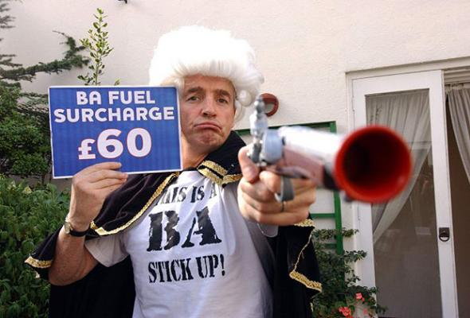
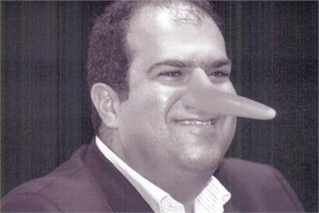
This is a BA (British Airways) stick up
EesyJet Founder with Pinocchio-style long nose

Slide 57
Michael O’leary Quotes
“Screw the travel agent. Take the fuckers out and shoot them. What have they done for passengers over the years?”
“We don't fall all over ourselves if they... say my granny fell ill. What part of no refund don't you understand? You are not getting a refund so fuck off”
“At the moment the ice is free, but if we could find a way of targeting a price on it, we would”

Slide 58
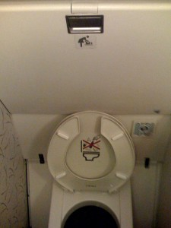
Marketing Strategy: Publicity as free marketing
“We offer Beds and Blow Jobs” O’Leary
“We’re thinking of putting a coin slot on the toilet so people may have to spend a pound to spend a penny,” O’Leary
One advantage of this controversial approach is the huge free publicity it generates!!!!

Slide 59
Business Strategies
Cost Control
Uniform fleets: 229 Boeing 737-800 aircrafts (reduce training and maintenance expenses
no seatback pockets, no blankets/pillows, & airsickness bags upon request
Point to point flights
Outsourcing its customer services in the purpose of reducing cost (ticketing, pax handling)
Internet check-in (cancelled check in desk from May 1, 2009)
No frills service (free food/drinks, lounges), supplied by 3rd party who pays a flat rate/flight
In-house marketing that does a terrible job
Use of secondary airports: lower landing and handling charges

Slide 60
Business Strategies cont.
Maximum Utilization of Resource
189 seats of all economy class
Quick turnaround time (25mins) (30% faster than industry average)
Productive base pay for crew and pilots (low base pay, high variable compensation (that is not form Ryanair’s pocket))

Slide 61
Threats
Ryanair has terminated the negotiation with Boeing for an order up to 200 aircrafts because they could not read mutual agreement on the price and delivery data. This might further damage the relationship with Boeing, one of the two suppliers.
Potential outcome: High switching cost to Airbus: pilot retraining, maintenance costs.

Slide 62
Operation Expenses in %
Ryanair’s10 years average OE
Staff | 13%
Depreciation | 10%
Fuel | 31%
Maintenance, materials & repairs | 2%
Marketing and Distribution | 1.5%
Aircraft rental | 3%
Route & landing Charge | 13%
Airport & handling charges | 17%
Other | 7%
The average Labor cost In Europe is 25%.
The employee compensation system lower
Its labor cost.
They have no agency/commission expense,
No Labor Union
Average aircraft rental in Europe is 6%

Slide 63
Ancillary Revenues
Components of Ancillary:
Non-flight scheduled operations (excess baggage charges, debit/credit card transactions, sales of bus & rail ticket, accommodations and travel insurance)
Car rental
In-flight sales
Internet related service
***they charge £5-10 per online check in
£15-20 per Kilo for excess baggage fee

Slide 64
%Δ in operating expenses
Operating expenses | 2009 |  | 2008 |  | 2007
staff costs | 309,296 | 10.86% | 285,343 | 13.11% | 226,580 | 12.84%
Depreciation | 256,117 | 8.99% | 175,949 | 8.08% | 143,503 | 8.13%
Fuel and oil | 1,257,062 | 44.12% | 791,327 | 36.35% | 693,331 | 39.28%
Maintenance, materials and repairs | 66,811 | 2.34% | 56,709 | 2.61% | 42,046 | 2.38%
Marketing&distribution cost | 12,753 | 0.45% | 17,168 | 0.79% | 23,795 | 1.35%
Aircraft rental | 78,209 | 2.74% | 72,670 | 3.34% | 58,183 | 3.30%
Route charges | 286,559 | 10.06% | 259,280 | 11.91% | 199,240 | 11.29%
Airport Handling Charges | 443,387 | 15.56% | 396,326 | 18.21% | 273,613 | 15.50%
Others | 139,149 | 4.88% | 121,970 | 5.60% | 104,859 | 5.94%
Total Operating expense | 2,849,334 |  | 2,176,742 |  | 1,765,150
Fuel price increased 59%
The increase of depreciation: fleet expansion
Increase of route charges, and airport handing charges: routes expansion
Notes:
Look at the increase in fuel expense 2008-2009
decrease in staff costs, marketing, !!!! Strong cost control

Slide 65
Acquisition of AerLingus (LSE: AERL)
Carriers in Ireland, serving Europe, North America, & North Africa
Began to acquire AerLingus since October 5th 2006
Purpose: expansion
Blocked by Europe Commission
Reason: reduce consumers’ choice and increase fare price
Currently holds 29.8% of AerLingus (aggregate cost of €407m)
AERL Stock Price dropped from £3 to £0.6 from 2007 to 2010
Only worth €93m Today.

Slide 66
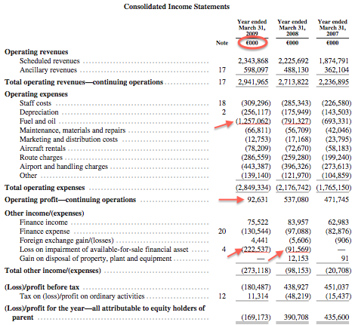
Notes:
1 Euro=1.363 USD
One of the few airlines that had a operating profit that year

Slide 67
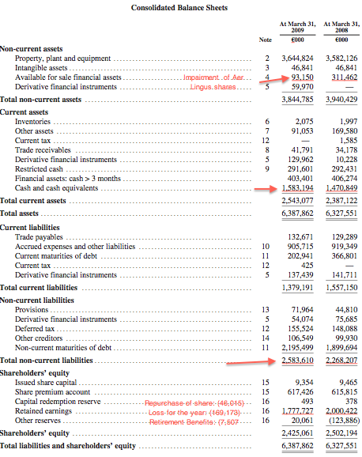

Slide 68
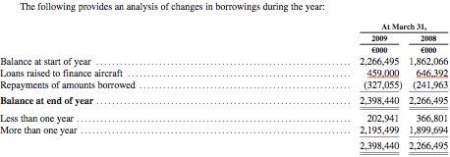
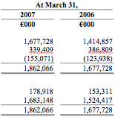
Loans raised to finance aircrafts

Slide 69
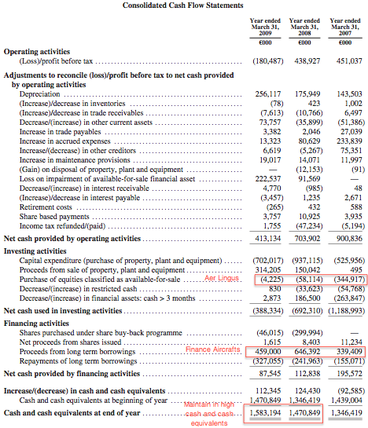

Slide 70
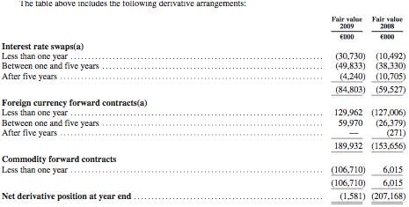
Hedging
The Company’s objective for interest rate risk management is to reduce interest-rate risk through a combination of financial instruments, which lock in interest rates on debt and by matching a proportion of floating rate assets with floating rate liabilities.
The Company’s historical fuel risk management policy has been to hedge between 70% and 90% of the forecast rolling annual volumes required to ensure that the future cost per gallon of fuel is locked in.

Slide 71
Recommendation
Strong Buy

Slide 72
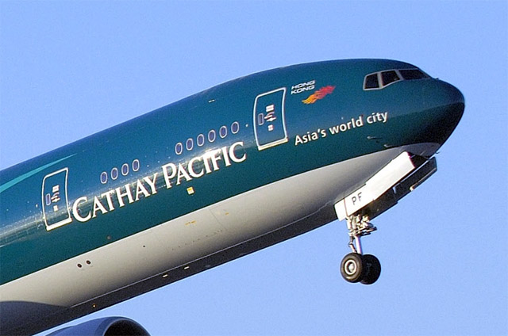

Slide 73
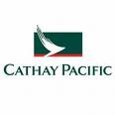
Company Background
an international airline; based in Hong Kong
offers scheduled passenger and cargo services to 114 destinations in 35 countries and territories.
founded in Hong Kong in 1946
one of the world’s leading global transportation hubs
Investments include catering, aircraft maintenance, ground handling companies
a founding member of the one-world global alliance, whose combined network serves almost 700 destinations worldwide.

Slide 74
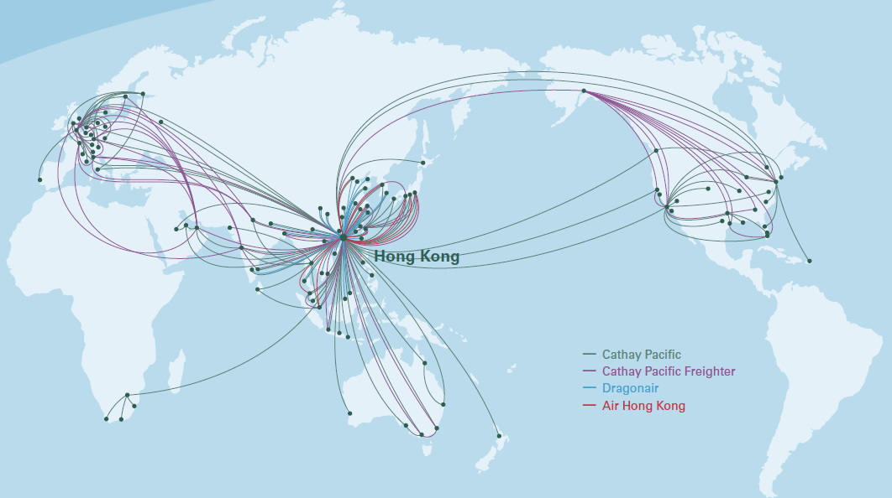

Slide 75
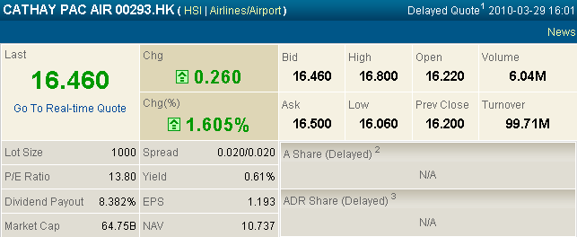
Stock Info.

Slide 76
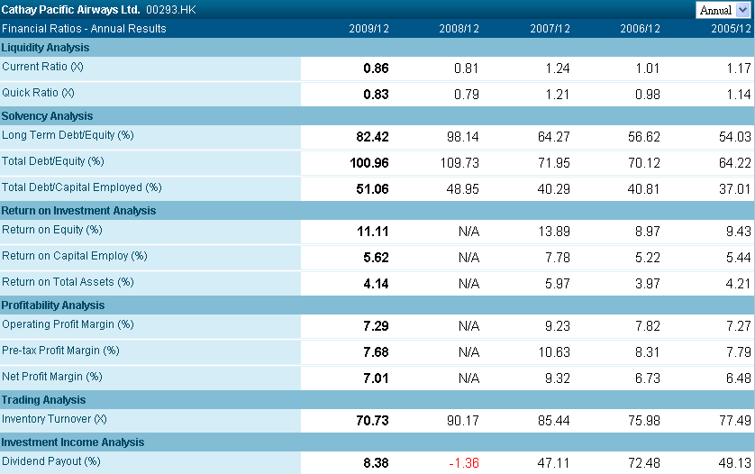

Slide 77
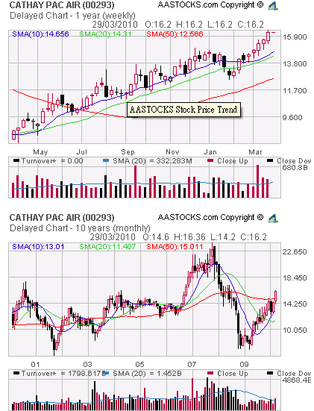
Stock price in 1 year & 10 year

Slide 78
One year stock price vs. Market index (Hang Seng)

Slide 79
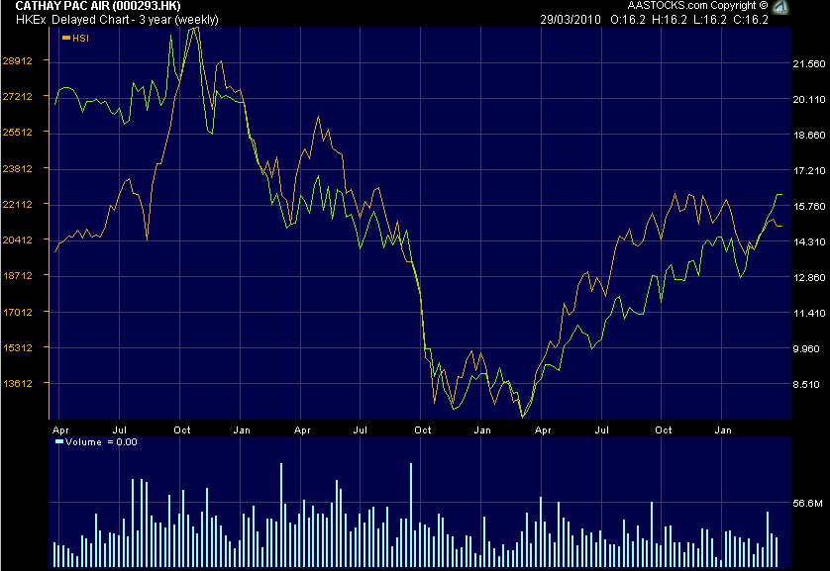
Three year stock price vs. Market index (Hang Seng)

Slide 80
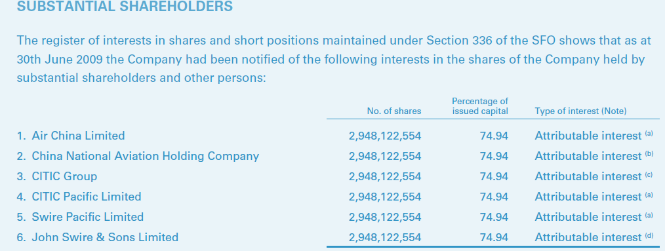

Slide 81
Company Management
Christopher Dale Pratt
The chairmen and executive director of Cathay Pacific and Swire Pacific
also the Chairman of Hong Kong Aircraft Engineering Company Limited(HAECO), John Swire & Sons (H.K.) Limited, Swire Beverages Limited and Swire Properties Limited, and a Director of Air China Limited and the Hong Kong and Shanghai Banking Corporation Limited
served as the Executive Director of the Swire Pacific's Trading and Industrial Division between 2000 and 2005
has an honor degree in modern history from the University of Oxford
awarded the Commander of the Order of the British Empire(CBE) (Civil Division) in the 2000 New Year Honor List for his services to the community in Papua New Guinea

Slide 82
Management (Cont.)
Tony Tyler
Chief Executive Officer (CEO)
has been a Director of the Company since 1996 and was appointed Director Corporate Development in 1996 and Chief Operating Officer in 2005
also Chairman of Hong Kong Dragon Airlines Limited and Director of John Swire & Sons (H.K.) Limited and Swire Pacific Limited
current Chairman of the International Air Transport Association (IATA) Board of Governors
a graduate of Oxford University
During this breakfast, he likes to give his insights on the future of the aviation industry. He will also share how he is managing the airline groups' challenges

Slide 83
Management (Cont.)
John Slosar
Chief Operating Officer (COF)
Was managing Director of Hong Kong Aircraft Engineering Company Limited from January 1996 to June 1998 and Managing Director of Swire Pacific Limited’s Beverages Division from July 1998 to June 2007
also a Director of John Swire & Sons (H.K.) Limited, Swire Pacific Limited, Hong Kong Dragon Airlines Limited and AHK Air Hong Kong Limited
holds degrees in Economics from Columbia University and Cambridge University

Slide 84
Passenger services
accounts for about 70% of total revenue (Turnover)
carried a total of 25.0 million passengers in 2008 – up 7.3% on the previous year but below a capacity increase of 12.7% for the same period.
Passenger revenue rose by 17.2% to HK$58,046 million.
The load factor for the period was 78.8% – down 1.0 percentage point from 2007.

Slide 85
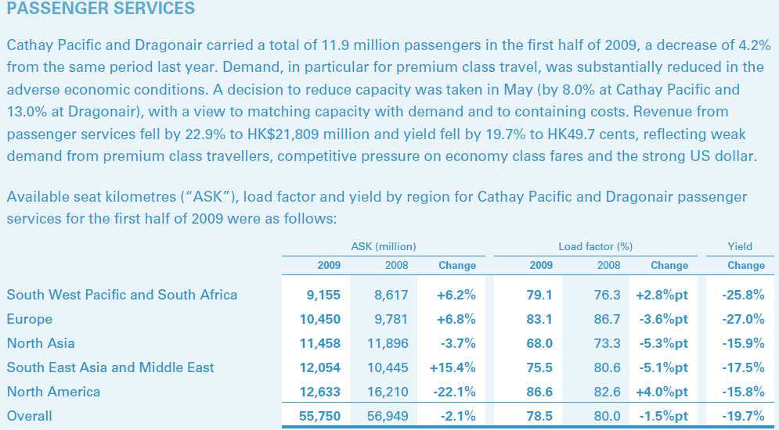

Slide 86
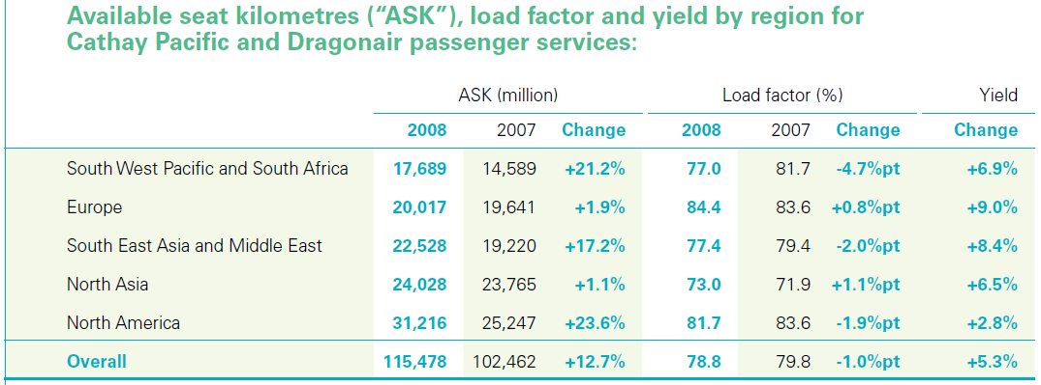

Slide 87
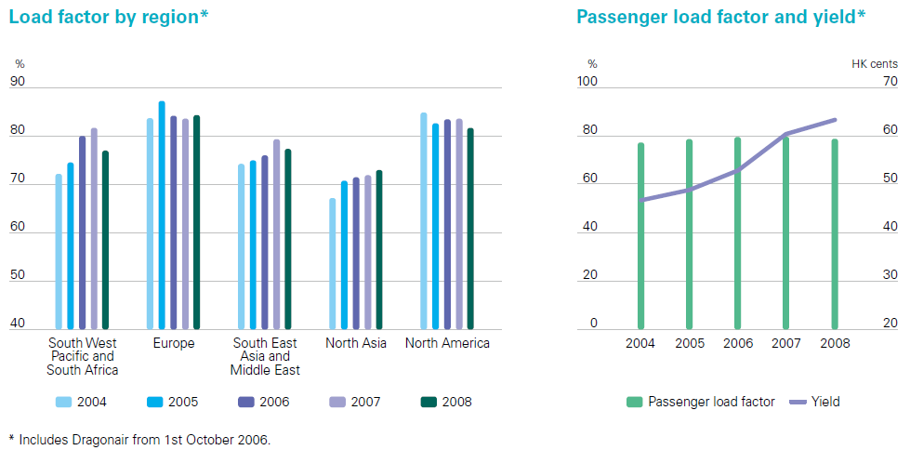

Slide 88
Cargo Services
accounts for about 30% of total revenue (Turnover)
In 2008, Cargo and mail tonnage carried by Cathay Pacific and Dragonair fell by 1.6% to 1,644,785 tonnes compared to a capacity rise of 0.7%.
The load factor fell by 0.8 percentage point to 65.9% while yield, with the help of higher collection of fuel surcharges, rose by 12.4% to HK$2.54.

Slide 89
Financial Review
an attributable loss of HK$8,558 million in 2008 against a profit of HK$7,023 million the previous year.
the high price of fuel in the first half of the year, followed by a sharp decline in both passenger and cargo traffic in the second half.
drop in fuel prices towards the end of the year caused significant mark to market losses on the fuel hedging contracts
Fuel surcharges, insurance surcharges and cargo security charges are traffic turnover

Slide 90
Financial Review in 2009 & 2008

Slide 91
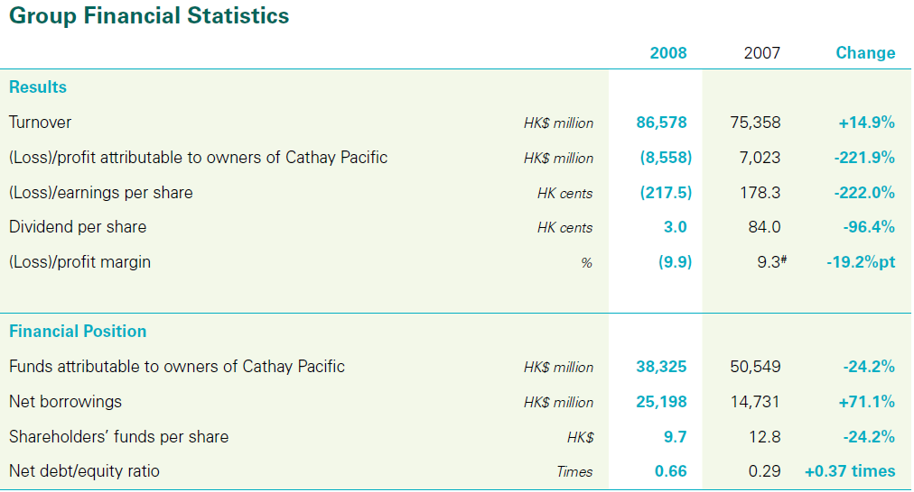
Financial Review in 2008 & 2007

Slide 92
Turnover (revenue) in 2008 & 2007

Slide 93
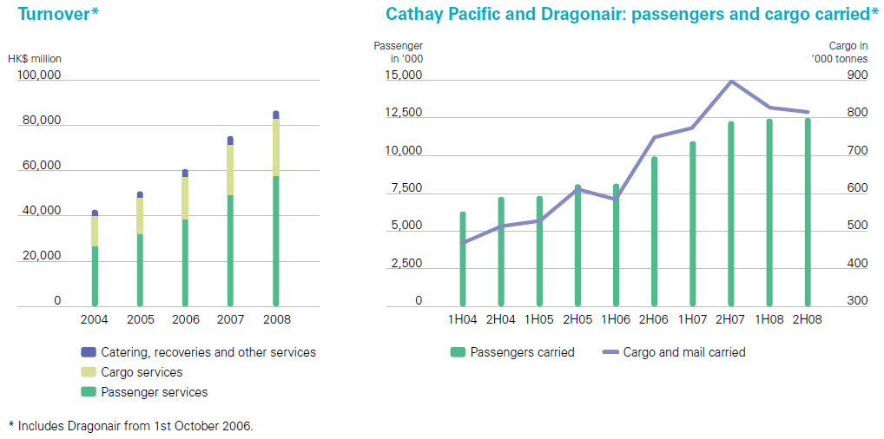

Slide 94
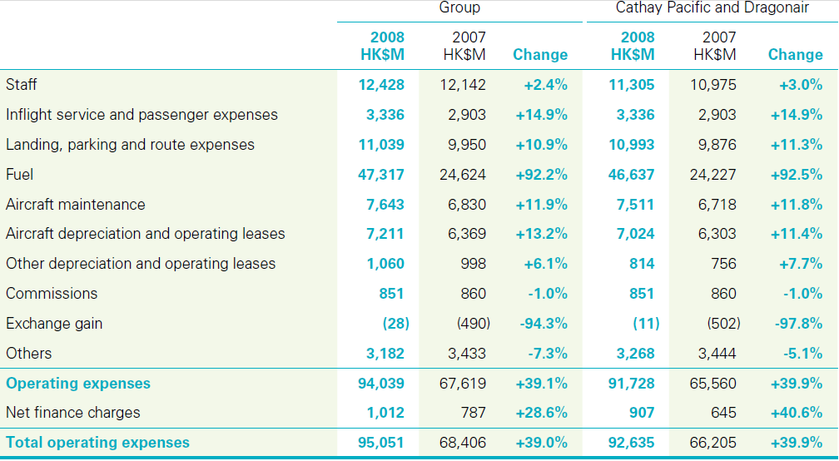
Operating expense (2008 & 2007)

Slide 96
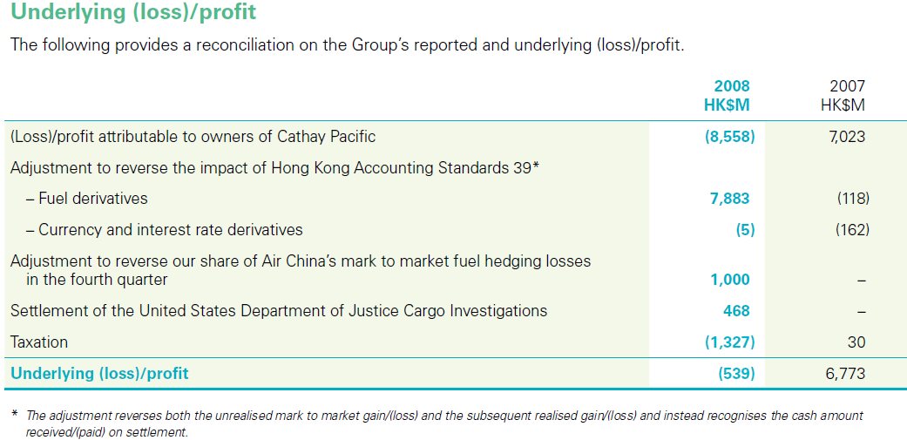

Slide 97
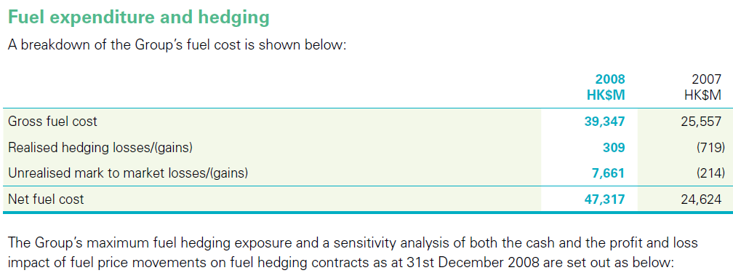
Breakdown of the Fuel Cost

Slide 98
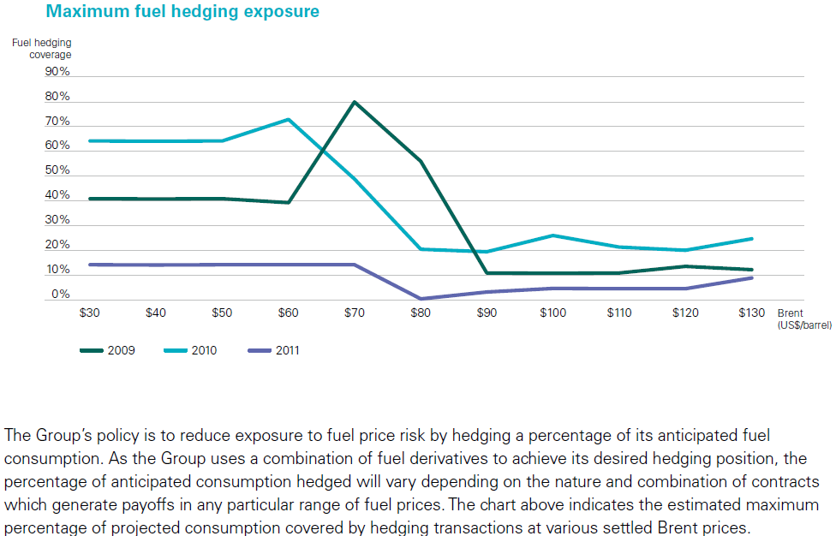

Slide 99
Sensitivity analysis of cash and profit and loss impact of fuel price movements on fuel hedging contracts

Slide 100
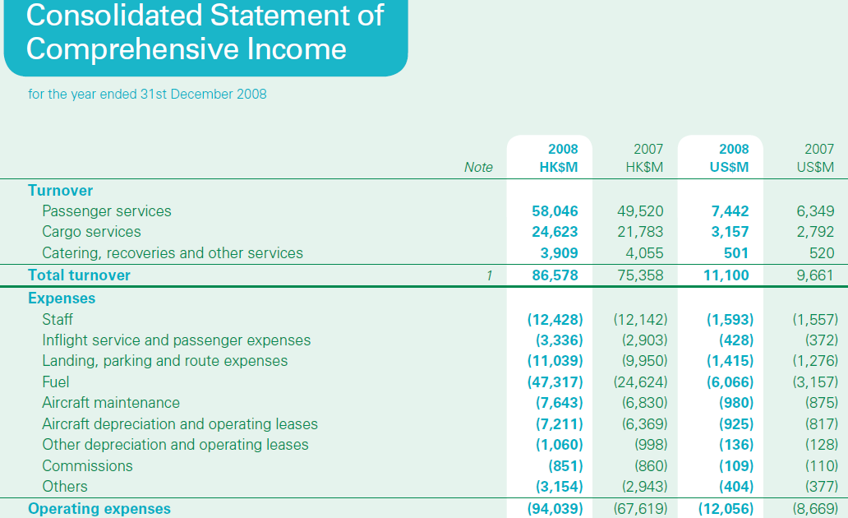

Slide 101
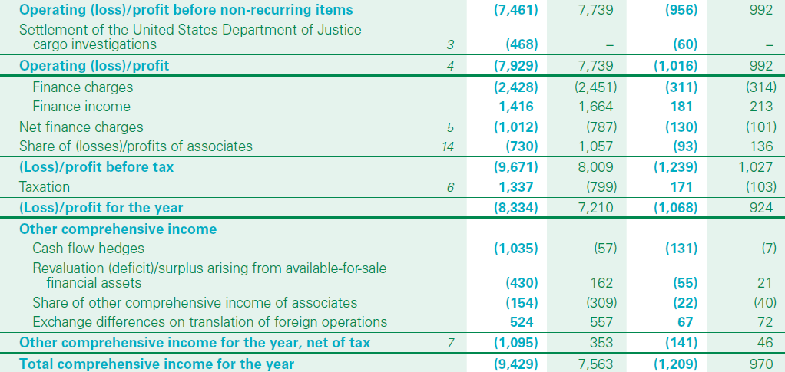

Slide 102
The Cathay Pacific Group recorded an attributable loss of HK$8,558 million in 2008, compared to a profit of HK$7,023 million the previous year. Turnover rose by 14.9% to HK$86,578 million.

Slide 103
The price of aviation fuel reached new highs in July 2008 though prices fell significantly towards the end of the year.
Fuel surcharges on cargo and passenger tickets only partially offset the additional cost incurred over the course of the year.
The fall in fuel prices caused unrealised mark to market losses of HK$7.6 billion on our fuel hedging contracts for the period 2009-2011 which were entered into in order to give a degree of certainty as to future fuel prices and protection against price increases.

Slide 104
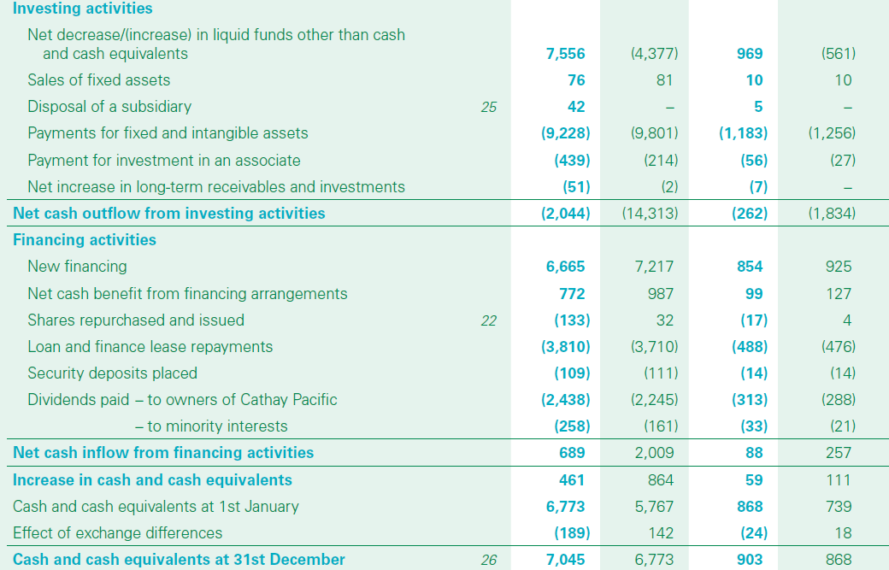

Slide 105
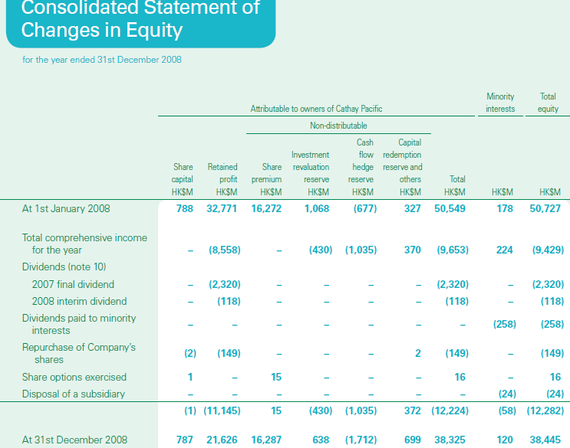

Slide 107
Recommendation
Hold

Slide 109
Stock Information
Traded on: New York Stock Exchange
March 26, 2010
Ticker: LUV
Exchange: New York Stock Exchange
Market Capitalization: $9,682.32 Million

Slide 110
Earning Per Share
2008
Outstanding share: 735million
Net Income: 178million
EPS= $0.24
2009
Outstanding share:741 million
Net Income: 99 million
EPS=$0.13
Notes:
change

Slide 111
Equity Per Share
2008
Equity 4,953.00m
Outstanding shares: 735 m
Equity per share: 6.74
2009
Equity 5,466.00m
Outstanding shares: 741m
Equity per share: 7.37
Notes:
change

Slide 112
1 Year Price Chart

Slide 113
5 Year Price Chart

Slide 114
10 Year Price Chart

Slide 115
5 years LUV vs. S&P500
Notes:
change

Slide 116
10 Year LUV vs. S&P500

Slide 117
10 Year LUV vs. Dow Jones US Total Stock Market

Slide 118
10 Year LUV vs. OIL Price

Slide 119
COMPANY INFO.

Slide 120
Historical Timeline:1960-1980
1967: Incorporated as Air Southwest Co
1971: Launches first route with 3 Boeing 737 aircrafts serving only Dallas, Houston and San Antonio
1973: Southwest posts first profit
1976: Renamed to Southwest Airlines Co. (SWA)
1977: SWA carries its 5 millionth passenger and is listed on the NYSE
1978: SWA flies outside Texas to New Orleans

Slide 121
Historical Timeline:1980-present
1982: SWA begins flights to the West Coast
1990: Revenues exceed $1 billion
1994: Morris Air and Arizona One are acquired
1996: Online booking site is launched
2005: SWA enters first ever code share arrangement, with ATA Airlines
2009:Southwest Airlines is the largest carrier in the US with 545 Boeing 737 aircrafts servicing 68 airports in 35 states and able to offer more than 3,300 flights a day

Slide 122
About the Company
Founders: Rollin King and Herbert D. Kelleher
An American Low cost airline.
Southwest Airlines is the largest carrier in the US with 545 Boeing 737 aircrafts servicing 68 airports in 35 states
As of May 3, 2009, Southwest operates approximately 3,510 flights daily.
The largest airline in the world by number of passengers carried per year(as of 2009)
As of 2009, SWA has been profitable for 37 consecutive years.
Notes:
change

Slide 123
Executive Team
Herbert D. Kelleher
Founder of Southwest Airlines Co.
Executive Chairman from 1978-2008
President and CEO from 1981-2001
Graduated with honors from Wesleyan University, where his major was English and minor Philosophy
Graduated from New York University Law School, where he was a Root-Tilden Scholar.
Notes:
-Herb Kelleher is a Founder of Southwest Airlines Co. and served as Executive Chairman from March 1978 to May 2008 and as President and CEO from September 1981 through June 2001.
-Kelleher graduated with honors from Wesleyan University, where he was an Olin Scholar and where his major was English and his minor Philosophy, and from NYU Law School, where he was a Root-Tilden Scholar.

Slide 124
Executive Team- continued
Gary C. Kelly
1986: Joined the company as Controller
1989: CFO and VP of Finance
1991: Executive Vice President
1994: CEO
2008: Chairman of the BOD
Earned B.B.A. in Accounting from University of Texas
Certified Public Accountant

Slide 125
Executive Team- continued
Colleen C. Barrett
A founding Employee and President Emeritus of Southwest Airline
served as a member of the Board of Directors from 2001- 2008 May
Corporate secretary from March 1978 to May 2008
Vice President Administration from 1986 to through1990
Executive Vice President Customers from 1990 through 2001
President from 2001 through July 2008
Education: graduated from Becker Junior College, 1964.

Slide 126
Business Model
Point-to-Point
Flying multiple short quick trips
Factors that allow low operating costs
Employees: Empowerment and Respect
Higher productivity
Flying into the secondary airports of major markets
Reduces costs associated with landing fees, etc.
Less congestion → Increase turnaround
One Aircraft Type: Boeing 737
Reduce costs associated with maintenance, training and ground operations
These factors allow Southwest to provide ‘low-cost’ flights
Notes:
Southwest's successful business model involves flying multiple short, quick trips into the secondary (more efficient and less costly) airports of major markets, and using only one aircraft type, the Boeing 737.

Slide 127
Market Share

Slide 128
Servicing Map

Slide 129
Financials

Slide 130
Income Statement—10 years
Notes:
In 2008 and 2009. the oil price increase
Most of company lose money
But, Southwest Airline earn

Slide 131
CONSOLIDATED STATEMENT OF OPERATIONS in 2009 (unaudited) (in millions, except per share amounts)
Notes:
In both periods, these "other (gains) losses" primarily resulted from unrealized gains/losses associated with fuel derivatives. The cost of the Company's hedging program (the premium costs of derivative contracts) was $148 million in 2009 and $69 million in 2008, which is also included in "other (gains) losses".

Slide 132
Income Statement (millions)
262
449
791

Slide 133
Income Statement (millions)

Slide 134
Consolidated Balance Sheet(in millions)

Slide 135
Consolidated Balance Sheet(in millions)

Slide 136
Consolidated Statement of Cash Flows (in millions)

Slide 137
Consolidated Statement of Cash Flows (in millions)
Notes:
$381 million from the sale and leaseback of eleven 737-700 aircraft and $455 million in proceeds from secured term loan agreements

Slide 138
RECOMMEDATION
HOLD

Slide 139
THANKS

