Slide 1
BUDDHISM
Its Direct Effect on the Japanese Religio-Æsthetic Civilisation.

Slide 2
BUDDHISM
FOUR NOBLE TRUTHS
EIGHT-FOLD PATH

Slide 3
FOUR NOBLE TRUTHS (Credo)
LIFE IS SUFFERING
SUFFERING COMES FROM DESIRE
ELIMINATE SUFFERING BY ELIMINATING DESIRE
HOW? FOLLOW THE EIGHT-FOLD PATH
RATIONALIST
numerical (=order)
logical
coherent & cohesive
programmatic
SIMPLE
MNEMONIC
INDIVIDUAL
neither individualist nor collectivist
PRESCRIPTIVE
DOGMATIC
‘open, firm, & honest declaration of a clear and specific set of articles of belief.’

Slide 4
EIGHT-FOLD PATH (Praxis)
Right Understanding
Right Thought
Right Speech--
Right Action-
Right Livelihood
Right Effort
Right Mindfulness
Right Concentration
> WISDOM
> MORALITY
> MEDITATION

Slide 5
EIGHT-FOLD PATH con’t
The basic truth of the Universe is that it is has a WAY (‘the Tao’)
there is a definite direction to the Universe.
Note that the Eight-Fold Path is correspondingly a ‘Way’.
The Way is an OBJECTIVE TRUTH:
Reality exists independently of what humans think that it is, wish that it were, or think that it should be.
Thus, the basic fact for human life is to (a.) learn the Way and (b.) harmonise oneself to it as closely as possible.
The closer that human thought and action harmonises with the Way that the Universe is going, the happier and more contented the individual (and, by extension, society) will be.
Wide latitude for individual temperaments and personalities
Ultimately a MORAL worldview
there is a Right and a Wrong
RIGHT is behavior which matches the Way
WRONG is behavior which does not match the Way.

Slide 6
Japanese Civilisation Concepts
mujokan
mushin
chinmoku + seijaku
mono no aware
wabi-sabi
ki-sho-ten-ketsu
……...

Slide 7
“shibui”
Ascerbic good taste: ‘astringency.’
Simple, unadorned, subtle, hidden, beauty
The taste of umeboshi

Slide 8
Japanese Religious-Æsthetic Concepts
Shichi-Go-San: “7-5-3” Celebrate a child's 3^{rd,} 5th & 7th birthdays, and a deceased’s 3^{rd,} 5th & 7th anniversaries.
Haiku is 5-7-5 syllables
rock-gardens have odd-numbered - arrangements of stones
Numbers 4 and 9 are shunned:
“4” can be “shi” meaning ‘death.’
9 can be “ku” meaning ‘suffering’

Slide 9
Japanese Religious-Æsthetic Concepts
Ten-Chi-Jin: ‘heaven-earth-man’
a sense of something high, something low. and an intermediary: the axes are spacial, temporal and human. The middle concept is (explicit in the configuration of the Noh stage) a bridge.

Slide 10
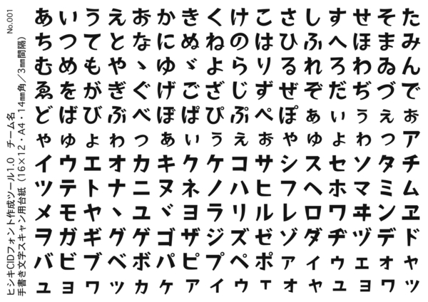
Japanese Religious-Æsthetic Concepts
Shin-Gyo-So (true, moving & grass-like.)
In calligraphy, block-style, kana & cursive; in the cha-no-yu, of its implements, formal, semi-formal, informal. Shin-gyo-so is an effective schema for mapping the uniquely Japanese manner of reacting to any discrete new foreign encounter. Evident in literature in comparative representations, structural contrasts and developments in character

Slide 11
Japanese Religious-Æsthetic Concepts
Jo-Ha-Kyu (gathering, break, urgent action)
A concept exemplified by -- & likely originating in contemplation of -- the waterfall. In literature -- notably haiku -- it signifies introduction, development, action. In music, it has several compounding applications, essentially a triptych of increasing rapidity & climax. This is accepted as the natural rhythm -- gestation, birth, life is just one obvious universal triad/

Slide 12
Japanese Religious-Æsthetic Concepts
Shu-Ha-Ri (keep the form, lose the form, no form)
the process by which mastery of any art or practice is attained.
copy and practice the fundamental forms
Steadily lose reliance on use of fundamental form
Achieve mastery where the art is natural, personal, and subconscious (=mushin)
applies to the arts (e.g. calligraphy, literature, painting), professions, martial arts, sport, etc.

Slide 13
haiku: complexity in simplicity
686 AD haiku by the great bashō, which can be translated (insofar as poetry can be translated) as follows:
(nb: haiku=3 phrases, 5-7-5 syllables)
old pond! frog jumps in water's sound

