Slide 1
LIBS 7007:
TECHNOLOGY & SOCIETY
TECHNOLOGY & MEDICAL PRACTICE
Stephen A. Ogden, Ph.D.

Slide 2
The Hippocratic Oath

Slide 3
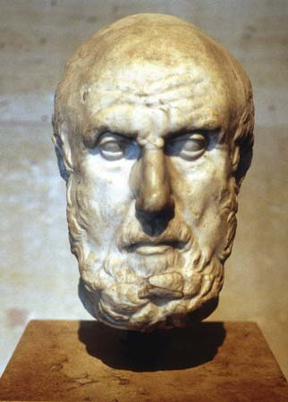
Hippocrates
c. 460 bc --c. 375 bc
Physician during Greece’s Classical period regarded as the father of medicine
60 medical writings have survived that bear his name
Revered for ethical standards in medical practice, mainly the Hippocratic Oath (which he perhaps did not write)
Younger contemporary Plato mentions H. twice & Aristotle once.
His writings show basic assumptions about how the body works & what disease is
Give sense of the substance and appeal of ancient Greek medicine

Slide 4
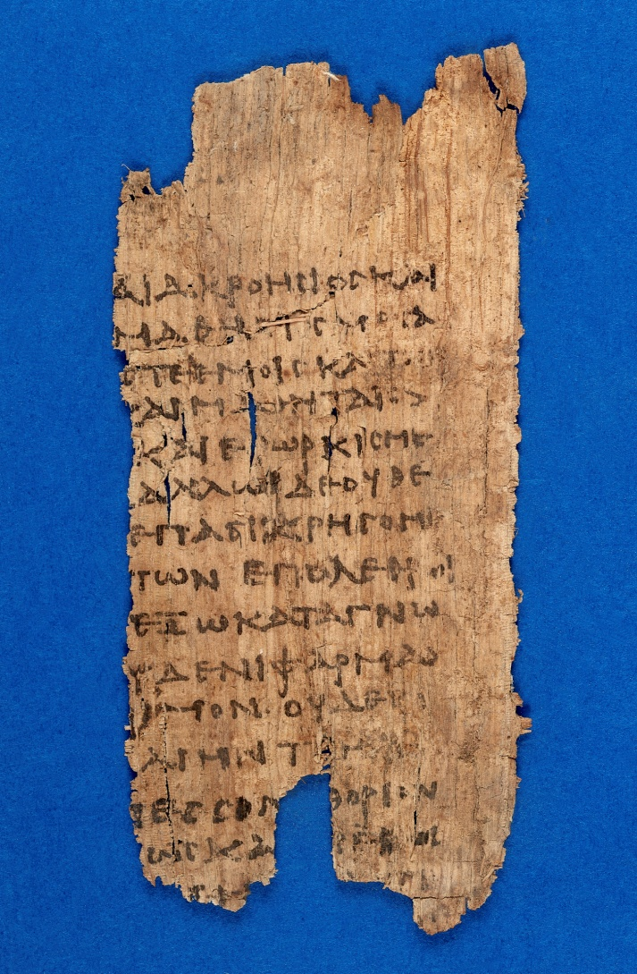
Hippocratic Oath
The ethical code attributed to Hippocrates, adopted as a guide to conduct by the medical profession throughout the ages and still used in the graduation ceremonies of many medical schools.
From an extant a body of manuscripts, called the Hippocratic Collection
It requires a new physician to swear to Divinity to uphold specific ethical standards and practices.
Gives both commanded and proscribed actions.

Slide 5
Hippocratic Oath: “I Swear”—
Indicates Society’s Ultimate Ground of Value
Ancient
Modern
…..by Apollo The Healer, by Asclepius, by Hygieia, by Panacea, and by all the Gods and Goddesses, making them my witnesses, that I will carry out, according to my ability and judgment, this oath and this indenture.
[1964 by Louis Lasagna, Academic Dean of the School of Medicine at Tufts University]
….to fulfill, to the best of my ability and judgment, this covenant.

Slide 6
Hippocratic Oath: “I Swear” —
Indicates Society’s Filial Duty Lines
Ancient
Modern
….to hold my teacher in this art equal to my own parents; to make him partner in my livelihood; when he is in need of money to share mine with him; to consider his family as my own brothers, and to teach them this art, if they want to learn it, without fee or indenture; to impart precept, oral instruction, and all other instruction to my own sons, the sons of my teacher, and to indentured pupils who have taken the physician’s oath, but to nobody else.
I will respect the hard-won scientific gains of those physicians in whose steps I walk, and gladly share such knowledge as is mine with those who are to follow.

Slide 7
Hippocratic Oath: “I Swear” — indicates Society’s Moral Restrictions on Medical Practice
Ancient
Modern
…. I will use those dietary regimens which will benefit my patients according to my greatest ability and judgement, and I will do no harm or injustice to them.
Neither will I administer a poison to anybody when asked to do so, nor will I suggest such a course.
Similarly I will not give to a woman a pessary to cause abortion.
In purity and according to divine law will I carry out my life and my art.
I will not use the knife, even upon those suffering from stones, but I will leave this to those who are trained in this craft.
I will apply, for the benefit of the sick, all measures which are required, avoiding those twin traps of overtreatment and therapeutic nihilism.
I will remember that there is art to medicine as well as science, and that warmth, sympathy, and understanding may outweigh the surgeon's knife or the chemist's drug.
I will remember that I do not treat a fever chart, a cancerous growth, but a sick human being, whose illness may affect the person's family and economic stability. My responsibility includes these related problems, if I am to care adequately for the sick.

Slide 8
Hippocratic Oath: “I Swear” —
Societal Accountability of Physicians
Ancient
Modern
…. Into whatsoever houses I enter, I will enter to help the sick, and I will abstain from all intentional wrong-doing and harm, especially from abusing the bodies of man or woman, bond or free.
And whatsoever I shall see or hear in the course of my profession, as well as outside my profession in my intercourse with men, if it be what should not be published abroad, I will never divulge, holding such things to be holy secrets.
….I will not be ashamed to say "I know not," nor will I fail to call in my colleagues when the skills of another are needed for a patient's recovery.
I will respect the privacy of my patients, for their problems are not disclosed to me that the world may know. Most especially must I tread with care in matters of life and death. Above all, I must not play at God.

Slide 9
Hippocratic Oath: “I Swear” —
Indicates Society’s Moral Valuation of Oaths
Ancient
Modern
So long as I maintain this Oath faithfully and without corruption, may it be granted to me to partake of life fully and the practice of my art, gaining the respect of all men for all time.
However, should I transgress this Oath and violate it, may the opposite be my fate.
If I do not violate this oath, may I enjoy life and art, respected while I live and remembered with affection thereafter. May I always act so as to preserve the finest traditions of my calling and may I long experience the joy of healing those who seek my help.

Slide 10
Technology & Medicine:
OVERVIEW
Here again, in our study of “technology & society”, is a topic of immense size & social reach.
Proper treatment of “medical technology & society” would require its own course
For our Module this week, we will get a framework and then focus on one important and controversial area in order to quickly appreciate the significance of medical technology for society
Medicine, in Western society certainly, and perhaps by definition, just is science and technology.
  mixing of poultices and potions, setting splints, and trepanning, are early but still identifiably technological approaches to medicine

Slide 11
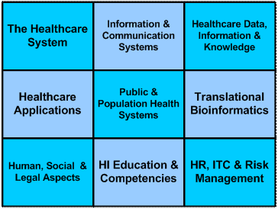
Health Informatics
Medical technology now has a large component of data collection, storage, and analysis: health informatics.
Health information science is the study of:
  how health data are collected, stored and communicated,
  how those data are processed into health information suitable for administrative and clinical decision making, and
  how computer and telecommunications technology can be applied to support these processes....

Slide 12
Health Informatics, con’t
As health information is increasingly being processed by computers and transmitted by communications technology, health informatics degree programs have a significant technological component.
For instance, the University of Victoria has B.Sc., M.Sc., M.N. ,and Ph.D. degree programmes in health informatics
UBC Medicine “ Sociotechnical approaches in eHealth.”
Large-scale data gathering, collating, and analysing, from individuals, sub-cultures, ethnicities, any and all demographic groupings, and nations, of biological detail, body and mind, through a full life-span, will have significant social effect:
  on matters of personal privacy,
  control of data use and sale
  the genetic level, patent ownership.

Slide 13

HEALTH informatics, con’t
BCIT, of course, includes strong health informatics courses in the nursing and medical programmes.
CARD 3205 - Introduction to Health Informatics
BCIT Health Informatics resources page
Cf. the Obamacare website…

Slide 14

Medical technology & politics
As we know, technology involves as much politics and economics as machinery; and this is very much intensified in the case of medicine.
In the USA, the State is moving with intense partisanship to nationalise health care: making very clear that medicine in Western society is now very much a dimension of politics.
In Canada, medicine is politics: through the 1984 Canada Health Act. Private health care delivery is heavily restricted by law.

Slide 15
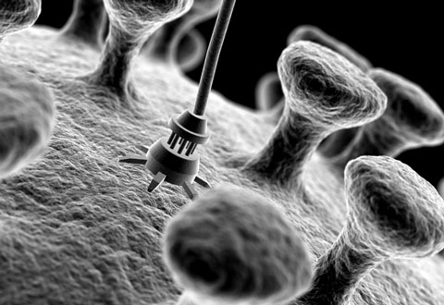
Medical technology & ECONOMICS
With technology and politics at the centre of medicine, economics are necessarily centralised as well.
Medical care is 11.5% of GDP in Canada, and approaches 50% of Provincial budgets.
Present Western civilisation trends will result in spending on medical technology being unlimited.
The causes of the sharp—i.e. infinite—medical expenses curve are clear.

Slide 16
Some of the Causes of the infinite medical cost curve
Technology is advancing and proliferating: that is, there are more types of technologies and the types are becoming ever-more sophisticated:
  nanotechnology,
  cybernetics
  genomics,
Health--the preservation of our life—is fundamental.
the latest medical technology is the the best (it is assumed), treatment; and because it is the latest it is the most expensive (for hard and self-evident facts of the laws of economics).
A never-ending demand for new advancements in medical technology stimulates ever-more sophisticated and far-reaching--that is, massively expensive--research and development.
Diseases, maladies, infections, and mortality itself, being in effect limitless, the requirement for costly medical technologies is correspondingly unlimited

Slide 17
POLITICs, economics, & medicine: conclusion
If medical economy was a private matter, then spending would simply be a matter of each individual's family budget.
But in Western society, where health care is now heavily Socialist, spending is primarily political matter, where purchase of, and access to, medical technologies is determined first according to the calculus of politics, and then, and only then, the manner of payment follows that calculus.
This, it should be clear, is not an argument against or for socialised health care: rather it is the background context for the economic significance of technology in medicine and society.

Slide 18
the social effects of medical technology: one example
Not only does medical technology have large-scale social effects at these general aspects, many specific medical technologies have effects on a equally large social scale.
To take just one vivid example, the technologies of artificial contraception have already had an incalculable social effect.
Human reproduction can now be reliably controlled through technology:
  chemical technologies (in the form of pills),
  mechanical implant technologies (such as IUDs),
  prophylactic technologies (condoms, etc.)
The effects of these technologies on the sexes, in relationships, in employment, in education--in fact in almost all social dimensions--is too well documented and widely known to be worth more than a mention.

Slide 19
CONTRACEPTIVE TECHNOLOGY:
THE case of japan
Japan is a vivid case of the radical population effects of planned reproductive reduction.
Japan, as we recall from previous Course weeks, has almost no immigration of non-ethnic Japanese; which requires at least a replacement fertility rate to sustain the population.
Japan, however, has a trajectory of sub-replacement fertility, which is even now causing unrest in the society, where an increasingly-small proportion of working adults are supporting an increasingly-large proportion of elderly Japanese (already more than 33% of the population are over 60 years old.)
Artificial contraception is, of course, only one of the several causes of fertility reduction: but it is nonetheless a significant and confirmed cause

Slide 20

CONTRACEPTIVE TECHNOLOGY: one large effect in the case of canada
Canada also has sub-replacement fertility rate--1.60 births per woman in 2015--caused in part by contraceptive technologies.
One social effect in Canada is a massive immigration increase.
Canada has one of the highest per-capita immigration rates in the world with transformative social results.
The ethnic polyculturalism of Canada in a single generation is visible evidence for the undeniable and undeniably comprehensive effect that medical technology has on society.

