Slide 1
Industrial revolution
& society
Dr stephen a. ogden
Liberal studies, bcit

Slide 2
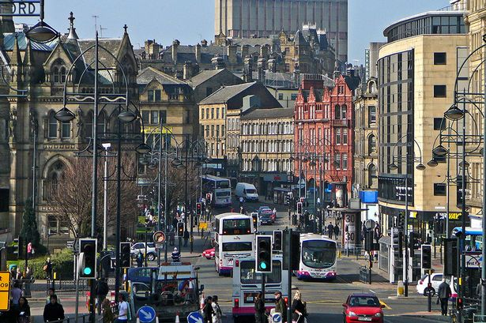
Bradford is Britain's most dangerous city
“People think Bradford is Britain's most dangerous city - is that true?
A YouGov poll asked people how safe or unsafe they think the UK's most populous cities are. Bradford came out as the place people feel most at risk - but how dangerous is it really?”

Slide 3
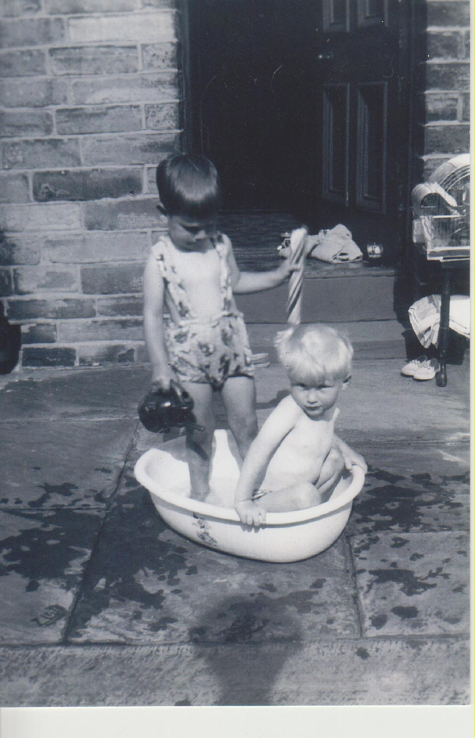
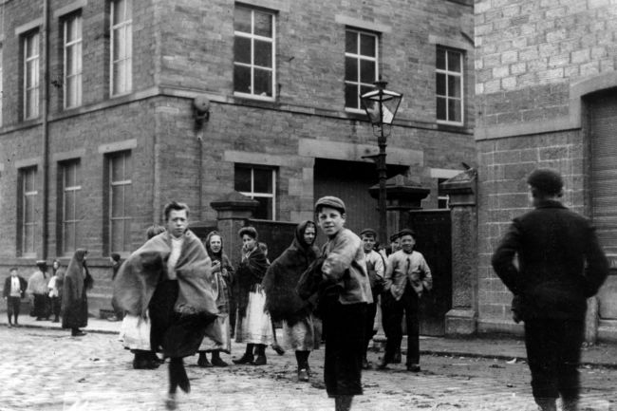
BRADFORD & OGDEN

Slide 4
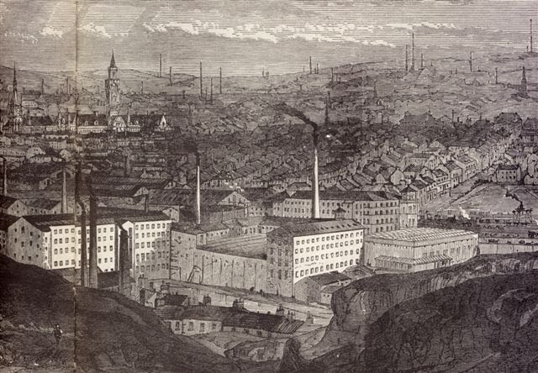

Industrial bradford

Slide 5
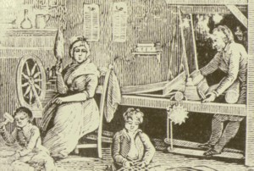
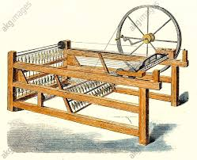
18th C. Domestic Spinning technologies

Slide 6
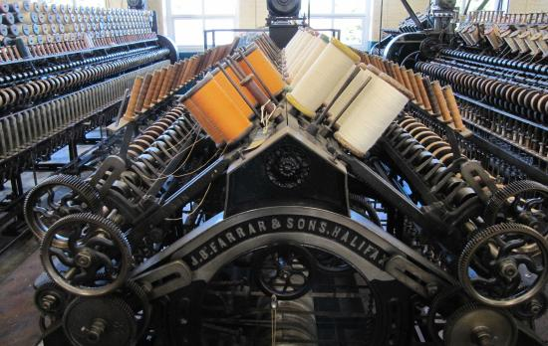
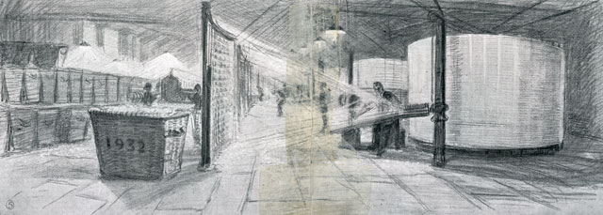
19th c. industrial Spinning technologies

