Slide 1
LIBERAL STUDIES 7005
Introduction.
“Technology, Invention, & Power”
Dr. Stephen A. Ogden

Slide 2

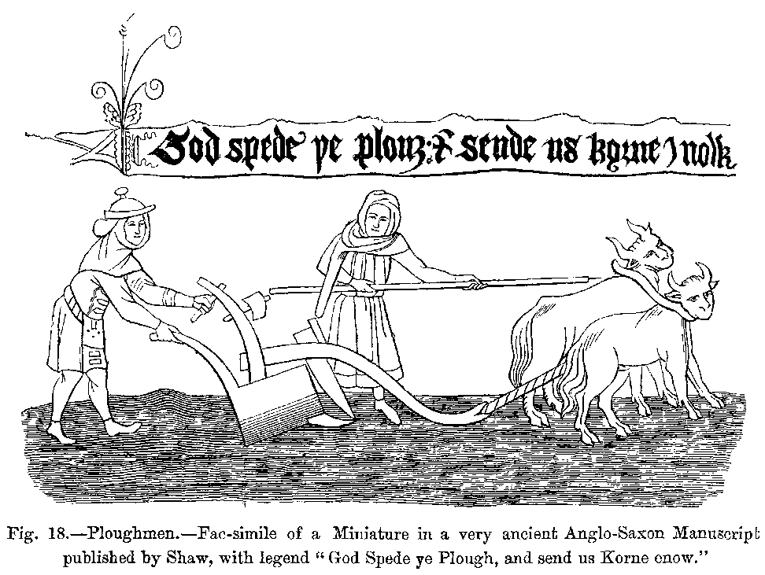
Serfs & Peasants are Technologists: technologists who have only operational knowledge of their technology.

Slide 3
A HARD FACT
(‘hard’ in both senses of the word)
Prospective employers don’t care about your technical competency.
Q: Why is this?
A: They take it for granted: all applicants before the hiring authority have the credentials & work experience that the job requires—this is listed in the job ad.
Q: What do prospective employers care about?
A: Let’s ask them!

Slide 4
What BC Employers Want
The Business Council of British Columbia
  a voluntary council of BC’s top employers from all BC’s major economic sectors, working to improve relations with communities (such as post-secondary institutions) and governments.
  publishes a biennial ‘Skills and Attributes Survey’ that asks all BC employers what they want in new hires—not what governments, post-secondary institutions, or special interest groups, tell that that they should want.

Slide 5
Course Task #1
Search online for the 2010 Biennial Skills & Attributes Survey Report.
Study Chart #1 and Chart #2 and come up with an answer to these two questions:
  How many of the top ten in each of the two charts are technical?
  What do you call the types of skills and attributes that are predominant in the two lists?
Remember: these are what your actual employers are telling you they want you to have to get hired.

Slide 6
HARD SKILLS VS. SOFT SKILLS
mathematics, engineering, technical proficiency are called hard skills
communications, knowledge of history & literature, interpersonal competency are called soft skills.
“hard and soft skills are often referred to when applying for a job. For most jobs, while the hard skills are essential to getting the interview, it's the soft skills that will land the job because employers want someone who won't just perform their job function, but will be a good personality fit for the Co. and make a good impression on clients” INVESTOPEDIA.COM

Slide 7
Course Task #2
The terminology in the “Hard Skills-Soft Skills” binary privileges hard skills.
Your Instructor’s Judgment: this binary is incoherent—even a null binary: a false dichotomy, certainly.
  What is your position, For and Against, on your Instructor’s judgment on this binary.

Slide 8
Course Task #3
“Technology, Invention, & Power”
Do you know what ‘Technology’ is?
Give your own paraphrased definition of ‘Technology’ from the Oxford English Dictionary (online at the BCIT Library) that is concise, concrete & not-abstract, universal, and not question-begging.

