Slide 1
Homer & the Odyssey
Dr. Stephen A. Ogden,
BCIT Liberal Studies

Slide 2
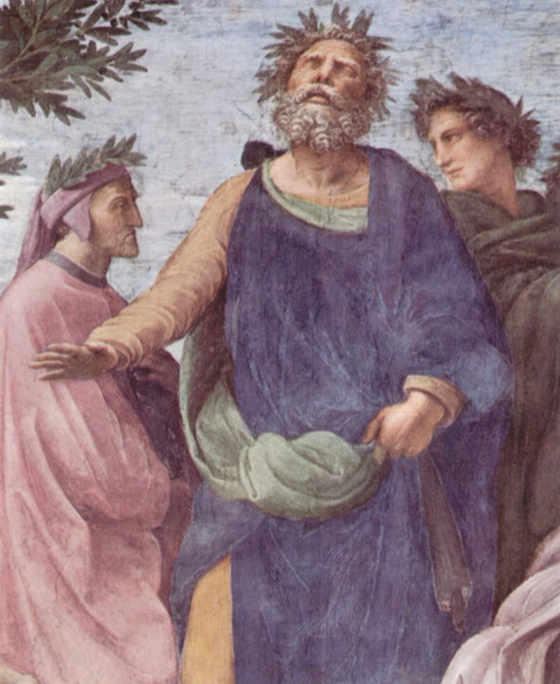
Homer: blind, or partially-sighted, non-existent, man or woman, men or women, poet(s) who created Western civilisation
Origins of the poet Homer are obscure. Agreed that he lived circa 9th-8th C. BC
Plato rated him the ‘leader of learning’.
Homer’s manner of writing, his subjects of writing, and his moral of writing, became the default template for Western writing…and Western study, and therefore Western civilisation’s foundation,

Slide 3
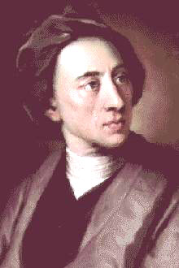
Praise of Homer from the greatest Western writers is superlative.
Alexander Pope:
  Be Homer's Works your Study, and Delight/
  Read them by Day, & meditate by Night /
  Thence form your Judgment, thence your Maxims bring, / And trace the Muses upward to their Spring…. / Still with It self compar'd, his Text peruse /
  Nature & Homer [are] … the same. /
  …Those oft are Stratagems which Errors seem,
  Nor is it Homer Nods, but We that Dream.
“indignor quandoque bonus dormitat Homerus” [Horace]—”Homer nods”

Slide 4
Homer’s mode of writing
Epic: a long narrative poem, on a grand scale, about the deeds of warriors and heroes.
Epic incorporates myth, legend, folk tale, and history. Most embody the values and aspiration sof a nation in a lofty and grandiose manner.
Primary epic is oral: Illiad & Odyssey, Gilmagesh, Beowulf, Norse Edda, etc.
Secondary epic is literary: Aeneid, Le Mort D’Arthur, Paradise Lost, etc.
Homer is the pivot between the two types: first encoded ballads, lays, histories, into literary form. Homer’s combination is seamless: perfect.
He articulates human universals: truth of human nature-character in all times & places

Slide 5
Homer: The Odyssey
The form—the complex structure of the narrative—is psychologically and intellectually perfect: the shape of the story matches two necessary things:
  the idea that the epic is design to communicate
  the expectations of the human psyche: what our mind seem to be constructed to respond to and be satisfied by.
The epic form Homer uses for the Odyssey does many things:
  defines formational national events—justified war
  shows the effects on the heroes that fight them
  structures the foundational national value as the defining axis: stable family.
    The female was both the beginning (the casus belli )and the end of the epic.
Homer delivers the ultimate individual value: perseverance and nous achieve all things

