Slide 1
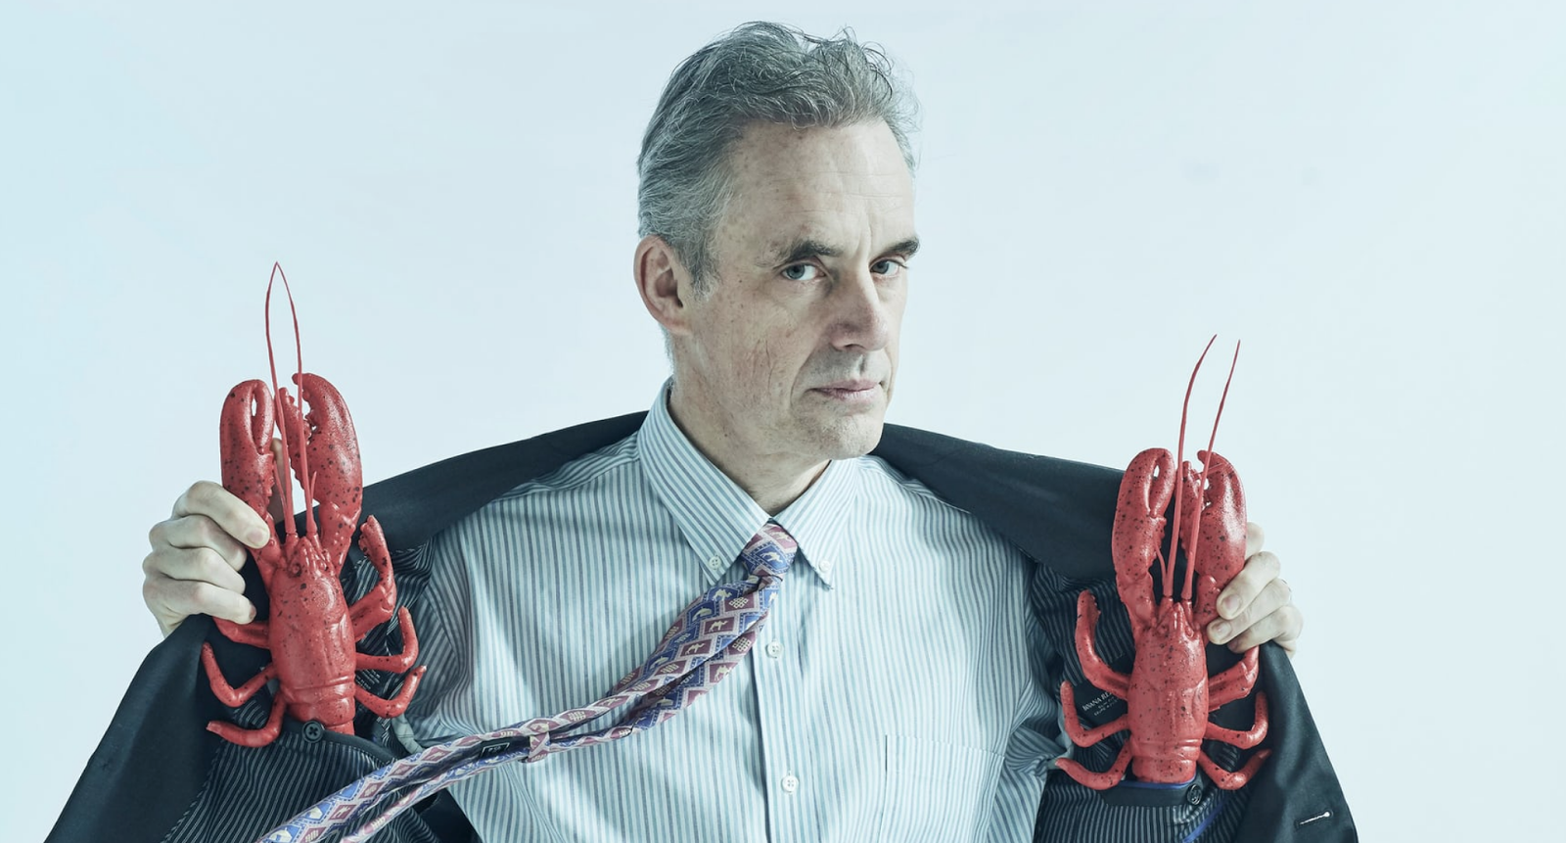
Dr Jordan B. Peterson
Proof for the Credibility of his Academic Use of Religion

Slide 2
CAMILLE PAGLIA
“Jordan Peterson is… restoring a peak period in North American thought, when Canada was renowned for…thinkers like media analyst Marshall McLuhan & myth critic Northrop Frye. I have yet to see a profile of Peterson … that accurately portrays the vast scope, tenor, and importance of his work.”

Slide 3
Boethius (5th C. Rome): The Consolation of Philosophy “Bottom of the dominance hierarchy is a terrible, dangerous place to be.”
Dame Fortune
Lady Sophia (Dame Philosophy)
Philo=Lover + Sophia=Wisdom

Slide 4
Jordan Peterson’s Religious Lineage: “Life is Suffering” e.g. Buddhism
THE 4 NOBLE TRUTHS
THE 8-FOLD PATH

Slide 5
Jordan Peterson’s Religious Lineage: “Life is Suffering” E.g. Christianity
⁶ To the woman He said:
“I will greatly multiply your sorrow and your conception; In pain you shall bring forth children; Your desire shall be for your husband, And he shall rule over you.”
¹⁷ Then to Adam He said,
“Because you have heeded the voice of your wife, and have eaten from the tree of which I commanded you, saying, ‘You shall not eat of it’:
“Cursed is the ground for your sake; In toil you shall eat of it All the days of your life. ¹⁸ Both thorns and thistles it shall bring forth for you, And you shall eat the herb of the field. ¹⁹ In the sweat of your face you shall eat bread Till you return to the ground, For out of it you were taken; For dust you are, And to dust you shall return.”

Slide 6
Jordan Peterson’s Religious Lineage
CONFESSIONAL LITERATURE
“I went back to prison…During my absence, two prisoners had attacked a third, a suspected informer. They…pulverized one of his legs with a lead pipe…I tried to imagine, really imagine, what I would have to be like to do such a thing…and experienced a frightening revelation. The truly appalling aspect of such atrocity did not lie in its impossibility…as I had naively assumed, but in its ease. I was not much different from the violent prisoners…I could do what they do.”
Jordan Peterson, Maps of Meaning

Slide 7
Jordan Peterson’s Religious Lineage
Wisdom Literature
Ascending Ladder of Intellect:
1st: Data
2nd: Information
3rd: Knowledge
4th: Understanding
5th: Wisdom
[OED]: “Capacity of judging rightly in matters relating to life and conduct; soundness of judgement in the choice of means and ends; …sound sense, esp. in practical affairs.”
Bible: Ecclesiastes (Solomon)
Stoic: Meditations (Marcus Aurelius)
China: Tao Te Ching (Lao Tzu)
Japan: Pillow Book, (Sei Shōnagon)
Persia: The Rubaiyat (Omar Khayyam)
——————————————————
Socrates-Plato: Eudæmonia
life lived in harmony with the Good.
Philosophy is not abstract passive theorising, but real active practice: valid only if offering solid principles of meaningful living in the world.

Slide 8
Wisdom: Comparative Examples
Jordan Peterson
History’s Wise People
“It wasn’t weakness that propelled so many boys out of the classroom to work at 40º below as roughnecks, arguably a better future. It was strength.” [Rule 11]
“We see tools and obstacles, not objects or things. We can literally feel things with the end of a screwdriver.” [Rule 10]
“You have to eternally sacrifice the present for the future; put aside pleasure for security, In short, you have to work.”
[Rule 2]
“To the working class, the notion of staying in school until you are nearly grown up seems contemptible & unmanly.”
George Orwell
“Technology is an extension of man.”
Marshall McLuhan
“The future is purchased by the present”.
Dr Johnson

Slide 9
Jordan Peterson: The Tao
‘The Way’
STOICISM
William James: Varieties of Religious Experience:
“Religion in the most… general terms possible…[is] the belief that there is an unseen order, and that our supreme good lies in harmoniously adjusting ourselves thereto.”
Aristotle: “Final Cause”
Jesus:
“Narrow the gate & difficult the way which leads to Life, and there are few who find it.”
‘Everything, even chance, is governed by Providence. And then there is the needs of the whole world, of which you are a part. Whatever the nature of the whole does, and whatever serves to maintain it, is good for every part of Nature.’
Marcus Aurelius, Meditations

Slide 10
Jordan Peterson: The Tao
Guide-Books to The Way
Ying-Yang
Stoicism: Marcus Aurelius (AD 121-180):
“By his time, the goals of ‘late Stoicism’ had been narrowed down to a philosophy of life that laid out the rules for virtue & happiness….a few basic principles of living.”
Bruce K. Alexander, A History of Psychology in Western Civilisation
Judaism: ‘The Ten Commandments’
Ten rules for harmonious social life and individual virtue.
[‘Laws’ are Rules enforced by power of the State]

Slide 11
Jordan Peterson: Intellectual-Religious Method
Dialectic
Example
‘DIA’ = ‘TWO’ + ‘LECT’=‘SPEECH’
OED: 1. a. Logic, reasoning; critical investigation of truth through reasoned argument… spec. by means of dialogue or discussion.
Jordan Peterson: Rule 9:
Assume That the Person You Are Listening to Might Know Something That You Don’t.
‘Thinking is an internal dialogue between two or more different views of the world.’ [I.e. Thought is Dialectic]
Individual
Rule 1. Stand up Straight With Your Shoulders Back.
Rule 6. Set Your House in Perfect Order Before You Criticize the World.
Society
“We are deeply social in our essence.”
“Culture is a fundamental universal existential reality. Every word we speak [&] the highly functional infrastructure that surrounds us, is gift from our ancestors.”
“In civilised open societies, the majority abide by a functional social contract aimed at mutual betterment.”

Slide 12
Jordan Peterson: Academic Religious Frame
“Varieties of Religious Experience”
William James’ Pragmatism
“Thought's meaning is the conduct it is fitted to produce; that conduct is its sole significance. Thought needs only the practical conduct we must prepare in case the object of thought be true. These practical consequences are our whole of our conception of the object, so far as that conception has positive significance at all.”
Varieties of Religious Experience

Slide 13
Jordan Peterson: Pragmatism
“I act as if God exists.” [Peterson, Online interview]
William James, Pragmatic religious belief:
“God is real since he produces real effects.”
“Faith is a biological as well as a psychological condition, and Tolstoy is absolutely accurate in classing faith among the forces by which men live. The total absence of it, anhedonia, means collapse.”
“The religious question is primarily a question of life, of living or not living in the higher union which opens itself to us as a gift.”
“I can imagine that the world of scientific laws may be all. But whenever I do this, an inward monitor whispers “bosh!” Humbug is humbug, even though it bear the scientific name, and the total expression of human experience, as I view it objectively, invincibly urges me beyond the narrow “scientific” bounds”
The Varieties of Religious Experience

