Slide 1
COMPUTATIONAL THOUGHT: social applications
Dr. STEPHEN A. OGDEN, BCIT Liberal Studies
WEEK TWO: CONTEMPORARY AI DYSTOPIA

Slide 2
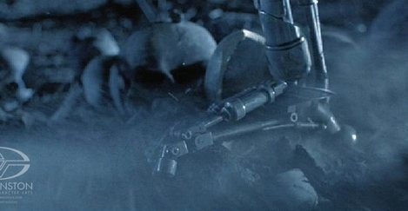
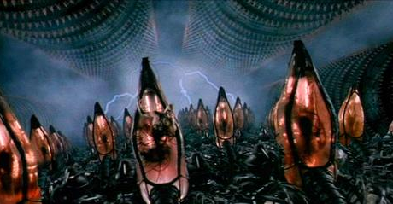
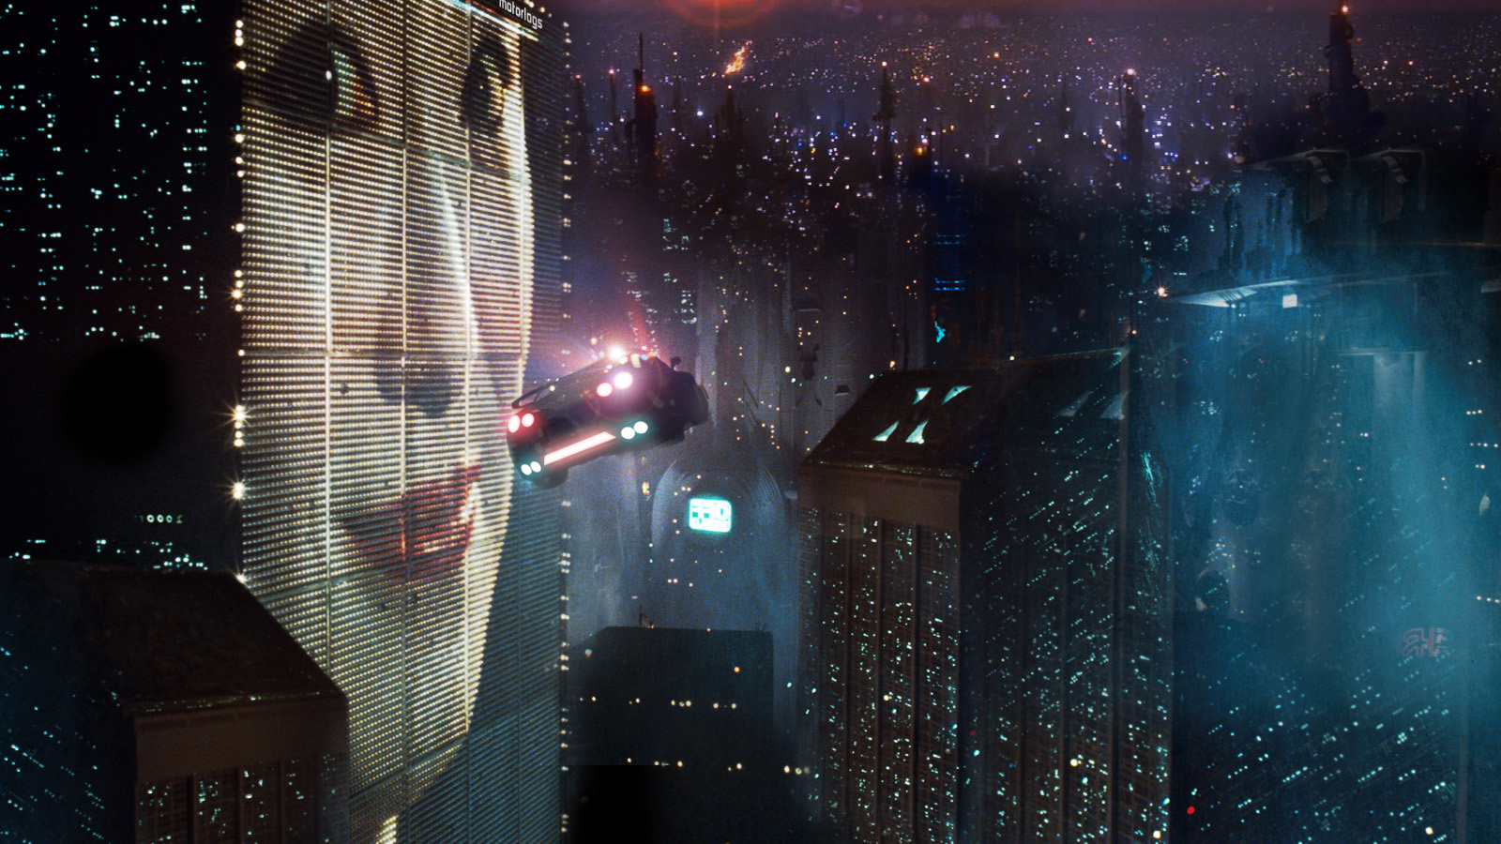
ARTIFICIAL INTELLIGENCE DYSTOPIA: a place broken by A.I.
TERMINATOR
Matrix
Blade Runner
A world where A.I. Machines walk over human skulls
A world of Humans enslaved by A.I.
Technological pollution and android alternatives to humans

Slide 3
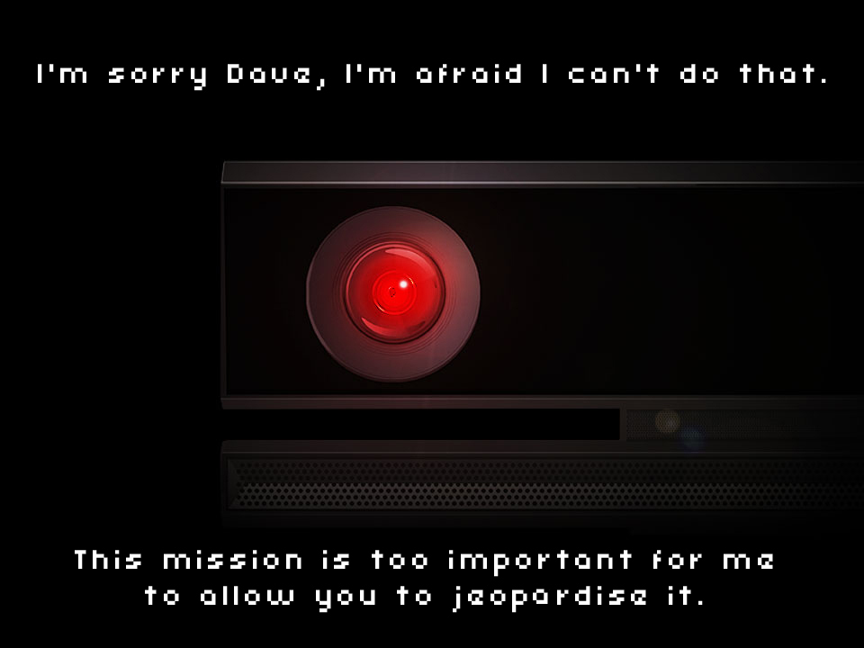
2001: A space odyssey
‘hal’ the A.I. murderer
The ‘HAL 9000’ computer that controls all aspects of the space flight to Jupiter perfectly rationally and perfectly unemotionally kills the human crew in succession.
A highly influential—and uncontentious—cultural configuration of A.I.

Slide 4
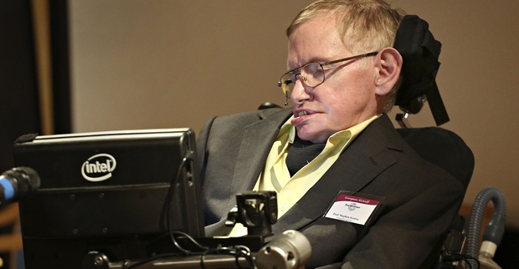
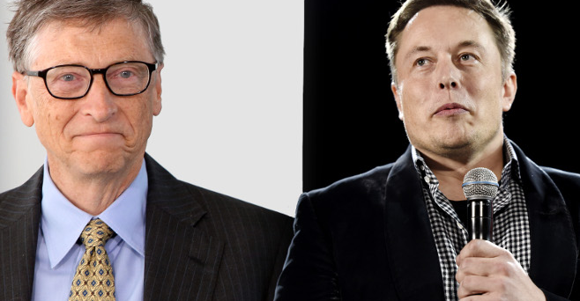
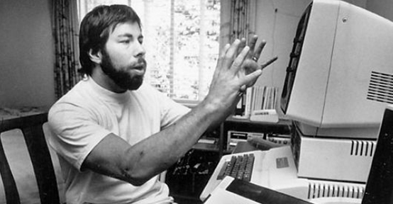
CONTEMPORARY dystopian VOICES: prominent technologists
Stephen Hawking
Bill Gates & Elon Musk
Steve Wozniak
"Humans, who are limited by slow biological evolution, couldn't compete, and would be superseded…the end of the human race"
“Artificial intelligence…our biggest existential threat…With artificial intelligence we are summoning the demon…. don’t understand why some people are not concerned.”
“If we build these devices to take care of everything for us, eventually they'll think faster than us and they'll get rid of the slow humans…."

Slide 5
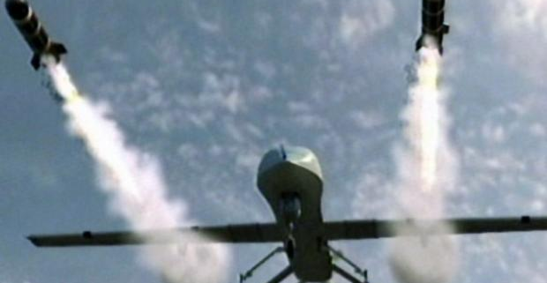
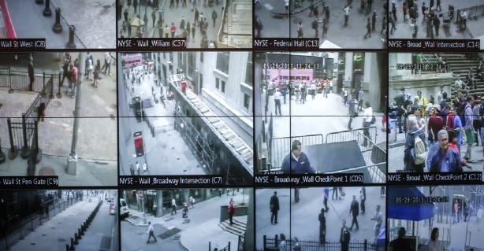
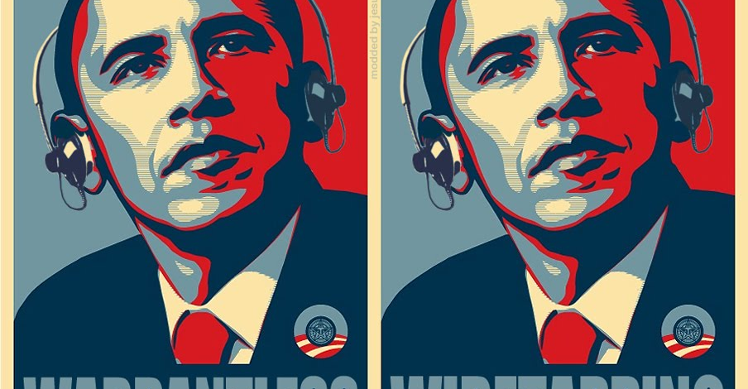
Contemporary concerns: overdetermination
Predator DRONES
Street SURVEILLANCE
Wiretapping & data mining
mobile surveillance and strike machinery on humans
Pedestrian and vehicular traffic capture public images of humans
All computer use is recorded and analysed

Slide 6
Voices of A.I. dystopia
Atlantic magazine, oct. 16 2015
“Americans Are More Afraid of Robots Than Death”
Chapman University Survey on American Fears, 2015
1. Political Corruption
2. Cyber-Terrorism
3. Corporate Tracking of Personal Data
5. Government Tracking of Personal Data
6. Bio-Warfare
7. Identity Theft
8. Electronic Identity Fraud & Theft
25. Robots
35. A.I.
43. Dying
Ten Categories of Fear: Survey Results
#1. Man-Made Disaster: [ Bio-warfare, terrorism, nuclear attacks ]
#2. Technology: [ Artificial Intelligence, Robots, Cyber-Terrorism ]
(Note that 1 & 2 reduce to the same thing)
#5. Personal Future: [ Dying, illness, unemployment ]

Slide 7
Why dystopia? Fear. but why fear?
The Atlantic Magazine story on the Chapman University Study:
“People tend to express the highest level of fear for things they’re dependent on but that they don’t have any control over, and that’s almost a perfect definition of technology,” said Christopher Bader, one of the co-authors of the study….
“Everybody would recognize that if they were about to be murdered, that would be a terrifying and horrible thing,” he continued, “but people have different senses of whether that would happen to them. Technology is more universal. It’s difficult for anyone to get by without it.”

Slide 8
FEAR: theory #1 created by DEPENDENCY
Logical Sequence
We fear what we depend on. [Chapman study: “…difficult to get by without [technology].”
Dependency means (by definition) that control is not yours.
So we Fear what we can not control.
A Control-Dependency Relationship is a Master-Slave Relationship
Slaves Fear Masters:
  For the harm—real or potential—that the dependent Slave is powerless to prevent from the controlling Master.
Thus: Man is dependent upon machine; is therefore Slave to machine; and is therefore necessarily in Fear of the machine

Slide 9
FEAR: theory #1
Examples of dependency-fEAR
Socrates-Plato:
  Logical Sequence: [1.] External technology replaces the Inner function. [2.] Use of the external results in atrophy of the inner function. [3.] With atrophy of function, man has necessary dependency on the external technology.
Management-Staff:
  Logical Sequence: [1.] Staff, Workers, have direct connection to work done. [2.] Managers and supervisors do not have direct connection to work [3.] But Managers & Supervisors have the responsibility for the work being done correctly. [4.] Managers & Supervisors are therefore dependent on workers. [5.] Thus, Managers & Supervisors operate perpetually from Fear.
Totalitarian Regimes:
  The Nazi example. Promoted their rise to power by playing up fear that Germany was dependent financially and internationally on the Jews—who controlled international finance.

Slide 10
FEAR: theory #2 created by UNKNOWN—The alien ‘Other’.
Sigmund Freud:
  Fear is an expression of the instinct for self-preservation.
  What arouses fear depends on (i.) our knowledge of and (ii.) our feeling of power over the outer world.
    “We deem it quite a matter of course that the savage fears a cannon or an eclipse of the sun, while the white man, who can handle the instrument and prophesy the phenomenon, does not fear these things”
  (ii.) is dependency-control again, but with (i.) Freud says what we don’t know can kill us, so our instinct for self-preservation creates Fear.
Charles Darwin:
  Emotions are an Instinct
  Instincts have survival value
  Fear is an Instinct
  The ‘Instinct of Fear’ impels us to urgent FLIGHT away from threat to survival
  The ‘Instinct of Fear’ also impels us to safety (survival) in reaction to the possibility of threat from the unknown

Slide 11
FEAR: theory #2 con’t created by UNKNOWN—The alien ‘Other’.
One means of power (tribal, social, political) is to manipulate a person or group as ‘the other’—something different from, lesser than, human: FEAR is the result.
  Returning to our previous example, Jews were presented as vermin (rats) by the Nazis.
  This past summer, local newspapers popularised a term that a Vancouverite coined to dehumanise householders who watered their lawns: “Grassholes”.
Marshall McLuhan:
  Technology is Extension-Amplification
  Extension results in Amputation (pace Socrates-Plato)
  Amputation creates Alienation (distance from the ‘Other’]
    FEAR OF BOTH ‘SPACE’ ALIENS and “IMMIGRANT ALIENS” = FEAR OF THE ‘UNKNOWN-OTHER’
  Logical Sequence
  Artificial Intelligence is the ultimate Extension and Amplification
  Therefore A.I. is the ultimate Other
  Therefore A.I. is the ultimate FEAR

Slide 12
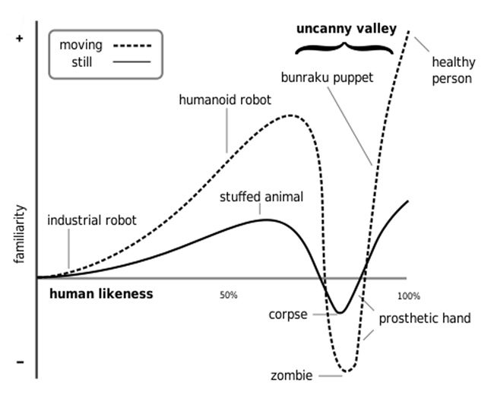
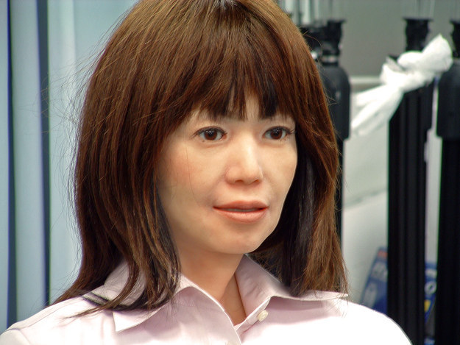
FEAR OF THE UNKNOWN—The alien ‘Other’:
The uncanny valley

