Slide 1
Week #9: The English Patient
Professor Poyner-Del Vento

Slide 2
Kindly turn off
All cell phones
The wireless component of any laptop computers

Slide 3
Overview of lecture
Introduction to author and novel
Historical background
Revision

Slide 4
Introduction to author and novel

Slide 5
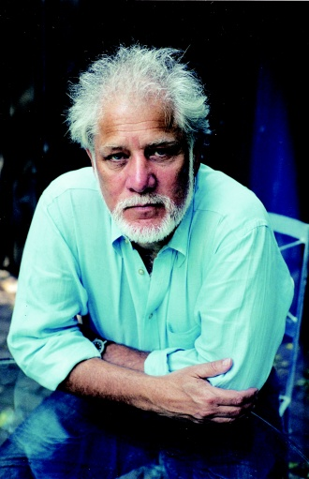
Introduction to Michael Ondaatje

Slide 6
Introduction to The English Patient

Slide 7
Lyrical style
The English Patient is written in a highly lyrical style
Some students struggle with reading this writing style

Slide 8
Historical background

Slide 9
World War Two
1939-1945
Involved countries from around the world
Allies
Axis
More than 100 million soldiers and other military members were involved
Between 50-70 million people killed

Slide 10
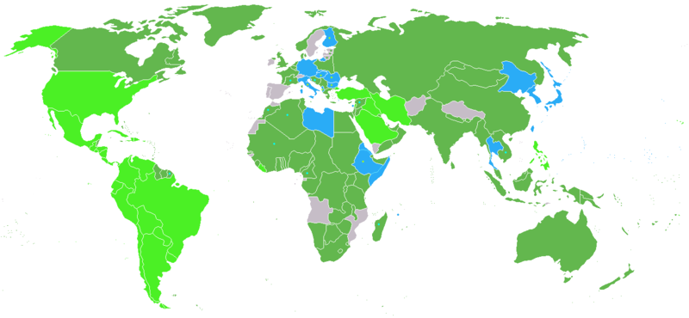
Countries involved in World War II

Slide 11
Revision

Slide 12
Two kinds of revision
Higher Order Concerns—big picture issues
Do you have a debatable thesis?
Is your essay well organized?
Are your ideas developed enough?
Lower Order Concerns—small details
Are you writing grammatical sentences?
Are you using punctuation correctly?
Are you using proper MLA Style?
adapted from OWL Website: http://owl.english.purdue.edu/owl/resource/690/01/

Slide 13
“One Art”
By Elizabeth Bishop
American poet
20th century
First page of handout

Slide 14
First draft of “One Art”
Second page of handout

Slide 15
Eleventh draft of “One Art”
Third page of handout

Slide 16
Real revision
truly revising means being willing to change anything

Slide 17
Advantage of Outline
Allows you to see essay as whole
Allows you to focus on HOCs, not LOCs
Resources available on WebCT

Slide 18
Format for Outline
Several pages, using point form
Works Cited page, using MLA style
Optional: Acknowledgements page
Will be graded according to rubric
Due dates are based on your tutorial dates
Mon, July 18th
Tue, July 19th
Also turn in via WebCT

Slide 19
The English Patient
Read until page 176 by next lecture

