Slide 1
Week #8: The Ghost Road
Professor Poyner-Del Vento

Slide 2
Kindly turn off
All cell phones
The wireless component of any laptop computers

Slide 3
Room for Exam
Exam is scheduled on Mon, July 4th, 12:30 to 1:30 p.m.
If your tutorial is D902, you will take your exam in a separate room
If you have any other tutorial, you will take your exam in SUR 5280
Short lecture about The English Patient, 1:50 to 2:20, in SUR 5280

Slide 4
Overview of lecture
Ghosts, haunting, and the dead
Billy Prior: boundary crosser
Civilization and savagery
Brief exam review
Quotations, paraphrases, and summaries

Slide 5
Ghosts, haunting, and the dead

Slide 6
Death as integral part of Melanesian culture
Spirits and ghosts are considered part of daily life
Elaborate rituals associated with death and mourning
Skulls of dead are kept in sacred houses
Traditionally, head-hunting was a big part of their culture

Slide 7
Death as integral part of British life in World War I
“All the men who’d passed through, through Scarborough, through her, on their way to the Front . . . He was aware of their weight on him, his arms were braced to carry it.” (Barker 40-41)

Slide 8
Death as integral part of British life in World War I
“Ghosts everywhere. Even the living were only ghosts in the making.” (Barker 46)

Slide 9
Connections between cultures’ understanding of death
“He knocked on the door of Mrs Irving’s private apartments . . . and as a man one had to make some kind of sense of them.” (Barker 116-117)

Slide 10
Skulls as connections between two cultures
“Rivers took the skull, aware of the immense honour that was being done to him, and searching for something to say and the words to say it in. . . . each holding the object of the highest value in the world.” (Barker 238-239)

Slide 11
Billy Prior: boundary crosser

Slide 12
Prior as boundary crosser
Last week, we made a list of the ways in which Billy Prior crosses traditional social roles

Slide 13
Prior as boundary crosser
How does Prior’s duality affect his view of society?
Does not firmly fit into any class, category, or civilization
Has a cynical and detached view of the world

Slide 14
Prior’s cynical view
“One in particular. . . . Nobody ever forgets that.” (Barker 100)

Slide 15
Prior as similar to Melanesians on boundary of cultures
“He looked up, at the blue, empty sky, and realized that their view of his society was neither more nor less valid than his of theirs. No bearded elderly white man looked down on them, endorsing one set of values and condemning the other. And with that realization, the whole frame of social and moral rules that keeps individuals imprisoned – and sane – collapsed, and for a moment he was in the same position as these drifting, dispossessed people. A condition of absolute free-fall.” (Barker 119-120)

Slide 16
Prior’s experiences with skulls
Prior also repeatedly sees or thinks of skulls (e.g., Barker 240)
His experiences are stripped of cultural meaning
He “sends” Hallet’s wounded skull to Rivers (Barker 230, 239)

Slide 17
Civilization and savagery

Slide 18
Rivers reflects on difference between savagery and civilization
“On Vao there was a custom that when a bastard was born some leading man adopted the child and brought him up as his own. . . . He had knelt at that altar rail for years, Sunday after Sunday, receiving the chalice from his father’s hands.” (Barker 103-104)

Slide 19
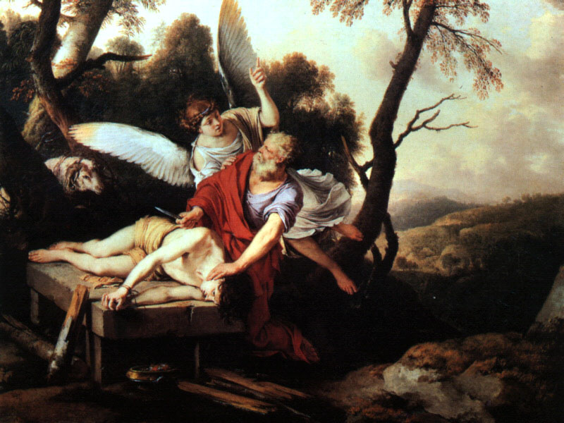
“Abraham Sacrificing Isaac” from Genesis 22:1-19

Slide 20
Melanesian culture as dying from lack of war
“Head-hunting had to be banned . . . much of that decline was deliberate.” (Barker 207)

Slide 21
British culture as dying from a surplus of war
“A generation lasted six months, less than that on the Somme, barely twelve weeks.” (Barker 46)

Slide 22
Parable of the Old Man and the Young
So Abram rose, and clave the wood, and went,
And took the fire with him, and a knife.
And as they sojourned both of them together,
Isaac the first-born spake and said, My Father,
Behold the preparations, fire and iron,
But where the lamb for this burnt-offering?
Then Abram bound the youth with belts and straps,
and builded parapets and trenches there,
And stretchèd forth the knife to slay his son.
When lo! an angel called him out of heaven,
Saying, Lay not thy hand upon the lad,
Neither do anything to him. Behold,
A ram, caught in a thicket by its horns;
Offer the Ram of Pride instead of him.
But the old man would not so, but slew his son,
And half the seed of Europe, one by one.
By Wilfred Owen

Slide 23
Fathers and sons
Rivers and Prior establish a father-son-like relationship (Barker 98)
Rivers is paternal toward many of his patients
Officers feel paternal toward their soldiers
Plus, there are a few biological fathers and sons (Hallet’s father and Hallet)

Slide 24
Rivers gains spiritual insight into his own culture
Hallet is “mate” (Barker 264-265)

Slide 25
Rivers gains spiritual insight into his own culture
Understands “Ave” in a scientific sense and learns the words of the exorcism (Barker 268-269)
Understands “Ave” in a spiritual sense and participates in a symbolic exorcism (Barker 274-274)

Slide 26
Brief Exam Review

Slide 27
Exam is open book and open notes
Must bring:
Pen or pencil
SFU student ID
Should bring:
Marked copy of The Ghost Road
Notes from lecture
Close Reading sheet
Specially prepared notes for exam
Scrap paper

Slide 28
Exam is open book and open notes
Might bring:
Dictionary
Another book for reference
CANNOT bring:
Anything electronic (e.g., laptop, electronic translator, cell phone)
Anything potentially noisy or distracting
Anything to share with classmates

Slide 29
Exam Format
1 hour long
2 questions, each worth 50%

Slide 30
Passage analysis
You will be given a choice of three passages from The Ghost Road.
Choose two.
For each passage you choose, write one or two paragraphs that analyze the internal complexities and ambiguities of the material, offering your own interpretations.
Your analyses will probably discuss the passage’s significance to the entire book.
Your answer should focus on an analysis of the passage, not merely a description of the passage or a list of observations about it.

Slide 31
To prepare for exam
Practice Close Reading
Choose passages relevant to themes in lecture
Bring examples of Close Reading to office hours

Slide 32
Room for Exam
Exam is scheduled on Mon, July 4th, 12:30 to 1:30 p.m.
If your tutorial is D902, you will take your exam in a separate room
If you have any other tutorial, you will take your exam in SUR 5280
Short lecture about The English Patient, 1:50 to 2:20, in SUR 5280

Slide 33
Quotations, paraphrases, and summaries

Slide 34
Three ways of using textual evidence:
Quotations
Paraphrases
Summaries
adapted from OWL Website: http://owl.english.purdue.edu/owl/resource/606/01/

Slide 35
Quotation
Must be word-for-word identical to original text
Uses a small section of original text
Must use quotation marks
Must cite author and page number
adapted from OWL Website: http://owl.english.purdue.edu/owl/resource/563/1/

Slide 36
Example of a quotation
When Rivers is travelling in Melanesia, “He looked up, at the blue, empty sky, and realized that [the natives’] view of his society was neither more nor less valid than his of theirs.” (Barker 119).

Slide 37
Paraphrase
Uses the ideas from the original text, but puts them into your own words
Uses a small section of original text
Does not use quotation marks
Must cite author and page number
adapted from OWL Website: http://owl.english.purdue.edu/owl/resource/563/1/

Slide 38
Example of a paraphrase
When Rivers is travelling in Melanesia, he views his own lifestyle through the perspective of the natives and experiences cultural relativism (Barker 119).

Slide 39
Summary
Uses the main ideas from the original text, but puts them into your own words
Much shorter than the original: uses a large section of original text and condenses it
Does not use quotation marks
Must cite author and page number(s)
adapted from OWL Website: http://owl.english.purdue.edu/owl/resource/563/1/

Slide 40
Example of a summary
When in Melanesia, Rivers questions the native people about their culture; in turn, they ask him the same questions back. Their amused response to his answers leads him to examine certain assumptions he has made about British values (Barker 118-120).

Slide 41
Problems with quotations, paraphrases, and summaries
Too many quotations
Poor coherence/transition/introduction
Not enough analysis
Incorrect MLA style

Slide 42
Format for First Draft
1500 words minimum
Works Cited page, using MLA style
Optional: Acknowledgements page
Will be graded according to rubric
Due dates are based on your tutorial dates
Mon, June 27th
Tue, June 28th
Also turn in via WebCT

Slide 43
The English Patient
Read until page 65 by next lecture
Good luck on your first draft!
Good luck on Exam #2!

