Slide 1
Week #7: The Ghost Road
Professor Poyner-Del Vento

Slide 2
Kindly turn off
All cell phones
The wireless component of any laptop computers

Slide 3
Overview of lecture
Historical background
Masculinity and empire
Billy Prior: boundary crosser
First draft of essay

Slide 4
Historical background

Slide 5
World War One
1914-1918
Centered in Europe, but involved countries from around the world
Allies
Central Powers
More than 70 million soldiers and other military members were involved
More than 9 million people killed

Slide 6
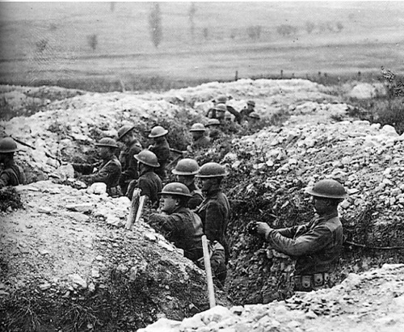
World War One

Slide 7
Anthem for Doomed Youth
What passing-bells for these who die as cattle?
Only the monstrous anger of the guns.
Only the stuttering rifles' rapid rattle
Can patter out their hasty orisons.
No mockeries now for them; no prayers nor bells,
Nor any voice of mourning save the choirs,—
The shrill, demented choirs of wailing shells;
And bugles calling for them from sad shires.
What candles may be held to speed them all?
Not in the hands of boys, but in their eyes
Shall shine the holy glimmers of good-byes.
The pallor of girls' brows shall be their pall;
Their flowers the tenderness of patient minds,
And each slow dusk a drawing-down of blinds.
By Wilfred Owen
Notes:
World War I were educated during the war. As well as poems were written.
World War I was famous for its war poetry.

Slide 8
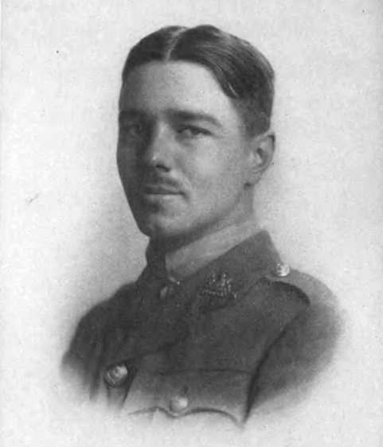
Wilfred Owen

Slide 9
Biographical information incorporated into The Ghost Road
Historical information about Wilfred Owen’s military experiences is used to create details about Billy Prior’s military experiences
Themes from Owen’s poems are interwoven into the novel’s plot

Slide 10
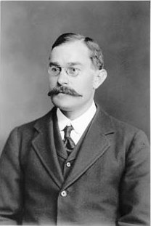
W.H.R. Rivers

Slide 11
W.H.R. Rivers
As a child, was family friends with Lewis Carroll (Mr. Dodgson), the author of Alice in Wonderland
Trained as a medical doctor
Studied indigenous cultures in Melanesia (Solomon Islands in Pacific Ocean) as an anthropologist
Performed groundbreaking research on the regeneration of nerves (by operating and experimenting on his colleague’s arm)
Developed revolutionary, humane methods for treating “shellshock” (PTSD) in soldiers during World War I

Slide 12
Biographical information incorporated into The Ghost Road
Information about family members
Memories of Mr. Dodgson (Lewis Carroll)
Extensive memories of anthropology trip to Melanesia
Psychological treatments for patients with PTSD

Slide 13
Masculinity and empire

Slide 14
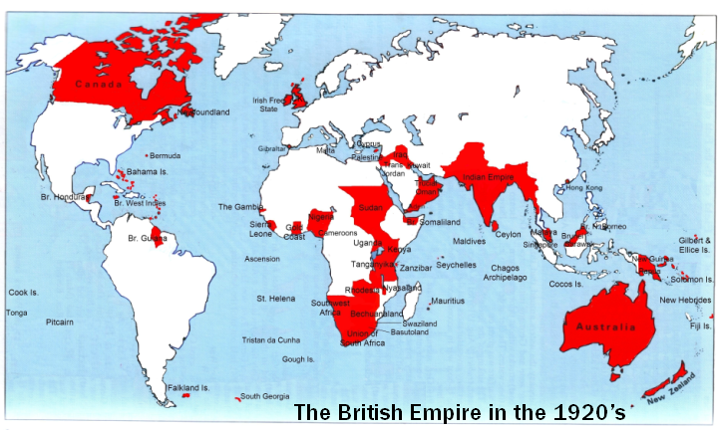
British empire
Notes:
Britain had the largest empire in human history. ¼ of the world and more than ¼ of the population of the world at that time.

Slide 15
Excerpt from academic article about The Ghost Road
Excerpt from “Dreams of Melanesia: Masculinity and the Exorcism of War in Pat Barker’s The Ghost Road” by Jennifer Shaddock
“Rivers . . . function[s] within a still-intact nineteenth-century British ideology of masculinity, a cultural belief system that inculcated Victorian boys into the variant roles necessary to the creation and preservation of the British Empire.” (659)

Slide 16
British military culture and World War I
Great Britain had a strong cultural emphasis on war
World War I produced an enormous need for soldiers
Young men enlisted in record numbers

Slide 17
Shellshock
Approximately 80,000 British soldiers were treated for shellshock (PTSD) during World War I (Shaddock 661)
Large number
Partially due to sheer size of war
Partially due to advancements in psychology
Perhaps partially due to nature of trench warfare

Slide 18
Mental illness as threat to masculinity
“‘I don’t like that word. Applied to this.’
‘Hysteria?’ He could quite see that shell-shock, useless and inaccurate though the term was, might appeal to Moffat rather more. It did at least sound appropriately male. ‘I don’t think anybody likes
hysteria. The trouble is nobody likes the alternatives either.’
‘It derives,’ Moffat continued, hardening
his voice, ‘from the Greek hystera, the womb.’
‘Yes,’ Rivers said drily, ‘I know.’” (Barker 48)

Slide 19
Mental illness as feminizing
Rivers’s patients feel that their masculinity is threatened:
Rivers draws “stocking tops” on Moffet to cure his hysterical paralysis (Barker 21)
Telford has a delusion that his penis has been cut off by a female nurse (54)
Other patients suffer from stereotypically female symptoms of hysteria: fainting, psychosomatic illnesses, etc.

Slide 20
Shellshock as a result of disempowerment
“Rivers’s theory is that the crucial factor in accounting for the vast number of breakdowns this war has produced is not the horrors–war’s always provided plenty of those–but that fact that the strain has to be borne in conditions of immobility, passivity and helplessness. Cramped in holes in the ground waiting for the next random shell to put you out.” (Barker 172)
Notes:
Lack of movement, lack of activity which is a kind of feminine war style leads to hysteria, Rivers.

Slide 21
Rivers’s approach to treating mental illness
Gentle and progressive, especially for that time period
Respectful and paternal toward his patients
Yet ultimately, his goal is to return them to the war

Slide 22
Rivers’s approach to treating mental illness
“Every day of his working life he looked at twitching mouths that had once been clenched. Go on. he said, though rarely in so many words, cry. It's all right to grieve. Breakdown's nothing to be ashamed of-the pressures were intolerable. But, also, stop crying. Get up on your feet. Walk. He both distrusted the silence and endorsed it, as he was bound to do, he thought, being his father's son.” (Barker 96)

Slide 23
Billy Prior: boundary crosser

Slide 24
Prior as boundary crosser
With a partner, make a list of the ways in which Billy Prior crosses traditional social roles
Notes:
Bisexual
Class – born in the working class but serves in the officer class
Engaged but promiscuous at the same time
Opinion about war
Sanity: what does it mean to be healthy?

Slide 25
Prior as boundary crosser
How does Prior’s duality affect his view of society?

Slide 26
Prior as boundary crosser
Page 101
Pages 143-144
Pages 119-120

Slide 27
First Draft of Essay

Slide 28
Tips for first draft
Revising your thesis
Paragraph formation

Slide 29
Revising your thesis
If . . .
Your Tutorial Leader tells you that your thesis isn’t debatable
OR your grade is significantly lower than you want it to be
Then, you should radically revise your thesis

Slide 30
Common problems with thesis
Not debatable
Not specific
Just describes novel
“In Cold Mountain, Inman has chosen to abandon his role as a soldier. He is behaving differently than a traditional masculine role.”

Slide 31
Solution: Read OWL for help
“Writing about Literature”: http://owl.english.purdue.edu/owl/resource/618/01/
“Writing about Fiction”: http://owl.english.purdue.edu/owl/resource/616/1/
Many documents have multiple sections
Other good resources listed on WebCT site

Slide 32
Solution: Brainstorm on own
Ask yourself: “How?” “Why?” “What are the implications?”
Perform Close Reading on passages from book

Slide 33
Solution: Brainstorm with Tutorial Leader or Professor P.D.
Professor P.D.
SUR 5191
Mondays 4-6 p.m.
Extra office hours this week
All Tutorial Leaders have office hours
Attend with questions and ideas

Slide 34
Paragraph formation
Unity
Coherence
Development
adapted from OWL Website: http://owl.english.purdue.edu/owl/resource/606/01/

Slide 35
Unity
Each sentence relates to your paragraph’s main point
Optional: use a topic sentence
adapted from OWL Website: http://owl.english.purdue.edu/owl/resource/606/01/

Slide 36
Coherence
One idea leads smoothly and logically to the next
Tips:
link ideas closely
repeat key words
establish a logical order
maintain consistency
use transitional words
make sure citations cohere with the rest of paragraph
adapted from OWL Website: http://owl.english.purdue.edu/owl/resource/606/01/

Slide 37
Development
fulfill the promise of your topic sentence
adapted from OWL Website: http://owl.english.purdue.edu/owl/resource/606/01/

Slide 38
Useful Handout: Hints for Adapting Passage Analysis for Essays
Contains tips for how to convert the skill of Close Reading for use in essays
Contains tips for how to craft body paragraphs
Available:
In tutorials
On WebCT, under “Resources to Help You Write Take-Home Assignments” in the folder “Step Two: First Draft”
Also check out other helpful resources in this same folder

Slide 39
Format for First Draft
1500 words minimum
Works Cited page, using MLA style
Optional: Acknowledgements page
Will be graded according to rubric
Due dates are based on your tutorial dates
Mon, June 27th
Tue, June 28th
Also turn in via WebCT

Slide 40
The Ghost Road
Read until end by next lecture
Good luck on your first draft!

