Slide 1
Week #2: Cold Mountain
Professor Poyner-Del Vento

Slide 2
Kindly turn off
All cell phones
The wireless component of any laptop computers

Slide 3
Overview of lecture
Plagiarism
Introduction to author , novel, and historical background
Historical fiction
Close Reading

Slide 4
Plagiarism

Slide 5
Contradictions in Academic Writing
“Develop a topic based on what has already been said and written but write something new and original
“Rely on opinions of experts and authorities on a topic but improve upon and/or disagree with those same opinions
“Give credit to researchers who have come before you but make your own significant contribution
“Improve your English or fit into a discourse community by building upon what you hear and read but use your own words and your own voice”

Slide 6
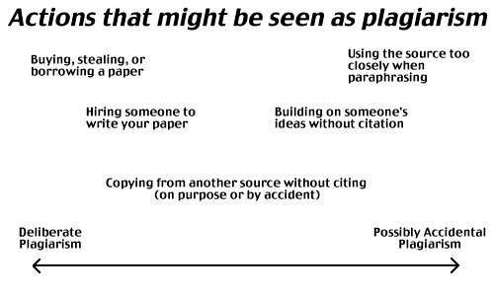

Slide 7
Should you cite?
Need to Cite | Don’t Need to Cite

Slide 8
Should you cite?
Information from a newspaper, book, or website
Information from an e-mail
Generally accepted facts
Reprinted illustrations or photographs
Your own memories or opinions
Ideas from conversations with classmates
Unique phrases
Common knowledge
Results from your own experiment

Slide 9
Patchwriting
Most common type of plagiarism in ENGL 101W
According to the SFU Plagiarism Tutorial: “Patchwriting occurs when a student paraphrases a passage but leaves it too similar to the original. In patchwriting, the writer may delete a few words, change the order, substitute synonyms and even change the grammatical structure, but the reliance on the original text is still visible when the two are compared.”
http://www.lib.sfu.ca/node/10470/take

Slide 10
Patchwriting
Patchwriting occurs when a student paraphrases a passage but leaves it too similar to the original. In patchwriting, the writer may delete a few words, change the order, substitute synonyms and even change the grammatical structure, but the reliance on the original text is still visible when the two are compared.
Patchwriting occurs when a student paraphrases a passage but leaves it too similar to the original. In patchwriting, the writer may delete a few words, change the order, substitute synonyms and even change the grammatical structure, but the reliance on the original text is still visible when the two are compared.

Slide 11
Collusion
A particular type of plagiarism
Unauthorized/inappropriate help on a take-home assignment

Slide 12
Is this help appropriate?
Appropriate in virtually all SFU courses
Help from your professor, T.A., or T.M. given during office hours
Research help from a librarian
Appropriate in ENGL 101 (with an Acknowledgements Page)
Proofreading from a friend or tutor
Not appropriate in ENGL 101
Radical rewrites from anyone but you

Slide 13
Is this help appropriate?
Original: “Cold Mountain is set during the US Civil War, it’s protagonist is a a deserter from the Confederate Army.”
Appropriate editing help: “Cold Mountain is set during the U.S. Civil War; its protagonist is a deserter from the Confederate Army.”
Inappropriate editing help: “Charles Frazier’s historical novel Cold Mountain creates a Confederate hero that is accessible to modern readers; as a deserter, Inman’s distrust in the South makes him more relatable.”

Slide 14
Plagiarism has large consequences
Any plagiarism, even accidental, will result in an automatic zero and will be reported to the Academic Integrity Office
No make-ups
Always follow a policy of CYA
More information is available on ENGL 101’s WebCT page in the folder “Resources on Avoiding Plagiarism”

Slide 15
Introduction to author, novel, and historical background

Slide 16
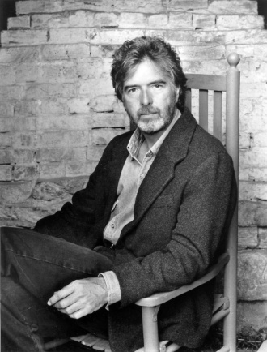
Introduction to Charles Frazier

Slide 17
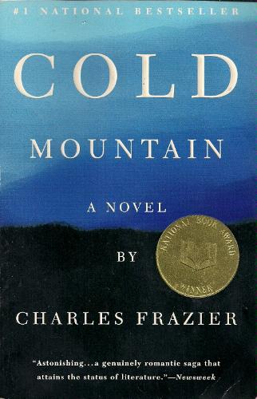
Introduction to Cold Mountain

Slide 18
U.S. Civil War (War Between the States)
Before 1861, all U.S. states were the same country
In southern states, slavery was legal
In northern states, slavery was not legal
In 1860, Southern states started seceding
War lasted from 1861-1865
South (Confederacy)
North (Union, Federals)

Slide 19
Civil War in Cold Mountain
Set in 1864, near the end of the war
Set in North Carolina (Southern state)

Slide 20
Historical fiction

Slide 21
Historical novel
A novel set in the past
A book that blends fictional characters and stories with historically accurate facts and real people and events

Slide 22
History in Cold Mountain
Large historical events
Cultural history
Real characters

Slide 23
Charles Frazier’s Interview with Book Browse
“[The original Inman] was my great great uncle. And part of the character was based on my great grandfather. Both of them went to the Civil War--volunteered in the first few months of that war fever and went off to battle. This Inman was in some of the worst fighting of the war. He was in Virginia and was in many battles in key positions. But I knew so little about him. There were no photographs of him; he wrote no letters home. It's just a little fragment of a family story about this guy--of his war experience, his coming home, and what happened to him when he got there. ”

Slide 24
Contradiction of a historical novel
Phrase is an oxymoron
history=past, old
novel=new
history= “real,” “true,” “non-fiction”
novel= “unreal,” “not true,” “fiction”

Slide 25
Excerpt from book about historical fiction
Excerpt from introduction of Novel History: Historians and Novelists Confront America’s Past (and Each Other)
“If we rely on stories to guide us through life, we want the guide to be reliable and truthful, and to tell it like it really is; however, we also want the guide to be artful and witty, and to lead us along paths with which we are familiar. The historical novel has emerged to satisfy these conflicting desires. It is inescapably a contradiction in terms: a non-fictional fiction; a factual fantasy; a truthful deception.”

Slide 26
Excerpt from book about historical fiction
“Historians and historical novelists do many of the same things and in much the same way. They research old documents and materials; they work with words, both as objects of study and implements of their trade; they seek perspective on the human experience by examining it from a chronological remove; they endeavour to speak to a contemporary audience; they aspire to represent the past truthfully and yet know that their presentations cannot be ‘truthful,’ ‘objective,’ or ‘accurate’ because logical clarity is incompatible with human affairs.”

Slide 27
Fictional portrayal of a real battle
“When he was squatted down loading, Inman could hear the firing, but also the slap of balls into meat. . . . Inman just got to hating tem for their clodpated determination to die.” (Frazier 11)
“To this accompaniment, the poorly shod of Inman’s party climbed over the wall to yank the boots off the dead. . . . Inman would always remember that, as the man came to the end of the row, the first light of down came up on his face.” (Frazier 13-14)

Slide 28
Nonfictional portrayal of a real battle
“Fredericksburg, battle of (1862), defeat of the Union army under the command of Burnside, grimly reminiscent of his performance at Antietam three months earlier. He planned a swift crossing of the Rappahannock at Fredericksburg to outflank Lee, but a three-week delay in the arrival of pontoons permitted the Confederates to fortify the ridge overlooking the town. It took a further two days to establish crossings in the teeth of deadly sniping by Barksdale's Mississippians, but finally throughout 13 December Sumner's Grand Division launched nine completely unsuccessful attacks in the open against a stone wall and a sunken road held by Longstreet's corps, covered by fire from Confederate artillery on the commanding Marye's Heights.”

Slide 29
Nonfictional portrayal of a real battle
“Better progress was made on the Union left by Franklin's Grand Division where, despite galling fire from flanking horse artillery under Pelham—a rare event in this war—Meade's division penetrated a weak spot in A. P. Hill's division of Jackson's corps. Unsupported and counter-attacked by Early's division, Meade was thrown back and suffered 40 per cent casualties. Union losses were 12,500 against under 5,000 for the Confederates. A satisfied Lee commented: ‘It is well that war is so terrible—we should grow too fond of it.’ ”

Slide 30
Excerpt from book about historical fiction
“The past exists only in our remembrance of it. Historians and novelists remember in different ways; either is incomplete. The historians’ preoccupations with facts and confirmatory evidence renders them less sensitive to the imaginative and emotional aspects of life, while the novelists’ craving for personal meaning and contemporary relevance may inhibit their ability to perceive the ways in which people in the past differ from us.”

Slide 31
Close Reading

Slide 32
Close Reading Sheet
Choose short section of text on which to perform “close reading”
Make observations, using these categories:
Genre
Point of View / Narrative Perspective
Tone / Mood
Page Design
Objects
Figures of Speech
Style
Any other observations
Analyze the implications of your observation(s)

Slide 33
A. Choose short section of text on which to perform “close reading”
“Of course, in her previous life Ada had taken little part in the garden Monroe had always paid someone to grow for them, and her mind, in consequence, had latched itself to the product—the food on the table—not the job of getting it there. . . . When the bleeding headless body staggered about the yard in the time-honored habit of sots, Ruby pointed to it with her ragged sheath knife and said, That your sustenance there.” (Frazier 104-105)

Slide 34
B. Make observations, using these categories:
Genre
Point of View / Narrative Perspective
Tone / Mood
Page Design
Objects
Figures of Speech
Style
Any other observations

Slide 35
1. Genre
Prose, fiction, novel
Historical novel

Slide 36
2. Point of View / Narrative Perspective
Third person
Fixed (Ada)

Slide 37
3. Tone / Mood
Forceful, urgent

Slide 38
4. Page Design
Two normal-sized paragraphs
Normal page design for this section

Slide 39
5. Objects
Garden
Food
Table
Nose
Dirt
Clothes
Nails
Roof
Shakes
Cold Mountain
Cream
Butter
Book
Pocket
Fields
Chicken
Chopping block
Head
Hatchet
Body
Sheath knife

Slide 40
6. Figures of speech
Personification: “her mind . . . had latched itself to the product”
Simile: fingernails “as crude as the claws of a beast”
Metaphor: headless chicken “staggered about the yard in the time-honored habits of sots”

Slide 41
7. Style
Repeated verb: “made”
Some regional and old fashioned language: “shakes,” “sots”

Slide 42
8. Any other observations
Emphasis on Ada’s transformation
Emphasis on Ruby’s role
List-like structure in first paragraph
Second paragraph focuses on killing a chicken

Slide 43
Choose which observation(s) to analyze
Genre
Point of View / Narrative Perspective
Tone / Mood
Page Design
Objects
Figures of Speech
Style
Any other observations

Slide 44
C. Analyze the implications of your observation(s)
This passage is about Ruby teaching Ada self-sufficiency; it shows how Ada is learning about the mechanics of producing food. This process is described as the “rudeness of eating” and is contrasted with Ada’s previously pampered lifestyle. The passage’s figurative language reinforces the sense of Ada’s transformation: her dirty fingernails are described “as crude as the claws of a beast.” Although this simile initially seems negative, it symbolizes Ada’s growing recognition that humans are a part of nature. Like any animal, Ada must eat to survive. The necessity of food is reinforced by the repetition of the word “made”: page 104 ends with a long sentence that lists out various activities that Ruby “made” Ada do. Here, Ruby embodies the “rudeness” of real life—life does not ask civilly; it compels.

Slide 45
Cold Mountain
Read until page 297 by next lecture
Have a great Victoria Day holiday!

