Slide 1
Week #12: The Things They Carried
Professor Poyner-Del Vento

Slide 2
Kindly turn off
All cell phones
The wireless component of any laptop computers

Slide 3
Overview of lecture
Introduction to author and novel
Historical background
Think aloud protocol
Announcements

Slide 4
Introduction to author and novel

Slide 5
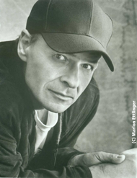
Introduction to Tim O’Brien

Slide 6
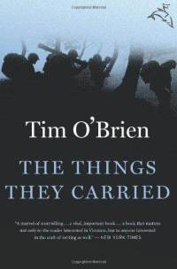
Introduction to The Things They Carried

Slide 7
Historical background

Slide 8
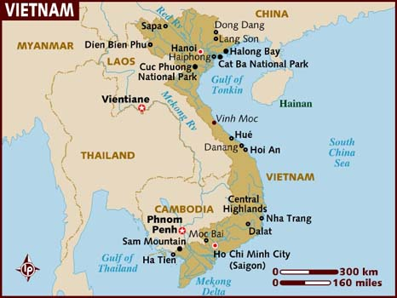
Vietnam

Slide 9
Vietnam War
1955-1975
Vietnam was colonized by the French (and briefly by the Japanese)
Vietnamese began fighting for independence during 1940s
Vietnam gained independence in mid-1950s
Civil war broke out
Other countries became involved in civil war
Viewed Vietnam’s conflicts as decisive showdown between democracy and communism

Slide 10
American involvement in Vietnam War
Americans were heavily involved in Vietnam War
Viewed it as a fight against communism / Soviet Union’s influence
Invested lots of time, money, resources, and human life
58,000+ American soldiers killed
300,000+ American soldiers wounded
Unpopular war
Many Americans at the time protested the war—saw it as unnecessary, immoral, and/or imperialistic
Many Americans have negative feelings toward the war today, for many reasons

Slide 11
Vietnamese involvement in Vietnam War
High death toll—perhaps as high as 3 million+ Vietnamese civilians and soldiers
Many Vietnamese viewed Americans as foreign invaders
Civil war ended in 1975—Communist government

Slide 12
Think aloud protocol

Slide 13
Think aloud protocol
Developed from usability testing of software instructions
Writers give software instructions to consumers and tell them to:
Read the instructions aloud
Speak aloud every single thought they have, as they’re thinking it
In this way, the writers can understand at what points readers become confused

Slide 14
Software instructions
Commands for English Text. EMACS enables you to manipulate words, sentences, or paragraphs of text. In addition, there are commands to fill text, and convert case.
Editing files of text in a human language ought to be done using Text mode rather than Fundamental mode. Invoke M-X Text rather than Fundamental mode. See section 20.1 [Major Modes], p. 85.

Slide 15
Transcript of a “Think Aloud” for software instructions
OK, now I’m going to try . . . Commands for English Text. EMACS enables you to manipulate words, sentences, or paragraphs of text. These commands sound like the ones I’d use all the time—good. In addition, there are commands to fill text, and convert case. I don’t know what it means to fill text. I guess it means putting data from one text into another . . . That is, filling the text with what you want in it. Well, I guess I’ll soon find out.

Slide 16
Transcript of a “think aloud” for software instructions
Editing files of text in a human language human language? Boy that sounds strange, what could they be distinguishing here? Maybe computer language or machine language from human language? ought to be done using Text mode rather than Fundamental mode. Well, I don’t what text mode or fundamental mode is, so how will I know which I’m in? Let’s see . . . Invoke M-X Text rather than Fundamental mode. I won’t do that because I do not have time to see the other section. That’s terrible to tell me to . . . See section 20.1 [Major Modes], p. 85.

Slide 17
Be a reader, not a critic
Don’t give advice, suggestions, or criticism
Just read and fully explain your thoughts
A “Think Aloud” is an eyewitness account of thoughts

Slide 18
Instructions for a “Think Aloud”
Read the essay aloud slowly
Frequently stop and offer a summary in your own words
Say when you understand
Say when you are confused and why
Try to verbally work through the confusing parts

Slide 19
“The Siyabaslakara” by Michael Ondaatje
In the 10th century, the young princess entered a rock pool like the moon
within a blue cloud
Her sisters who dove, lit by flares, were lightning
Water and erotics
The path from the king to rainmaking
—his dark shoulders a platform against the youngest instep

Slide 20
“The Siyabaslakara” by Michael Ondaatje
waving her head above him this way this way
Later the art of aqueducts,
the banning of monks from water events
so they would not be caught within the melodious sounds
or in the noon heat under the rain of her hair

Slide 21
Don’t judge the essay
DON’T say: “You don’t have a thesis statement.”

Slide 22
Just “Think Aloud” the reading experience
DO say something like this: ““Okay . . . I’m done reading the first paragraph. I’m not 100% sure what the essay is about though. I mean, it’s about violence, right? [Reader looks back over first paragraph.] Yeah, it’s definitely about violence, but I’m not exactly sure what you’re trying to say about it.”

Slide 23
Announcements

Slide 24
Evaluations will be conducted soon
You will evaluate the lecture and tutorial components separately
Evaluations are anonymous and will be NOT be opened until AFTER all grades are submitted
Please provide as much detail as possible—it helps us improve

Slide 25
Extra office hours
Tuesday, August 2nd, 4 to 6 p.m.
SUR 5191

Slide 26
Format for Final Draft
1500 words minimum
Works Cited page, using MLA style
Optional: Acknowledgements page
Will be graded according to rubric
Due date is Monday, August 8th during LECTURE
Also turn in via WebCT

Slide 27
The Things They Carried
Read until end by next lecture (in two weeks)
Good luck with your Final Draft!

