Slide 1
Welcome to ENGL 101W: Introduction to Fiction
Professor Poyner-Del Vento

Slide 2
Kindly turn off
All cell phones
The wireless component of any laptop computers

Slide 3
Overview of lecture
Introduction to instructors and course
Syllabus
Plagiarism
Mediation of war
“The Fictionalization of War”

Slide 4
Introduction to instructors and course

Slide 5
Professor
Professor Poyner-Del Vento
“Professor P.D.”
Responsible for the content of this course
Responsible for setting assignments
Responsible for giving weekly two-hour lectures

Slide 6
Tutorial Leaders (T.A.s)
Kyle Carpenter
Wendy Thompson
Responsible for conducting weekly one-hour tutorials
Responsible for grading

Slide 7
Course Aim
This course’s theme is “The Fictionalization of War.” This course is structured chronologically: our readings start with the U.S. Civil War, move through the two World Wars, and end with the Vietnam War. With this structure, we will explore the characteristics and contradictions of historical fiction. We will also focus on the purpose, as well as the difficulties, of fiction that portrays war for a primarily civilian readership.

Slide 8
Canada is at war
Canadian troops are part of the U.S.-led war in Afghanistan
Canada’s involvement:
Since 2001
Estimated to cost $18.1 billion
More than 13,500 Canadian soldiers have served (as of 2008)
155 Canadian soldiers killed

Slide 9
What do you know about the war in Afghanistan?
Stick to facts—don’t share your opinion
Write for several minutes
If you have time, include where you received this information (e.g., the Internet, the news, your friends)

Slide 10
How do you feel about the war in Afghanistan?
Share your feelings, opinions, and emotions
Use any format:
Paragraph
Poem
Drawing

Slide 11
Your thoughts and feelings

Slide 12
Syllabus
Less grim than discussing the war in Afghanistan
A syllabus is a contract

Slide 13
Plagiarism

Slide 14
Contradictions in Academic Writing
“Develop a topic based on what has already been said and written but write something new and original
“Rely on opinions of experts and authorities on a topic but improve upon and/or disagree with those same opinions
“Give credit to researchers who have come before you but make your own significant contribution
“Improve your English or fit into a discourse community by building upon what you hear and read but use your own words and your own voice”

Slide 15
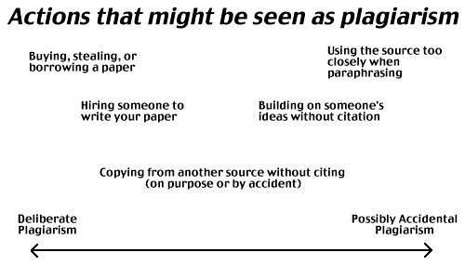

Slide 16
Should you cite?
Need to Cite | Don’t Need to Cite

Slide 17
Should you cite?
Information from a newspaper, book, or website
Information from an e-mail
Generally accepted facts
Reprinted illustrations or photographs
Your own memories or opinions
Ideas from conversations with classmates
Unique phrases
Common knowledge
Results from your own experiment

Slide 18
Patchwriting
Most common type of plagiarism in ENGL 101W
According to the SFU Plagiarism Tutorial: “Patchwriting occurs when a student paraphrases a passage but leaves it too similar to the original. In patchwriting, the writer may delete a few words, change the order, substitute synonyms and even change the grammatical structure, but the reliance on the original text is still visible when the two are compared.”
http://www.lib.sfu.ca/node/10470/take

Slide 19
Patchwriting
Most common type of plagiarism in ENGL 101W
According to the SFU Plagiarism Tutorial: “Patchwriting occurs when a student paraphrases a passage but leaves it too similar to the original. In patchwriting, the writer may delete a few words, change the order, substitute synonyms and even change the grammatical structure, but the reliance on the original text is still visible when the two are compared.”
http://www.lib.sfu.ca/node/10470/take

Slide 20
Collusion
A particular type of plagiarism
Unauthorized/inappropriate help on a take-home assignment

Slide 21
Is this help appropriate?
Appropriate in virtually all SFU courses
Help from your professor, T.A., or T.M. given during office hours
Research help from a librarian
Appropriate in ENGL 101 (with an Acknowledgements Page)
Proofreading from a friend or tutor
Not appropriate in ENGL 101
Radical rewrites from anyone but you

Slide 22
Is this help appropriate?
Original: “Cold Mountain is set during the US Civil War, it’s protagonist is a a deserter from the Confederate Army.”
Appropriate editing help: “Cold Mountain is set during the U.S. Civil War; its protagonist is a deserter from the Confederate Army.”
Inappropriate editing help: “Charles Frazier’s historical novel Cold Mountain creates a Confederate hero that is accessible to modern readers; as a deserter, Inman’s distrust in the South makes him more relatable.”

Slide 23
Plagiarism has large consequences
Any plagiarism, even accidental, will result in an automatic zero and will be reported to the Academic Integrity Office
No make-ups
Always follow a policy of CYA
More information is available on ENGL 101’s WebCT page in the folder “Resources on Avoiding Plagiarism”

Slide 24
Mediation of War

Slide 25
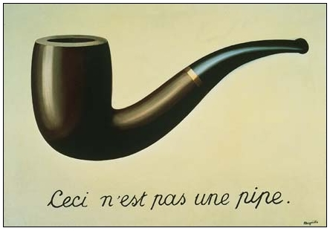
What are we looking at?

Slide 26
The war in media
Most of us have experienced the war in Afghanistan through various forms of media

Slide 27
Medium
According to The Concise Oxford Dictionary of Literary Terms, medium means “the material or the technical process in an art or a communication. In literature, the medium is language . . . A misleading implication in some uses of the term is that the meaning of a work already exists as a complete entity only requiring transmission through the medium of language; this notion is resisted by most modern theorists of literature.”

Slide 28
Mediated experiences of the war in Afghanistan
Have you read an article about the war in Afghanistan (in a newspaper, magazine, or online)?
Have you seen a photograph of the war in Afghanistan?
Have seen a news video of the war in Afghanistan?
Have you seen a movie about the war in Afghanistan?
Have you heard an interview with a soldier or a civilian from the war in Afghanistan?
Have you spoken to a soldier who has served in the war in Afghanistan or a civilian from the war in Afghanistan?

Slide 29
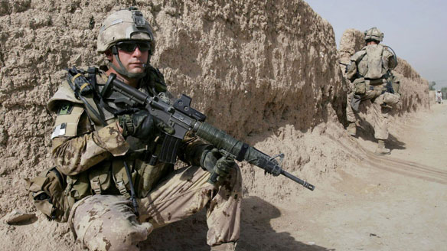
This is not the war in Afghanistan

Slide 30
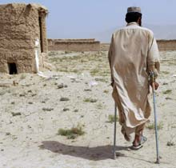
This is not the war in Afghanistan

Slide 31
These are not the war in Afghanistan
Photos
Video
Audio interviews
Newspaper articles
Essays
Stories
Poems
Plays
Movies
Conversations

Slide 32
Direct experiences of the war in Afghanistan
Has anyone in this class directly experienced the war in Afghanistan? (e.g., as a soldier, a civilian, a journalist, etc.)

Slide 33
“The Fictionalization of War”

Slide 34
Course Aim
This course’s theme is “The Fictionalization of War.” This course is structured chronologically: our readings start with the U.S. Civil War, move through the two World Wars, and end with the Vietnam War. With this structure, we will explore the characteristics and contradictions of historical fiction. We will also focus on the purpose, as well as the difficulties, of fiction that portrays war for a primarily civilian readership.

Slide 35
Four novels about four wars
Cold Mountain—U.S. Civil War
The Ghost Road—World War One
The English Patient—World War Two
The Things They Carried—Vietnam War

Slide 36
ENGL 101W will focus on
Contemporary fiction
Portrayals of soldiers’ experiences
Western perspectives
Mainly male perspectives

Slide 37
Professor P.D.’s particular interest
Disconnect between soldiers’ and civilians’ experiences
The role of fiction in mediating civilians’ experiences of war

Slide 38
Experiences of a soldier/student
Audio interview by the New York Times with a veteran of the Iraq War who is now a student at an Ivy League university
Explores his difficulty transitioning from war to civilian life
http://www.nytimes.com/interactive/2010/01/09/nyregion/veteran-columbia/index.html

Slide 39
Cold Mountain
Read up to page 146 by next lecture

