Slide 1







University of St Andrews
Probing low temperature phase formation in Sr₃Ru₂O₇
Andy Mackenzie
University of St Andrews, Scotland
Max Planck Institute for Chemical Physics of Solids, Dresden
CIFAR Summer School May 2013

Slide 2
Sources
S.A. Grigera et al., Phys. Rev. B 67, 214427 (2003).
R.S. Perry et al., Phys. Rev. Lett. 92, 166602 (2004).
S.A. Grigera et al., Science 306, 1154 (2004).
R.A. Borzi et al., Science 315, 214 (2007).
A.W. Rost et al., Science 325, 1360 (2009).
A.W. Rost et al., Proc. Nat. Acad. Sci. 108, 16549 (2011).
D. Slobinsky et al., Rev. Sci. Inst. 83, 125104 (2012).
A.W. Rost, PhD thesis, University of St Andrews
http://research-repository.st-andrews.ac.uk/handle/10023/837

Slide 3
Contents
Introduction: discovery using resistivity of new phenomena in Sr₃Ru₂O₇.
2. Measuring magnetisation using Faraday force magnetometry.
3. A.c. susceptibility as a probe of first order phase boundaries.
4. Using the magnetocaloric effect to measure field-dependent entropy.
5. Probing second order phase transitions with the specific heat.
6. Summary.

Slide 4
Magnetoresistance of ultra-pure single crystal Sr₃Ru₂O₇
T = 100 mK
l = 3000 Å
R.S. Perry et al., Phys. Rev. Lett. 92, 166602 (2004).

Slide 5
Does this strange behaviour of the resistivity signal the formation of one of more new phases?
T = 100 mK
l = 3000 Å

Slide 6
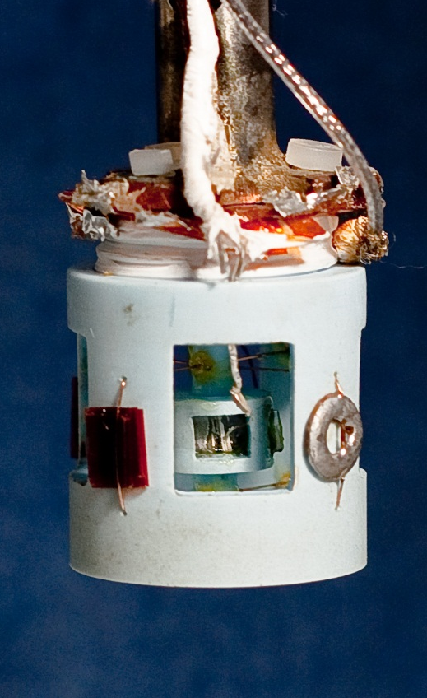

Low temperature magnetisation of Sr₃Ru₂O₇
T ~ 70 mK
ΔM ~ 10⁻⁴ (μ_{B}/Ru)/√Hz
2 cm
Lightweight plastic construction Faraday force magnetometer: Sample of magnetic moment m experiences a force if placed in a field gradient:
$$F_{z}∝m∂B/∂z$$
Detection of movement of one plate of a spring-loaded capacitor.
D. Slobinsky et al., Rev. Sci. Inst. 83, 125104 (2012).

Slide 7
Low temperature magnetisation of Sr₃Ru₂O₇
T ~ 70 mK
ΔM ~ 10⁻⁴ (μ_{B}/Ru)/√Hz
1 cm
Three distinct ‘metamagnetic’ features, i.e. superlinear rises in magnetisation as a function of applied magnetic field.
Are any of these phase boundaries?

Slide 8

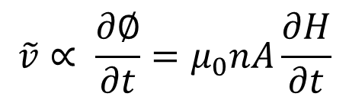
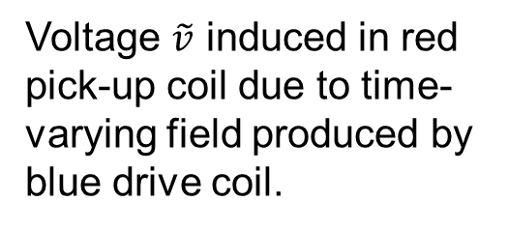

Probing first-order phase transitions using mutual inductance
$$\tilde{v}∝ \frac{∂∅}{∂t}=μ_{0}nA\frac{∂H}{∂t}$$
$$H=h_{0}cosωt$$
Voltage $\tilde{v}$ induced in red pick-up coil due to time-varying field produced by blue drive coil.
$$\tilde{v}∝ μ_{0}nAωsinωt$$
$\tilde{v} h$as an amplitude proportional to pick-up coil area A, number of turns n and measurement frequency and a phase (for ideal mutual inductance 90 degrees)
Two coils, opposite sense of connection implies zero signal; classic null method.

Slide 9
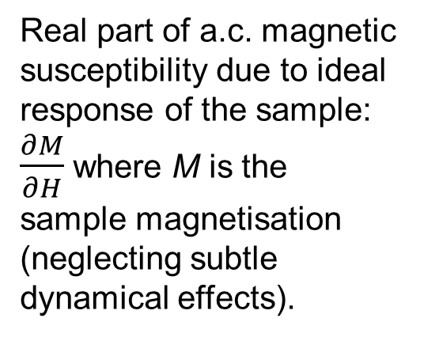

Possibility of a dissipative response
Now insert a sample in one coil: you get a complex signal back depending on the properties of the sample.
$\tilde{v}∝ χ^{′}ωsinωt+χ$’’$ωcosωt$
Real part of a.c. magnetic susceptibility due to ideal response of the sample: $\frac{∂M}{∂H}$ where M is the sample magnetisation (neglecting subtle dynamical effects).
Imaginary part which will only appear due to dissipation on crossing a 1st order phase boundary.
N.B. Dissipation in an a.c. measurement has the same roots as hysteresis in a d.c. one.

Slide 10
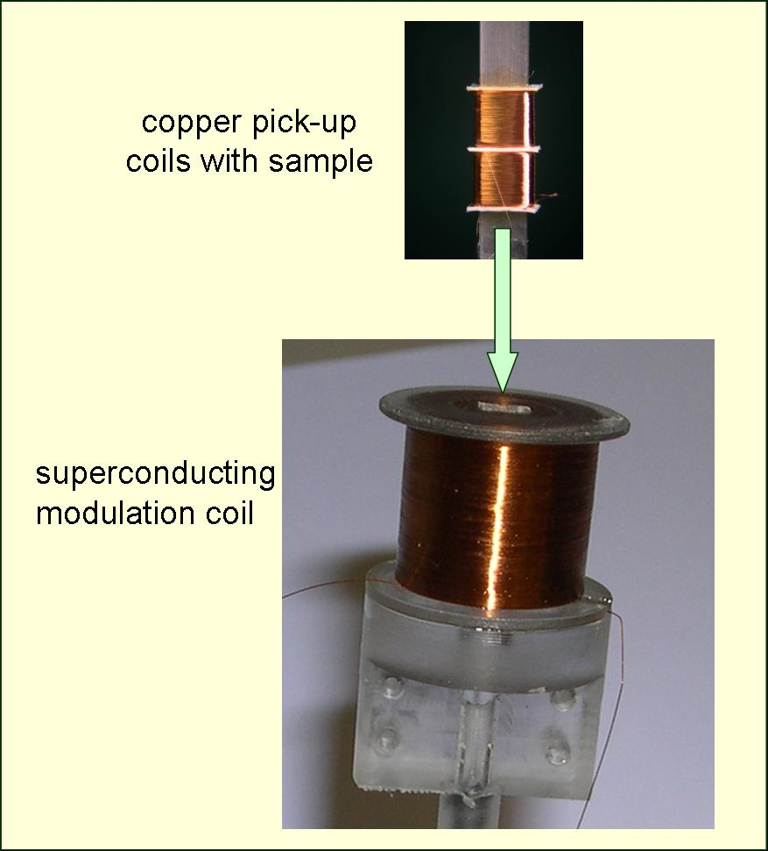
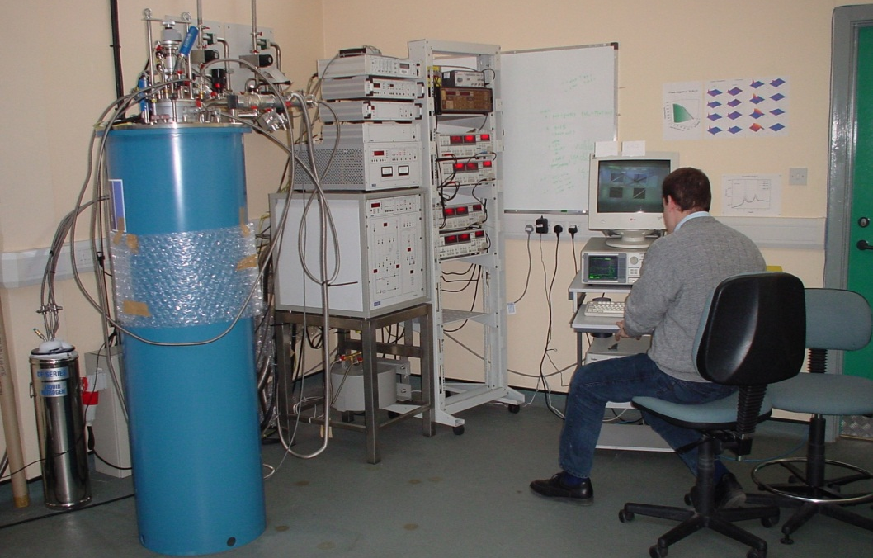
State-of-the-art a.c. susceptibility
Twin ‘pickup’ coils each > 1000 turns of insulated Cu wire 10 μm in diameter; one contains the crystal.
Coil craft: Alix McCollam, Toronto
‘Modulation’ coil of superconducting wire providing a.c. field h₀ up to 100 G r.m.s. at 20 Hz
Cryomagnetic system: 18 T superconducting magnet, base T 25 mK,
noise floor ~10pV/√Hz @ baseT, maximum B

Slide 11


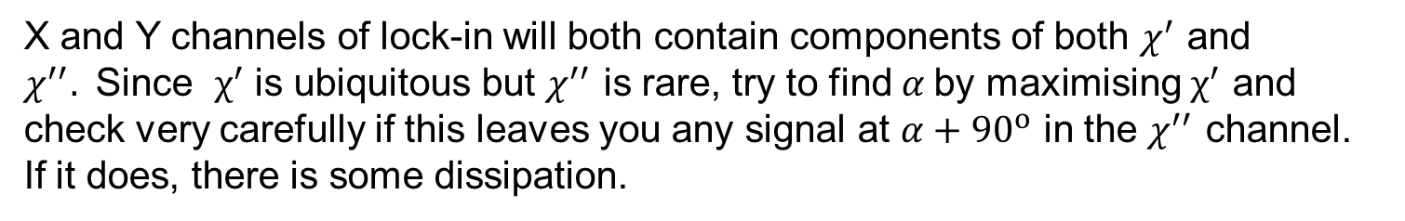
Key challenge in real life: establishing the absolute phase
Problem – signal amplification system contains unknown capacitance and inductance, so the absolute phase of the signal is not easily known:
$\tilde{v}∝ χ^{′}ωsinωt+χ$’’$ωcosωt$
$\tilde{v}∝ χ^{′}ωsin⁡(ωt+α)+χ$’’$ωcos⁡(ωt+α)$
X and Y channels of lock-in will both contain components of both $χ^{′}$ and $χ^{′′}\text{. }\text{Since} χ^{′}$ is ubiquitous but $χ^{′′}$ is rare, try to find $α$by maximising $χ^{′}$ and check very carefully if this leaves you any signal at $α+{90}^{o}$ in the $χ^{′′}$ channel. If it does, there is some dissipation.

Slide 12
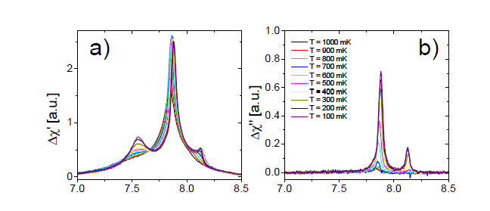
Susceptibility results from ultrapure Sr₃Ru₂O₇
T = 1 K
T = 500 mK
T = 100 mK
Examination of temperature and field dependence validates phase analysis.
R.S. Perry et al., Phys. Rev. Lett. 92, 166602 (2004).
S.A. Grigera et al., Science 306, 1154 (2004).
R.A. Borzi et al., Science 315, 214 (2007).

Slide 13
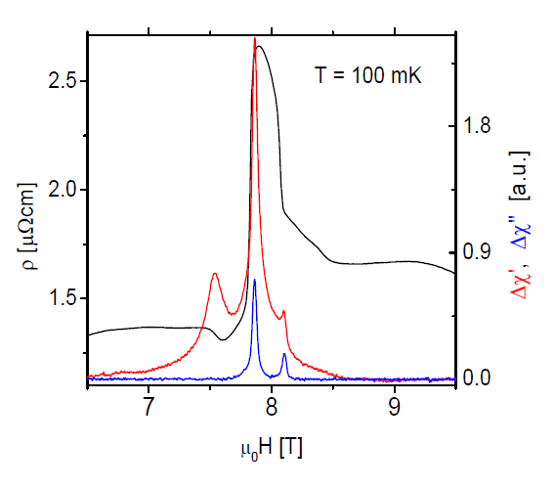
Direct comparison between susceptibility and resistivity
T = 100 mK
Susceptibility signal corresponding to the broad low-field metamagnetic feature
Sharp changes in resistivity correspond to first order phase transitions
R.S. Perry et al., Phys. Rev. Lett. 92, 166602 (2004).

Slide 14
Susceptibility results from ultrapure Sr₃Ru₂O₇
T = 1 K
T = 500 mK
T = 100 mK
Examination of temperature dependence validates phase analysis.
R.S. Perry et al., Phys. Rev. Lett. 92, 166602 (2004).
S.A. Grigera et al., Science 306, 1154 (2004).
R.A. Borzi et al., Science 315, 214 (2007).

Slide 15
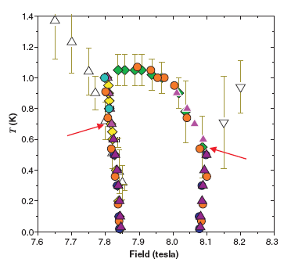
The low temperature phase diagram of Sr₃Ru₂O₇ mark I
1.2
S.A. Grigera et al., Science 306, 1154 (2004).
T(K)
0.8
0.4
0
7.7
7.9
8.1
8.3
μ_{o}H (T)
Outward curvature was a surprise – if these really are first order transitions, the magnetic Clausius-Clapeyron equation
implies that the entropy between the two phase boundaries is higher than that outside it. Unusual (though not unprecedented) for a phase.

Slide 16
Independent measurement of entropy change as a function of magnetic field
‘Any method involving the notion of entropy, the very existence of which depends on the second law of thermodynamics, will doubtless seem to many far-fetched, and may repel beginners as obscure and difficult of comprehension.’
W. Gibbs (1873)

Slide 17
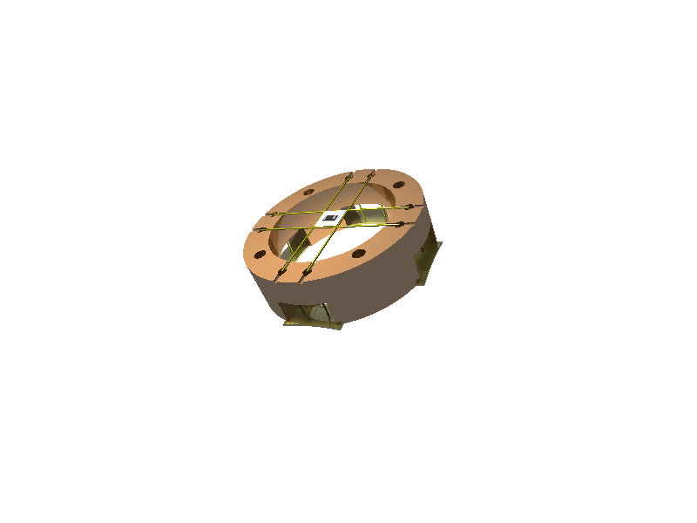
The magnetocaloric effect
Kevlar Strings (35 @ 17μm)
Under adiabatic conditions
Thermometer
(Resistor)
This is just the principle that governs the cooling of cryostats by adiabatic demagnetisation; here we use it to determine the field change of entropy.
Silver Platform
with sample
on other side
CuBe Springs
Copper Ring
2 cm
A.W. Rost, PhD thesis, University of St Andrews
http://research-repository.st-andrews.ac.uk/handle/10023/837
Notes:
dS = dQ/T = C/Tdt and negative sign corresponds to heat flowing from the sample.

Slide 18
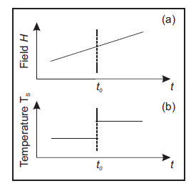
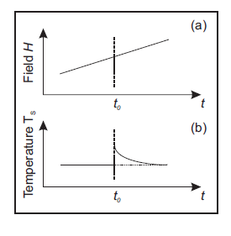
Two different modes of operation
Adiabatic conditions; 1st order transition at t_{o}
Non-adiabatic conditions (can be controlled by coupling sample platform to bath with wires of known thermal conductivity).

Slide 19
Sample raw Magnetocaloric Effect data from Sr₃Ru₂O₇
T [mk]
H [T]
Sharper features associated with first order transitions
‘Signs’ of changes confirm that entropy is higher between the two first order transitions than outside them.
Metamagnetic
crossover seen in susceptibility

Slide 20
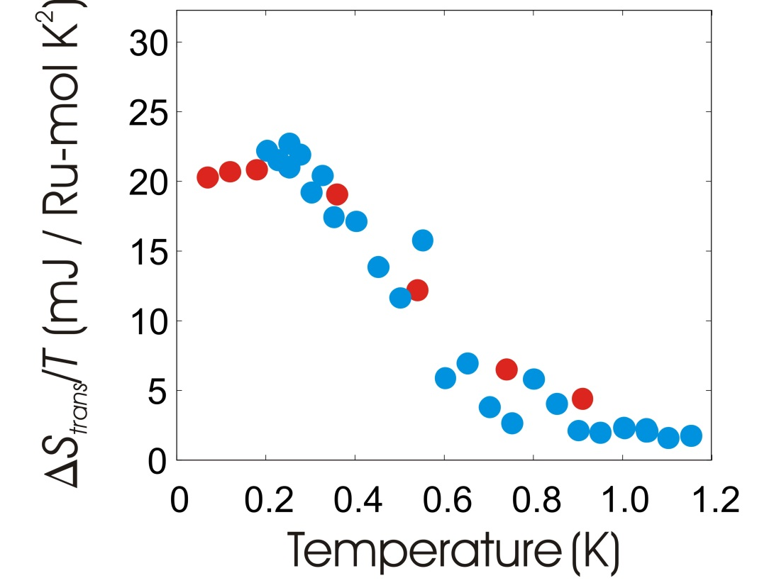
Quantitative thermodynamic consistency
Entropy jump at first order phase boundary from direct analysis of MCE data
Entropy jump determined independently from magnetisation data and Clausius Clapeyron relation

Slide 21
Two phase boundaries definitely established
S.A. Grigera et al., Science 306, 1154 (2004).
1.2
T(K)
0.8
A.W. Rost et al., Science 325, 1360 (2009).
0.4
0
7.7
7.9
8.1
8.3
μ_{o}H (T)
Green lines definitely first-order transitions; what about the ‘roof’?
For this, the experiment of choice is the heat capacity.

Slide 22
Our specific heat rig – just the magnetocaloric rig plus a heater.
Kevlar Strings (35 @ 17μm)
Thermometer
(Resistor)
Heater is a 120 Ω thin film strain gauge attached directly to the sample with silver epoxy
Silver Platform
with sample
on other side
CuBe Springs
Copper Ring
2 cm
Notes:
dS = dQ/T = C/Tdt and negative sign corresponds to heat flowing from the sample.

Slide 23
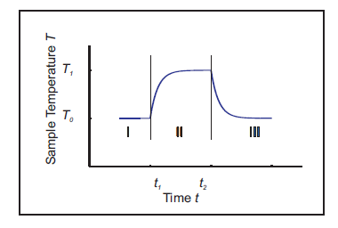
The relaxation time method for measuring specific heat
No heat
Heat at constant rate
No heat
Time constant of decay in stage 3 is proportional to C/k where C is the sample heat capacity and k is the thermal conductance of the link to the heat bath.
This ‘relaxation’ measurement principle is used in the Quantum Design PPMS.

Slide 24
Specific heat on cooling into the phase
μ_{o}H = 7.9 T
1.2
T(K)
0.8
0.4
0
7.7
7.9
8.1
8.3
μ_{o}H (T)
Clear signal of a second order phase transition but against the unusual background of a logarithmically diverging C/T.

Slide 25
Rising C/T is a property of the phase and not its surroundings
1.2
7.9 T
T(K)
0.8
0.4
11 T
6 T
0
7.7
7.9
8.1
8.3
μ_{o}H (T)
Although the phase is metallic it seems to be associated with degrees of freedom additional to those of a standard Fermi liquid.
A.W. Rost et al., Proc. Nat. Acad. Sci. 108, 16549 (2011).

Slide 26
Third boundary established – this is a novel quantum phase
S.A. Grigera et al., Science 306, 1154 (2004).
1.2
T(K)
0.8
A.W. Rost et al., Science 325, 1360 (2009).
0.4
0
7.7
7.9
8.1
8.3
μ_{o}H (T)
A.W. Rost et al., Proc. Nat. Acad. Sci. 108, 16549 (2011).
Green lines are first-order transitions, dark blue are second order.

Slide 27
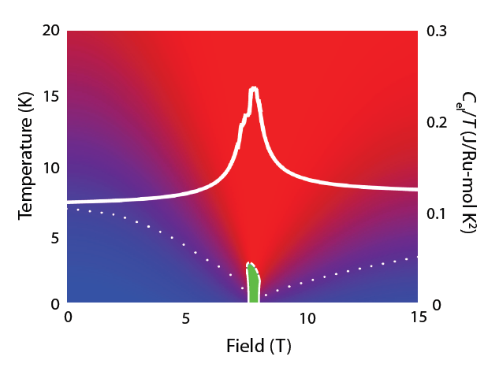
The bigger picture
Phase appears to have a nematic order parameter and to form against a background of quantum criticality.
A.P. Mackenzie et al., Physica C 481, 207 (2012)

Slide 28
University of St Andrews
Summary
The magnetocaloric effect, a.c. susceptibility and the specific heat are all effective probes of the formation of novel quantum phases.
Moral
Microscopics are all well and good, but never forget the power of thermodynamics in investigating many-body quantum systems.
CIFAR Summer School May 2013

